Slide 1
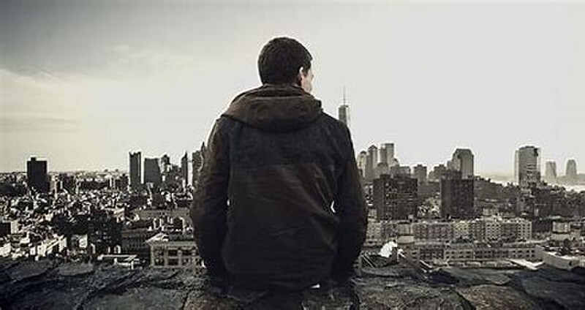


MARIO`S SONG
A FEATURE FILM BY PAUL BYRNE

Slide 2

W R I T T E N B Y
PAUL BYRNE
SOUNDTRACK BY
MICHAEL C DREBERT
R E P R E S E N T E D B Y
BETTY JO BUTLER ,
Agent / Exec Producer.
G R A P H I C L A Y O U T D E S I G N B Y
RAVI PARMAR
LEGAL LIAISON
BRYAN YORKE
F o r P r o m o t i o n a l U s e O n l y

Slide 3

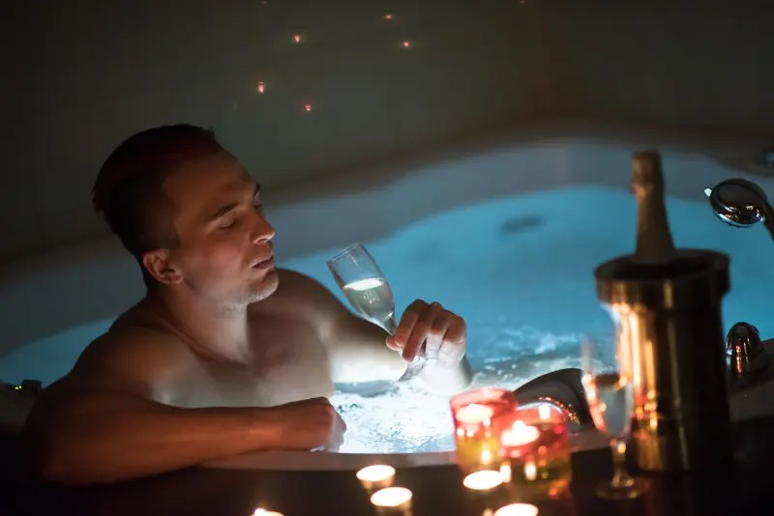
Domingos and Tito enjoy a champagne
night in their penthouse condo.

Slide 4
CHARACTERS

Slide 5
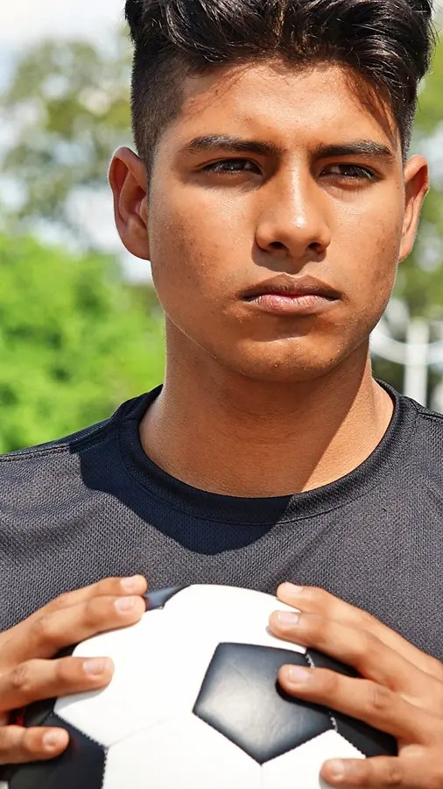
MARIO ACOSTA
18, 2nd generation Dominican,
soccer ace with straight A’s

Slide 6
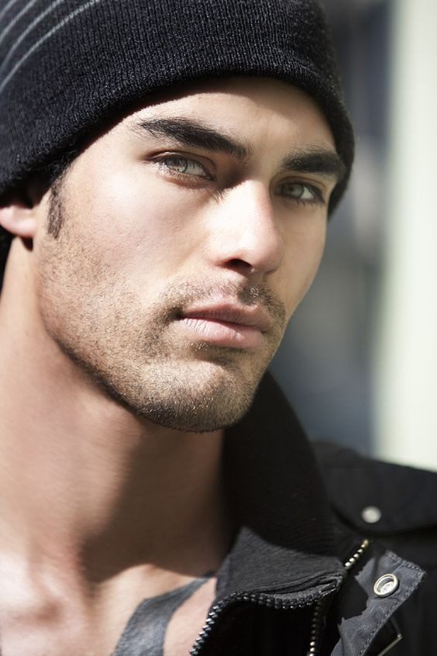
DOMINGOS SALAZAR
25, Dominican accent,
cool as a switchblade.

Slide 7
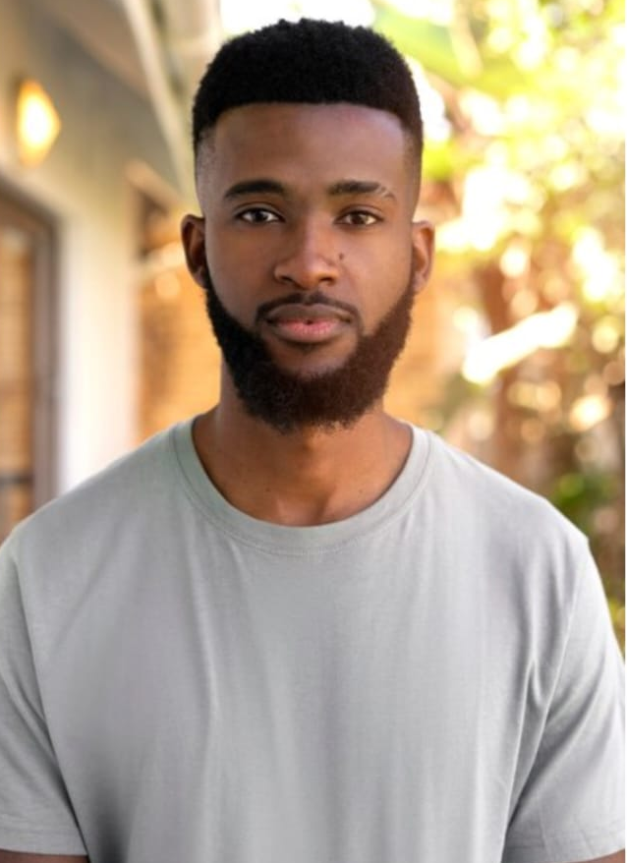
TITO
35, coiffed and street
hardened African American.

Slide 8
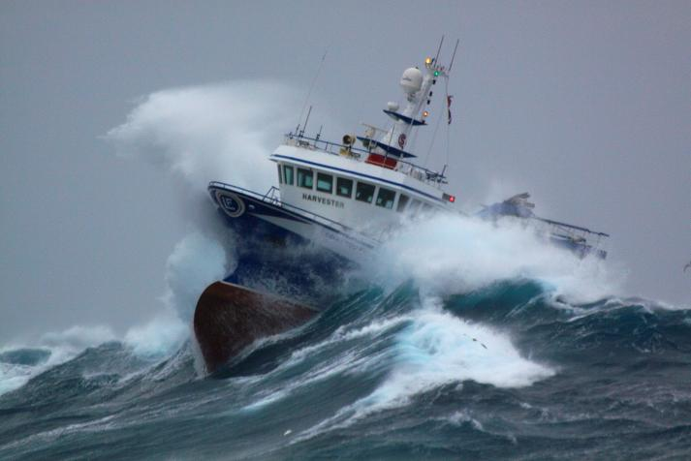
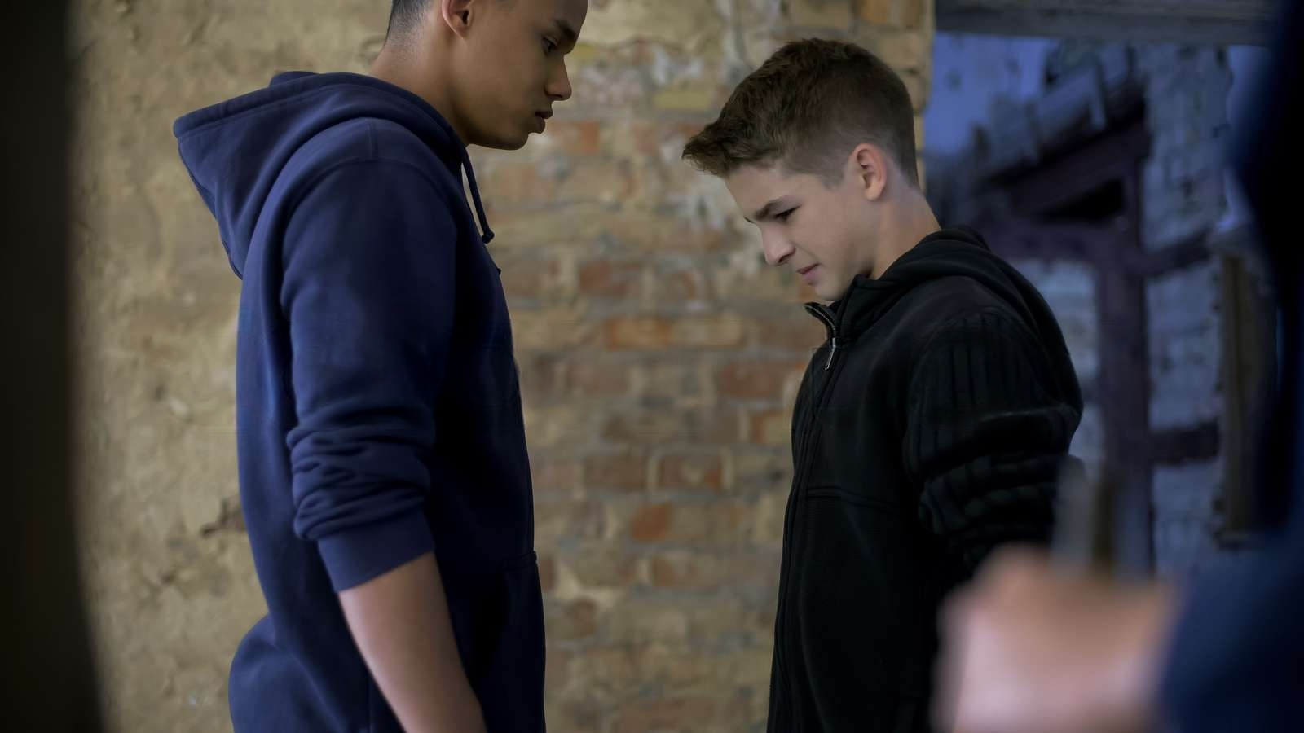
With his fisherman dad drowned at sea, Mario asks Domingos if he can join his crew.
Domingos tosses Mario out on
his ass.

Slide 9
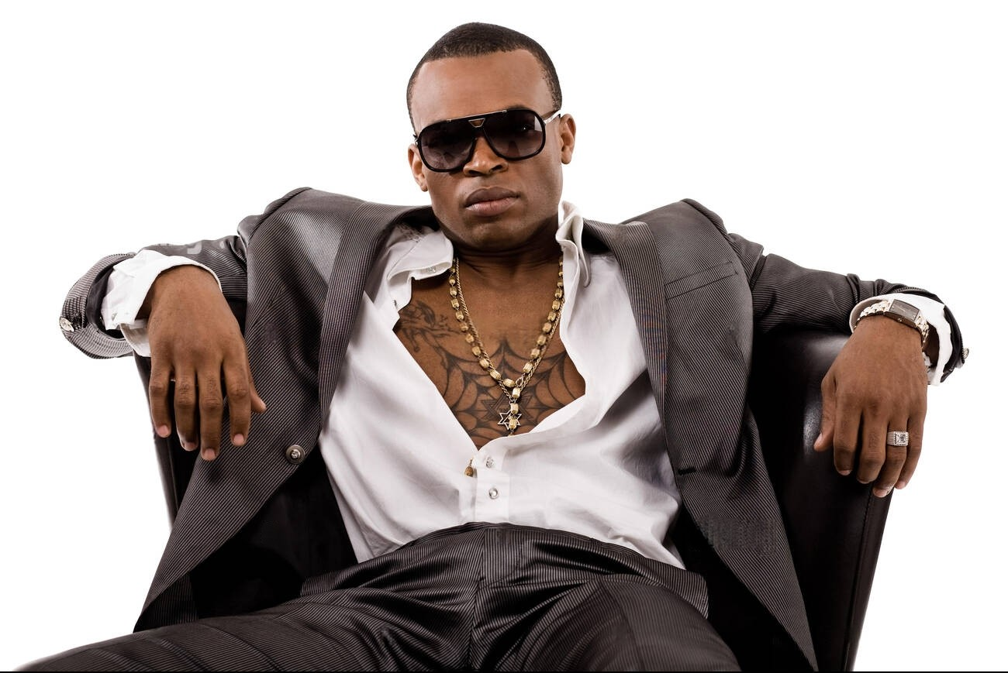
Domingos approaches Mario cleaning an office.
He makes Mario an offer he can’t refuse.

Slide 10
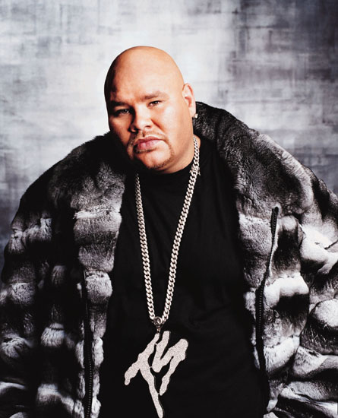
Mario delivers 4 keys of Smack to
Baptisto,
35, Jabba The Hut with gold chains.

Slide 11
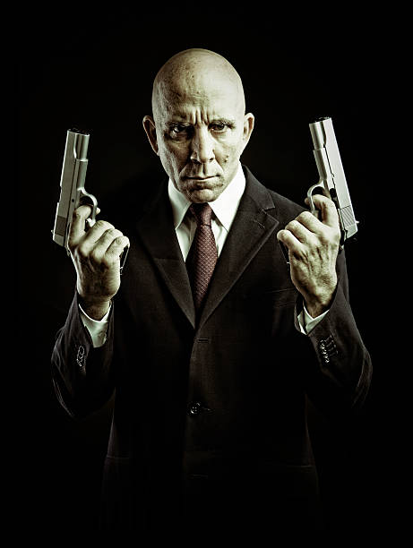
All hell turns loose when Domingos boots in the tenement door and saves Mario from a deadly rip off

Slide 12
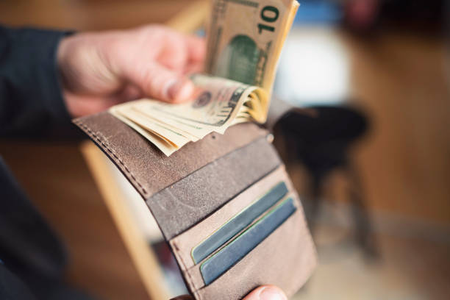
Mario refuses the blood money. Domingos “Are you gonna work hard and die early like your old man or are you gonna grab the future and make it your own?”

Slide 13

Mario, now Domingos’ right-hand man, suggests opening a nightclub to launder cash so he can invest in the stock market.

Slide 14
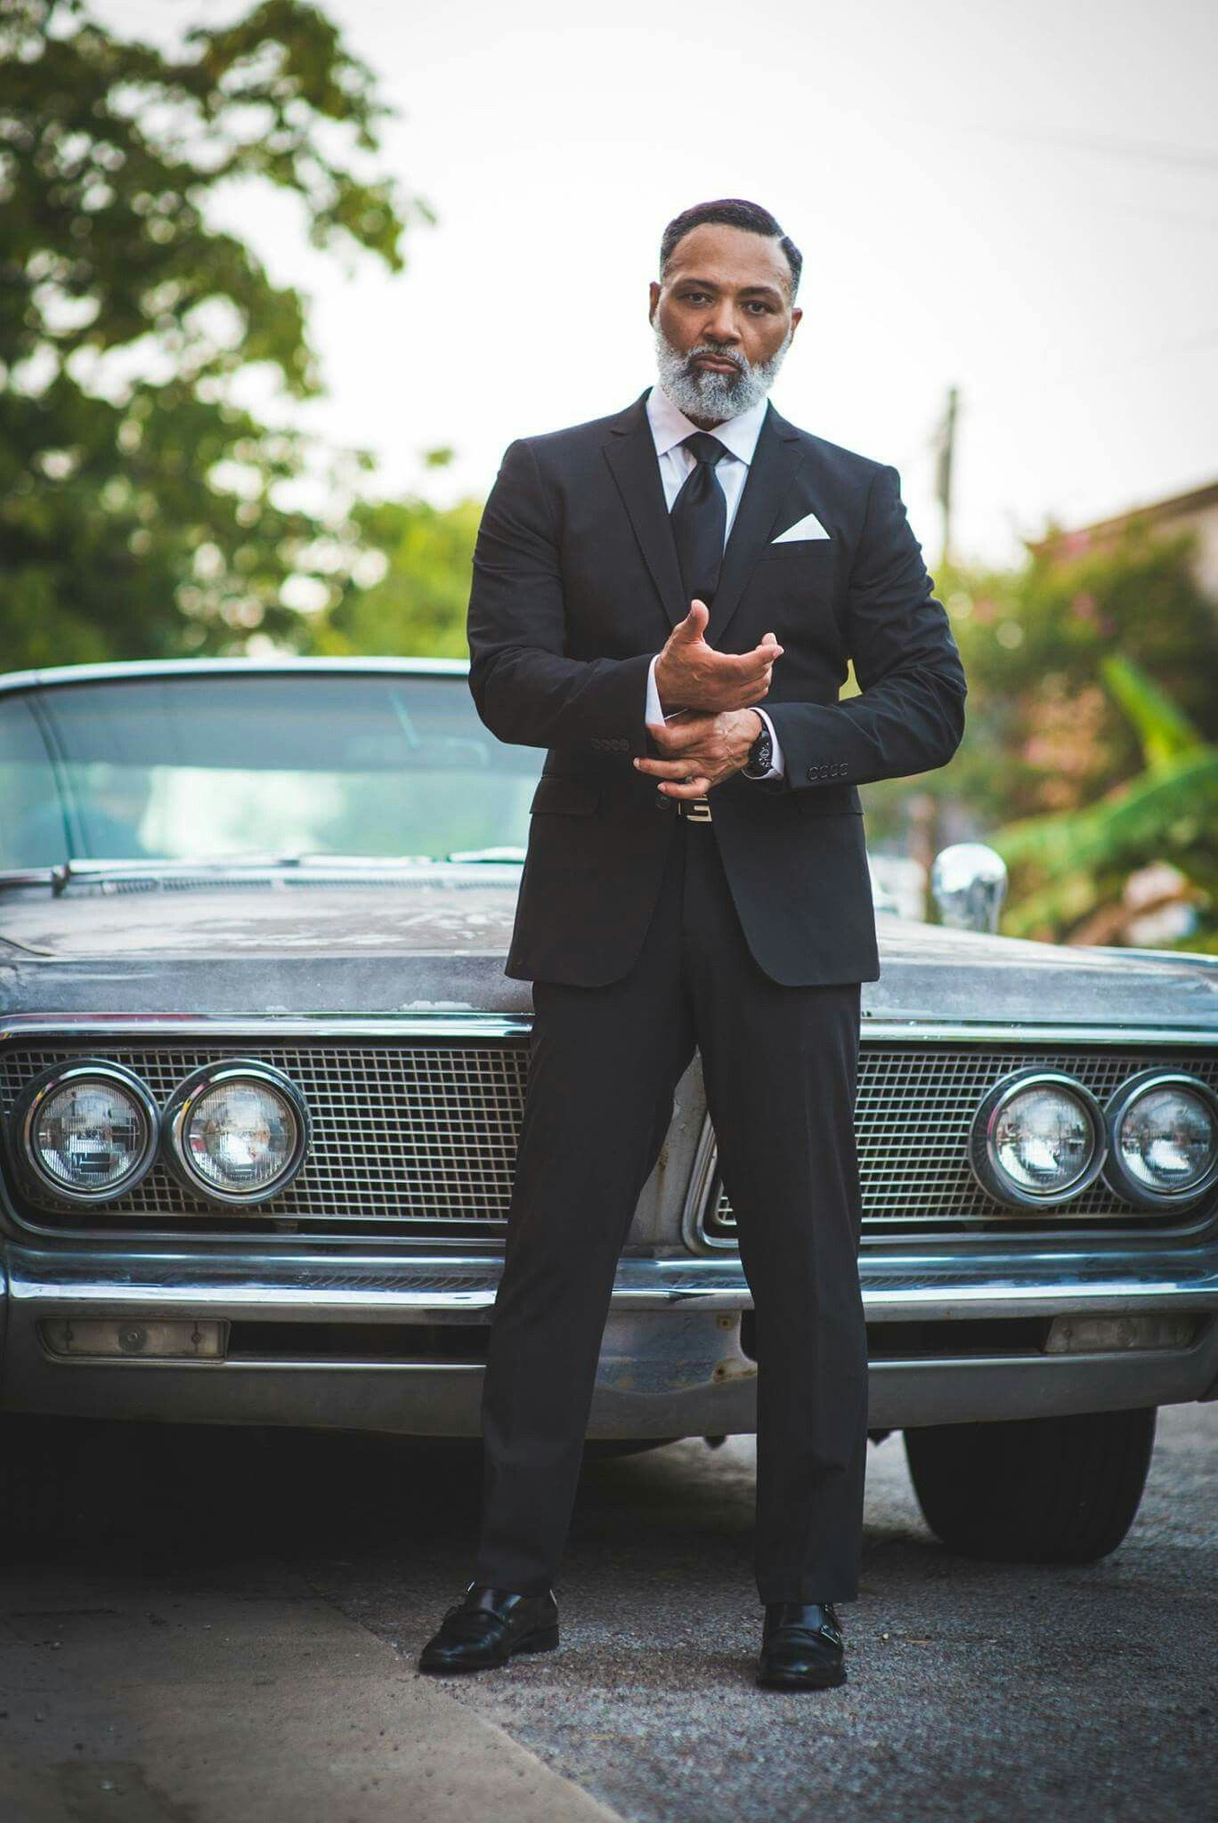
Mario, Domingos and Tito are abducted. Cesar tells them Baptisto’s turf belongs to him. To make his point, Cesar has Tito shot in the head.

Slide 15
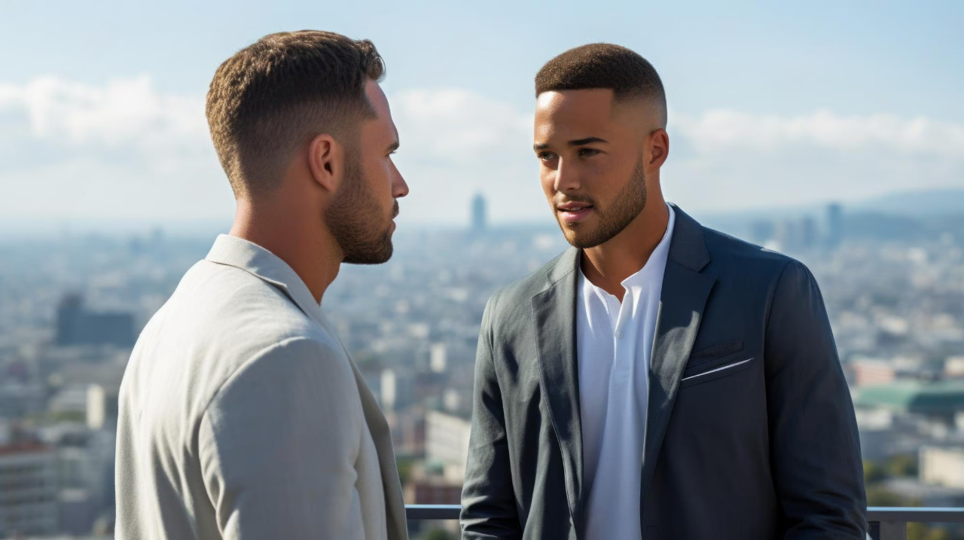
Domingos “All the crews from 12th St. up to 23rd have had it with Cesar’s 60 % take. If I whack Cesar, I need to know homes, are you down with this or not?”

Slide 16

“I’m a Catholic as I’m sure you are. You know for every sin there is a penance…” Domingos stabs Cesar in the heart!

Slide 17
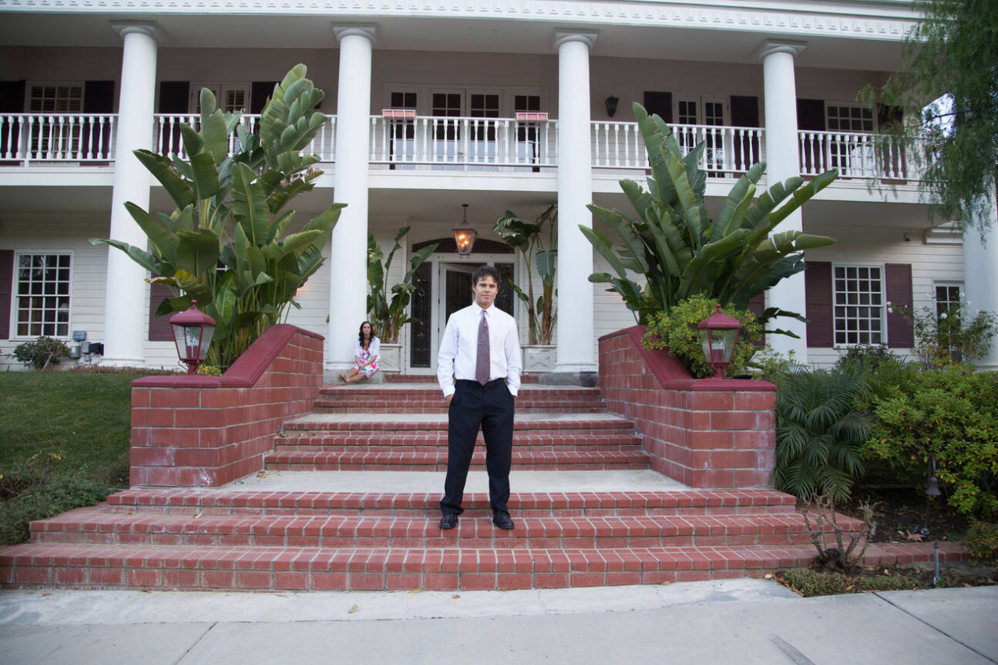
Domingos buys Cesar’s mansion. To Mario “Tito could decorate this joint… but the most important thing I learned from him was how to be a man. That’s what I’m trying to do with you.”

Slide 18
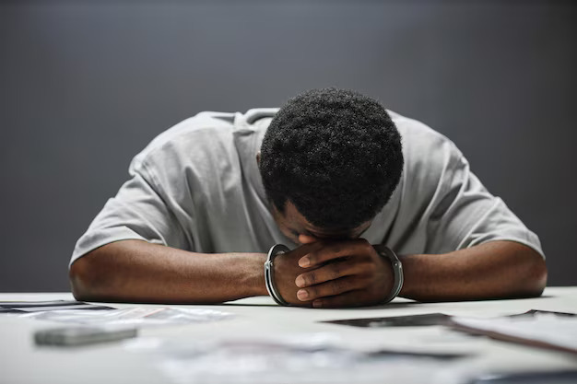
Mario is busted in a $40M police sting. D.A. to Mario ”Option one. Mandatory minimum… twenty-five years. Option two. Five years probation… set up Domingos.

Slide 19
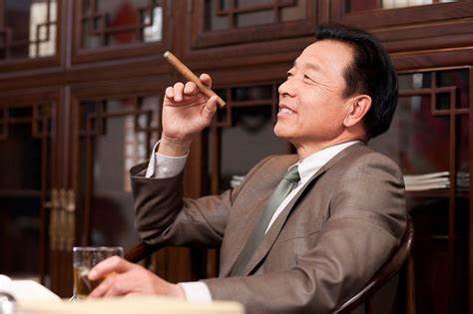
Domingos cuts a fentanyl deal with the Dai Lo (Big Boss) of the Hong Kong Triads. D.E.A. raids the meet. Mario is shot protecting Domingos.

Slide 20
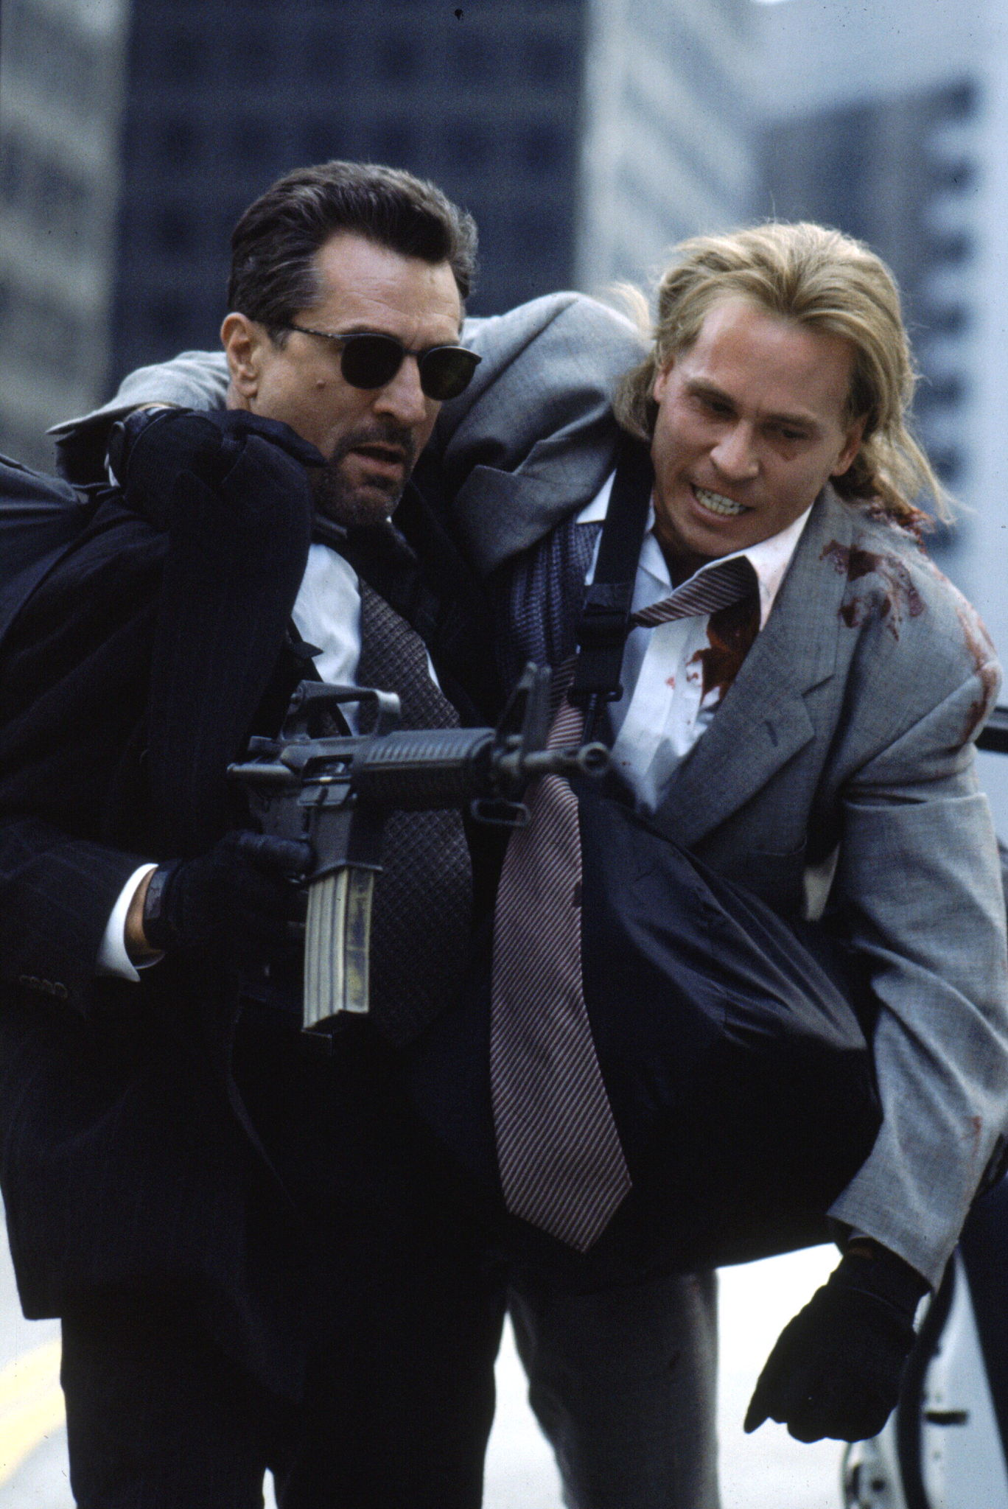
At gunpoint Mario confesses to Domingos he set him up. Domingos forgives him.
Guns blazing, Domingos
runs for a stairwell but the SWAT team kills him.

Slide 21
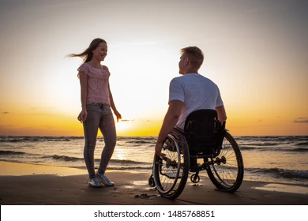
Paralyzed in a wheelchair, Mario is surprised to see his estranged teenage wife, Christina. At first pushing her away, Mario is touched by her words and agrees to give their marriage one more try.

Slide 22
Logline
His dad drowned at sea, a former straight-A soccer ace rises through a crime organization to support his family, only to be arrested and forced to decide to roll over on his boss who is like a brother or do hard time.

Slide 23
Genre : Crime Drama
Format : 40 page short film screenplay.

Slide 24
Main Characters
Mario Acosta – 18, soccer ace, 2nd generation Dominican.
Domingos Salazar – 25, Dominican accent, cool as a switchblade.
Christina Acosta – 18, Barrington blue blood without the attitude.
Cesar de la Cruz – 60, Dominican accent, scarred and suited.

Slide 25
Synopsis
Eighteen-year-old Mario Acosta, soccer ace & honor roll student from the wrong side of the tracks, secretly rendezvous with his uptown girlfriend Christina every day in a park. Mario’s world spins out of control when his fisherman father drowns at sea and his teenage girlfriend becomes pregnant. Working as a 3rd shift janitor and still going to school, Mario struggles to be head of his immigrant family. Losing his college scholarship & bill collectors breathing down his neck, Mario hooks up with a charismatic drug dealer Domingos Salazar.

Slide 26
Applying his school smarts, Mario quickly becomes Domingos’ right-hand man. Mario is busted in a $40M police sting and is given two options - do hard time in gladiator academy or flip on his drug kingpin boss who has become like a brother to him. Mario's big time decision leaves one of them dead and the other in a wheelchair.

Slide 27
Mission Statement : “Where mercy is shown, mercy is given.” Duane Chapman
Estimated Budget : $100K- $200K USD.
Production Timeline : Pre-production – 2 ½ weeks, principal photography – 3 weeks, post-production – 4 weeks.

Slide 28
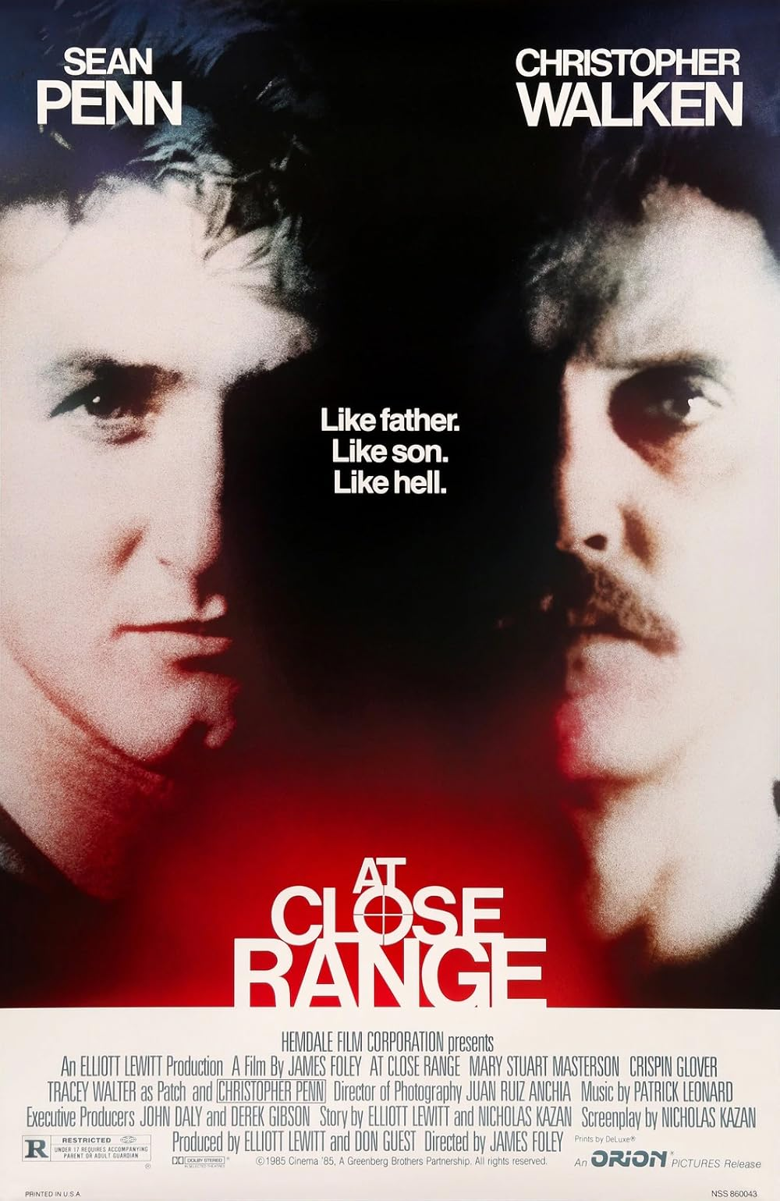
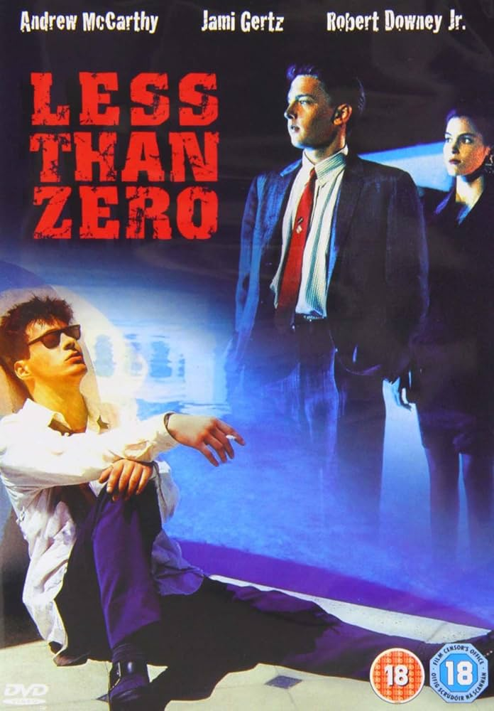
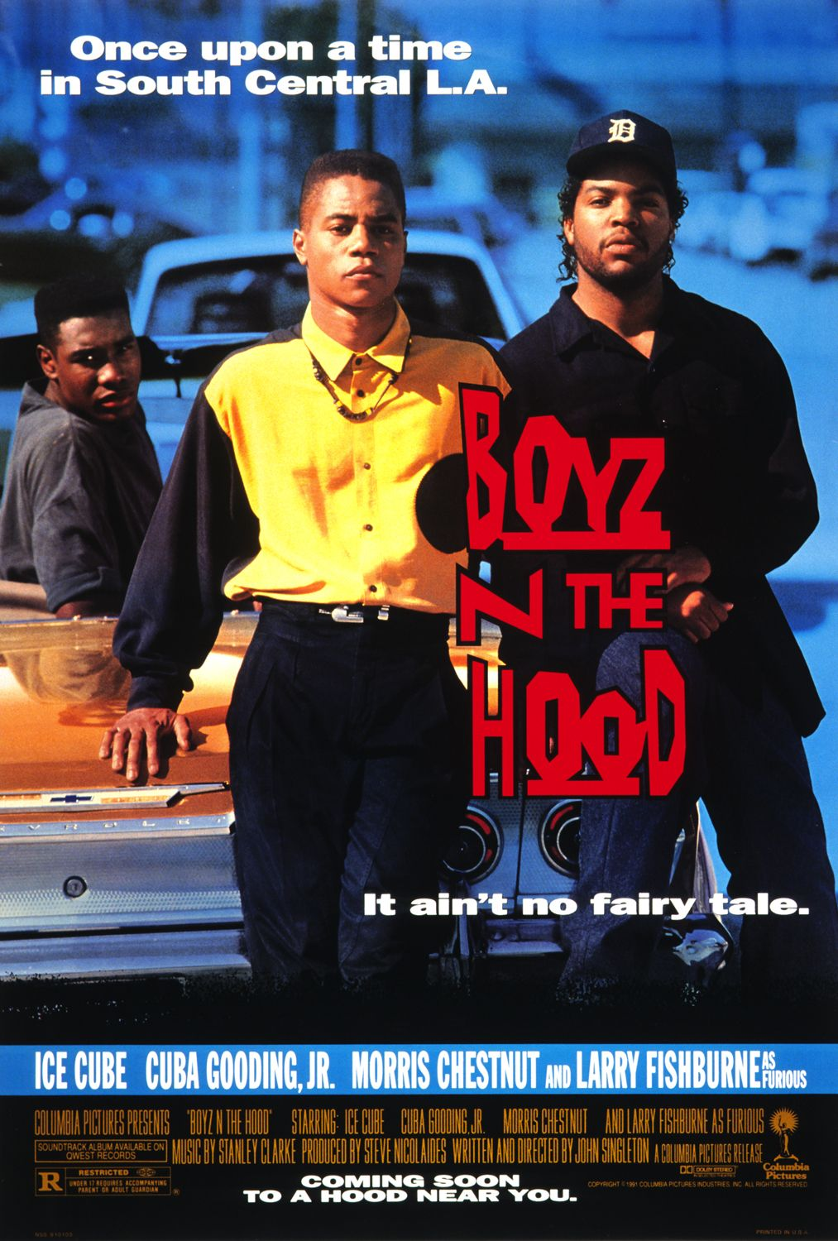
Comparable

Slide 29
Target Audience
Given the combined genre and location of the story, current trends show favorable U.S. age groups: 18-24 (58% of audience), ages 35-44 (26%), ages 45+(16%).
Sales Approach
Attaching an appropriate sales entity during the development phase will generate early interest in the film before production is complete.
Investment Projection
Contingent upon level of casting, foreign and domestic marketing strategies, taking advantage of the host city’s tax credits/incentives and a realistic rate of return commitments.

Slide 30

PA U L BYR NE
W R I T E R
Paul was born in Dublin but has lived in the U.S. most of his life. He is the Co-Owner of High Voltage Ent/Cool Breeze Prods. It is a family enterprise which creates and markets award-winning short and feature film screenplays. Paul is a graduate of the University of Oklahoma with a
B.A. in Sociology and a minor in Film Studies. He is currently based in southwestern Michigan near Chicago.
Paul was formerly employed as a single-family bond accountant with a
public housing authority screenwriter with his
near Washington, D.C. Now, he is a scripts being represented by Betty Butler,
BjbPresents. His work has received positive reviews from the Hollywood Scriptwriting Institute and the Gary-Paul agency. His work has also won or placed in national and international screenplay competitions, including Fade In Awards and Scriptwriting Network.

Slide 31



WEBSITE : www.rfstudiosusa.com
Email : rfstudios.bjb@gmail.com
Phone : 1 - 334- 874- 5499

Slide 32
THANK YOU

