Slide 1

Waking Conundrum
A story written by Dale "Maang" Loon

Slide 2
One Pager
Logline-
A man wakes up in a cavernous room with no memory and is accompanied by a woman that shakes him with world shattering news.
Synopsis-
Waking up in a room with a ceiling that seems to never end. A man struggles with his memory of recent events but remembers everything else from the past. The man meets a woman and brings him down to great disbelief and shock that shakes every atom in his body. A scheme is planned to escape this room. But is the plan for real?
Genre-
Post-Apocalyptic and Thriller

Slide 3

Directors Statement
When coming to the big city and its many cultures. I have come to the reality that women have been wanting to be more independent. Not needing men at all, to the point where men are seen as only necessary for pro-creation. So, when writing the script. I've placed my two characters in a world where it's only being told by mouth with no evidence. So, it will be easily speculated that it could be a lie?
By Sharing my script with others and Idea. The conclusion of the idea of women running the world with 0 men was surprising. Women have stated that men are needed to run the world. With only few women saying the men aren't needed at all. Women can run all sectors of the world.
I relate to this in contrast. Where I am from? Women are the life and blood of the community and honoured as such. So, creating a world where not feminism rules but women.
So, if I ever make this? I want to stir up conversations to the ancient battle of the sexes.

Slide 4
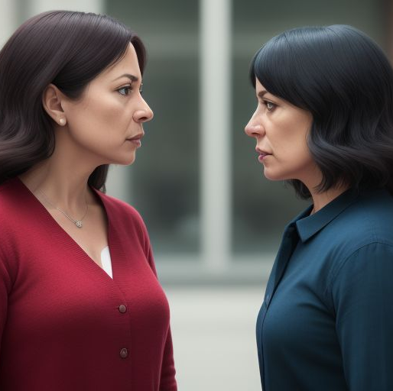
Themes
Female Empowerment: I've placed women in a world where they rule clearly in all aspects in the world. Women are at different social levels or are a part of a society that doesn't always follow rules. But rulers as part of survival and strength.
Challenges: Although women are seen as caregivers, loving, and bring order to chaos that men cause. I put these women in a world where they are all still seeing on how to rule the world. Women have seen how to run things differently and have gone their own ways in their matriarchy. The challenge these women face, are other women with opposing ideals.

Slide 5


Character Breakdowns:
Venora- Female 22, dressed ruggedly. Signs of being beaten on her arms, face and legs. Venora is a women of love and clear intellect. She often talks to herself, because it is easier to think, solve, and make sense of things when she hears it out loud. Venora is from a faction of women who are farmers and hard-workers, I believe most of the production of food comes from this faction through trade of goods.
Ender- Male 30, clean shaven and properly dressed in clean attire in the scenes. Ender is from a village hidden in the mountains away from any sort of outside contract. His village has animals, males, and females all living in peace and harmony. People are raised in his village, but not given history of the outside world. Most likely told that the outside world is of great danger

Slide 6

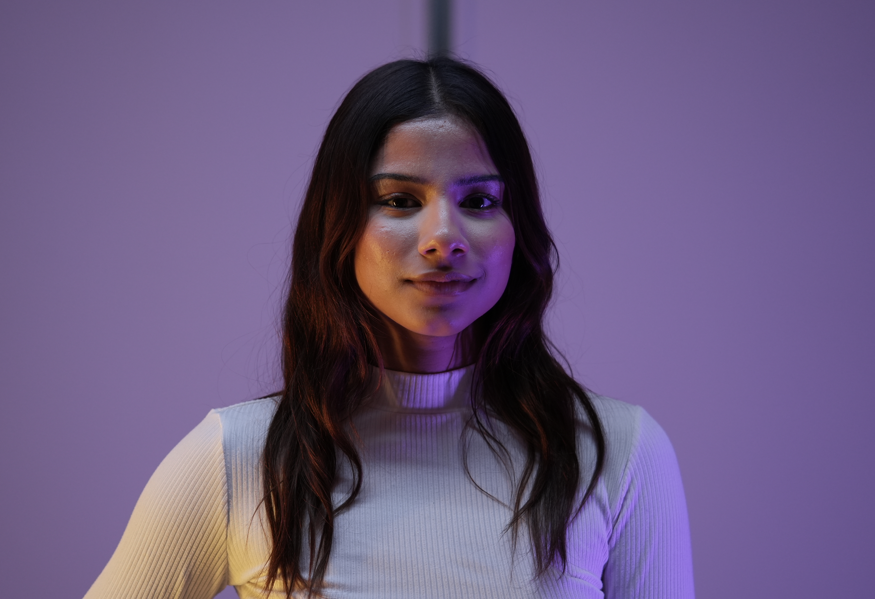
Casting
CASTING TBD
Idris Ali as Ender
Akshi De Silva as Venora

Slide 7
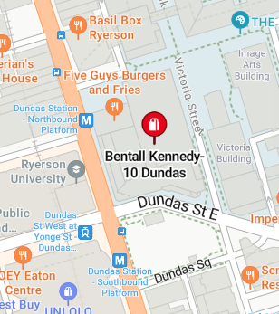
Location
TBD
10 Dundas Street East, Suite 704 Toronto, Ontario, M5BG27
Time- TBD
Date- TBD

Slide 8

Production Design
Lighting- The set will be lit by 4-6 tube lights that will run along the ceiling. They will light up both the set and the green screen that will blanket the top of the set. That will make the set cold, and dread filling room.
Props- One main prop will be a hard and uncomfortable bed in the room. And two secondary props will be 2 Bo staves that the two female guards hold.

Slide 9
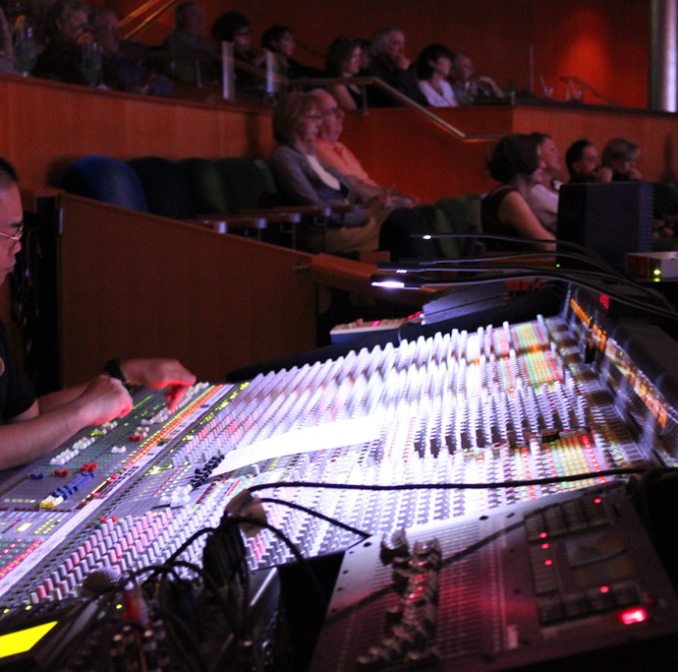
Production Design (Cont'd)
Set Design- The major items that will dress the set will be 4 big walls. 1 of the walls will have an opening as a window, and a single small door for where the Verona is brought in and out of. A green screen will blanket the set on top. Straight Forward
Sound Design- Sound design will only include Diegetic sounds. Music will be composed by a composer I met named, Jordan Liling. Sound will be captured by 2 lavaliers and 1 boom
This Photo by Unknown author is licensed under CC BY.

Slide 10
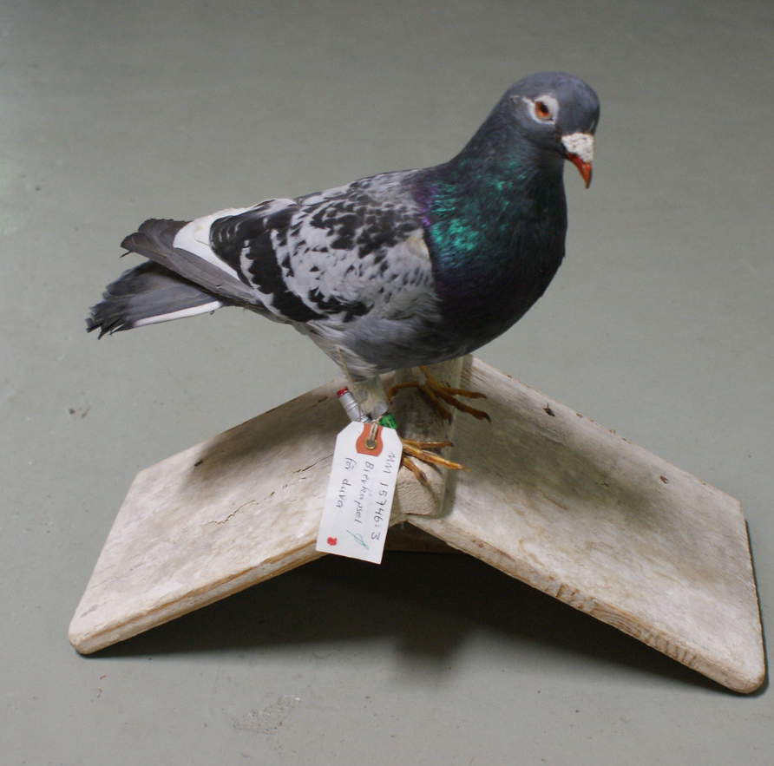
Contact information
Email: daleloon@gmail.com
Phone: +1-647-519-1844
Homing Pigeon #47
This Photo by Unknown author is licensed under CC BY-NC.

