Slide 1
-A Comedy-
OUT OF TUNE
Lost In Rosario
(In Spanish aka DESAFINADO)
Directed by Gustavo Postiglione
And Ezio R. Massa
Trailer
https://vimeo.com/983049140/2f2d446388

Slide 2
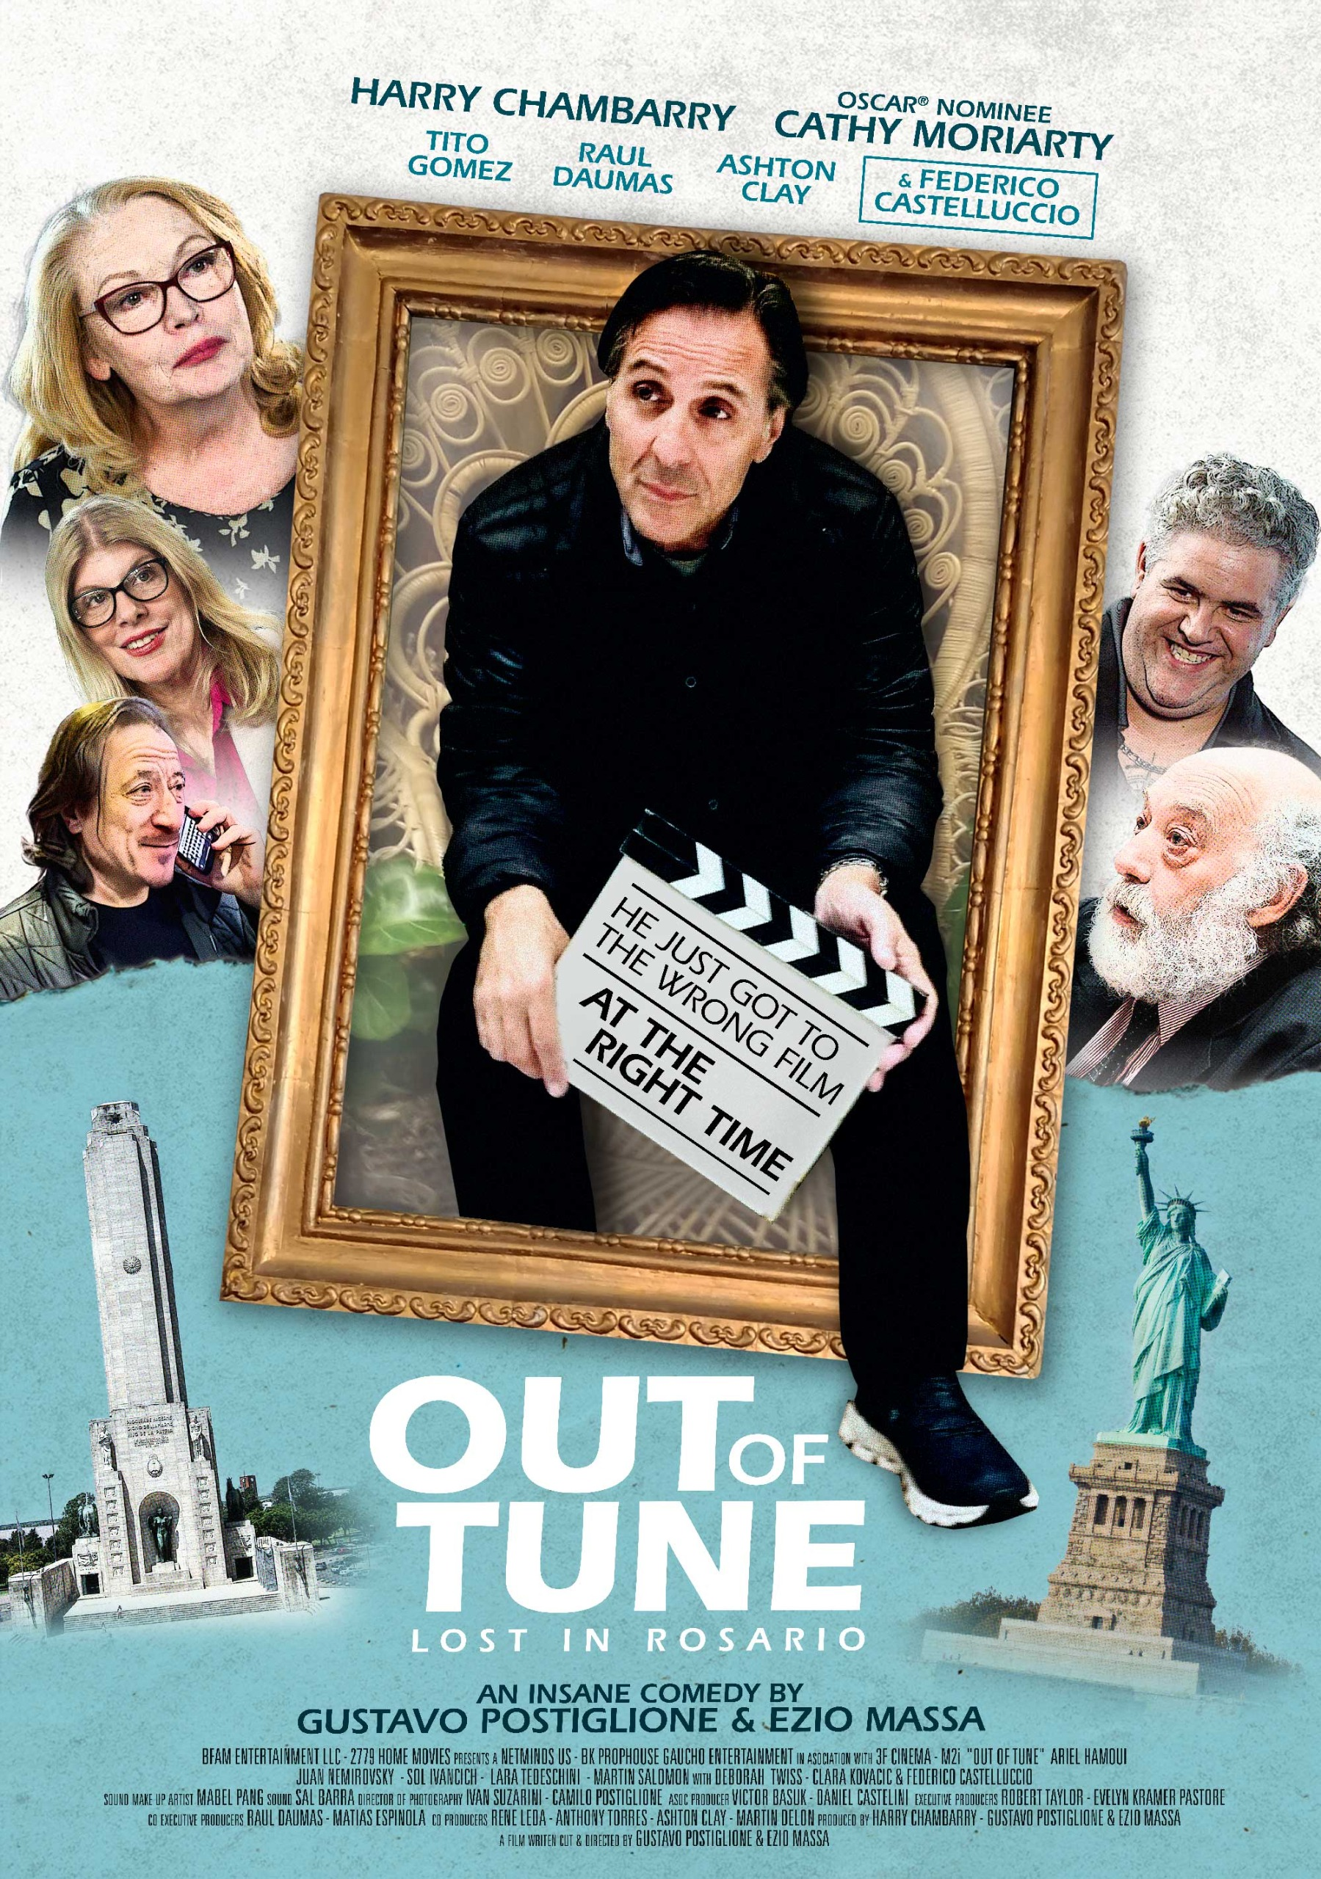

Slide 3
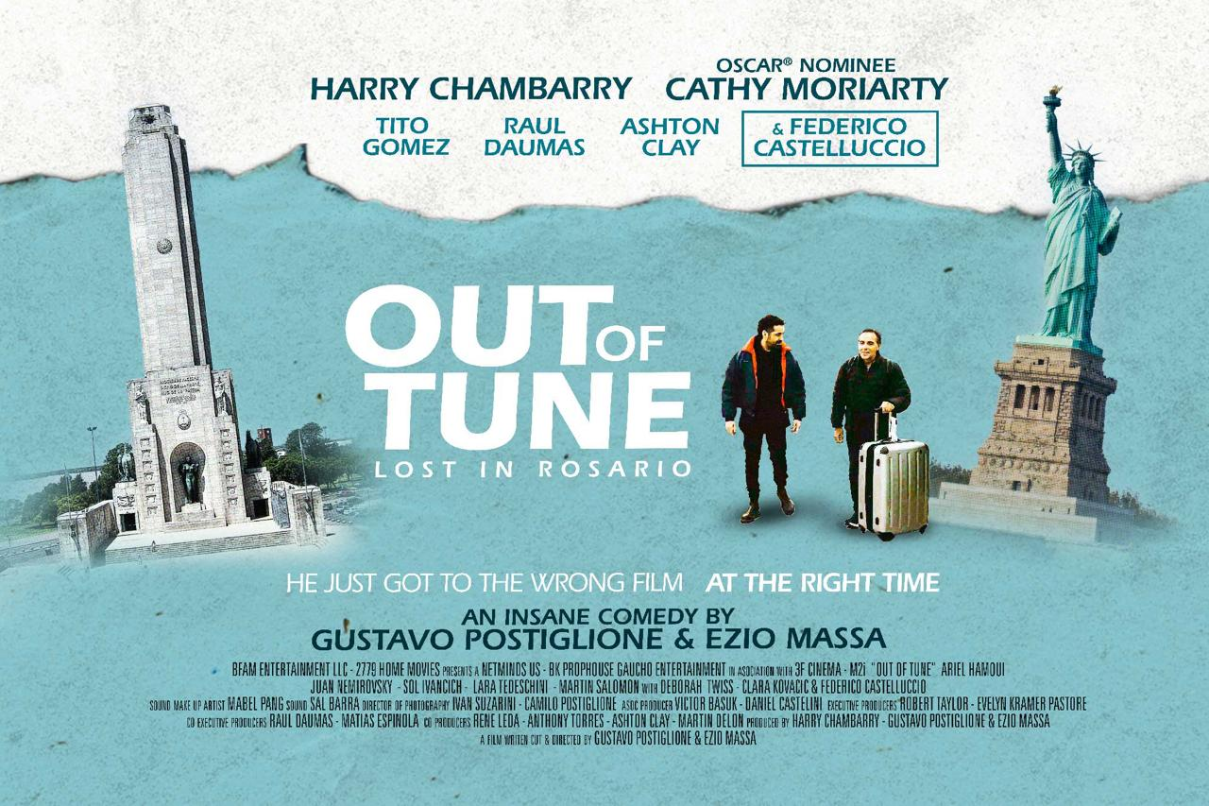

Slide 4
Synopsis
Harry Chambarry, a struggling New York City actor in his late 50s, finally gets his big break: a role in a highly anticipated indie film by legendary Argentinian director, Gustavo Postiglione. Excited yet nervous, Harry flies to Rosario, Argentina, ready to immerse himself in the role that could change his career. However, upon arrival, he discovers that Postiglione has mysteriously gone missing, leaving behind no trace or explanation. As Harry tries to track down the elusive director, he finds himself in a series of increasingly bizarre situations. To his bewilderment, the locals keep mistaking him for various famous Hollywood actors—sometimes a rugged action star, other times a suave romantic lead. Each case of mistaken identity pulls Harry further into the chaotic and vibrant life of Rosario, Argentina, from trendy neighborhoods to unexpected adventures in the city's more obscure corners.

Slide 5
As Harry navigates these surreal experiences, he starts to question his own identity and purpose. In a city where no one seems to recognize him for who he truly is, he begins to reflect on his career, his ambitions, and what it really means to be "seen" as an actor. Meanwhile, the mystery of Postiglione's disappearance deepens, leading Harry to unexpected allies and an unforeseen connection to the director’s own struggles with fame and identity. OUT OF TUNE: Lost in Rosario, is a witty and heartfelt exploration of the search for recognition, both personal and professional, set against the backdrop of one of the most colorful cities in the world. As Harry inches closer to discovering the truth about Postiglione, he also discovers a deeper truth about himself, culminating in a surprising and poignant climax.

Slide 6
Our Directors
Gustavo Postiglione
Is a film director, screenwriter, theater director, teacher and musician. He directed and wrote more than thirty feature films, a dozen plays and TV series. He is a teacher at the National University of Rosario and at the Higher Institute of Cinema and Audiovisual Arts of Santa Fe. He has been a teacher at the San Antonio Delaware los Baños International Film School (Cuba). Among his films, the trilogy made up of El Asadito, El Cumple and La Peli stands out, as well as such as Dias Delaware Mayo, Brisas Heladas and El Presi (these last two were also staged in theaters). Their work has been the subject of retrospectives both in Argentina and abroad, in cities like Paris, Madrid and Tel-Aviv. He alternates film directing with theater and occasionally appears with his rock and experimental music group The Band of Homemade Movies. He has made Simulacro, the first live film in Argentina and one of the few made in the world. He is currently completing his films Singapore (with Julieta Cardinali) and the essay En Trance. Out Of Tune (DESAFINADO): Lost in Rosario is his first US and English speaking co-production.

Slide 7
Our Directors
Ezio Massa
Born in the little city of Formosa in the north of Argentina. He studied at the IDAC Instituto de Arte Cinematografico. Malevo (1990) was his film first shot at the IDAC, when only 17 years old. He won best first short Film award at the IDAC. In 1991 he started as a second assistant director in the film industry, while he continued to attend the IDAC. In 1992 he made La terraza (1992) - a 30-min 16mm action movie which opened doors to the world of the Advertising TV spots Production. He worked on several of these, including Veritas, Panavox, Great films themes, Dauhori, Zanella, Yamaha, Camod, Puma.
In 1994 his film feature Más allá del límite (1994)_ (Beyond the Limit) won best first Film Feature at the 2ºLuias Sandrini Film Festival in December 1994. He moved to New York to attend advanced Directing Workshops at NYU and NYFA in 1995 and made "The Last Duel" (1997) a 35 min Tango Drama as a Thessis of NYFA. Cacería (2001), his new feature movie filmed in Argentina, has already won Best editing and best young performance at a Local Festival. It will be released on April 4 2002 in Argentina, Chile and Uruguay. His latest feature with theatrical release in the USA and Argentina; ALTER EGO, made in the USA, stars Dylan Walsh and Eric Roberts.

Slide 8
A personal note from Harry Chambarry
This film is a gift to all struggling actors, as well as anyone who is pursuing a dream to fulfill their life's destiny. The creation of this film was a gift to me from my brother from another mother, Ezio Massa. He conspired, without my knowing, with Gustavo Postilgione, to create this beautiful film in the glorious city of Rosario, Argentina. The circumstances that brought me to Argentina were originally just to meet Ezio's family and filmmaker friends. However, without my knowledge at all, I would be the subject of a feature film. I owe a great deal of gratitude to Ezio, Gustavo, and the brilliant talents of the actors and crew that helped create this film; in Argentina and the USA.

Slide 9
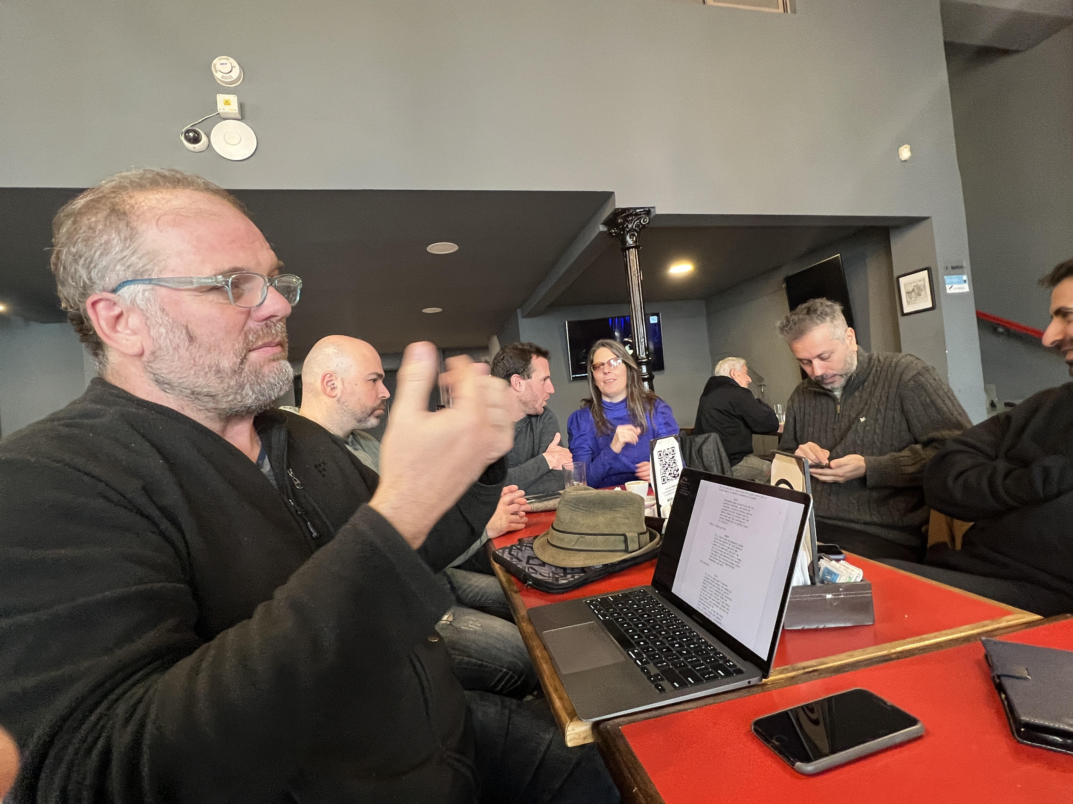
Director (in Argentina)
Gustavo Postiglione
Discussing shot at theater location with crew in Rosario, Argentina

Slide 10
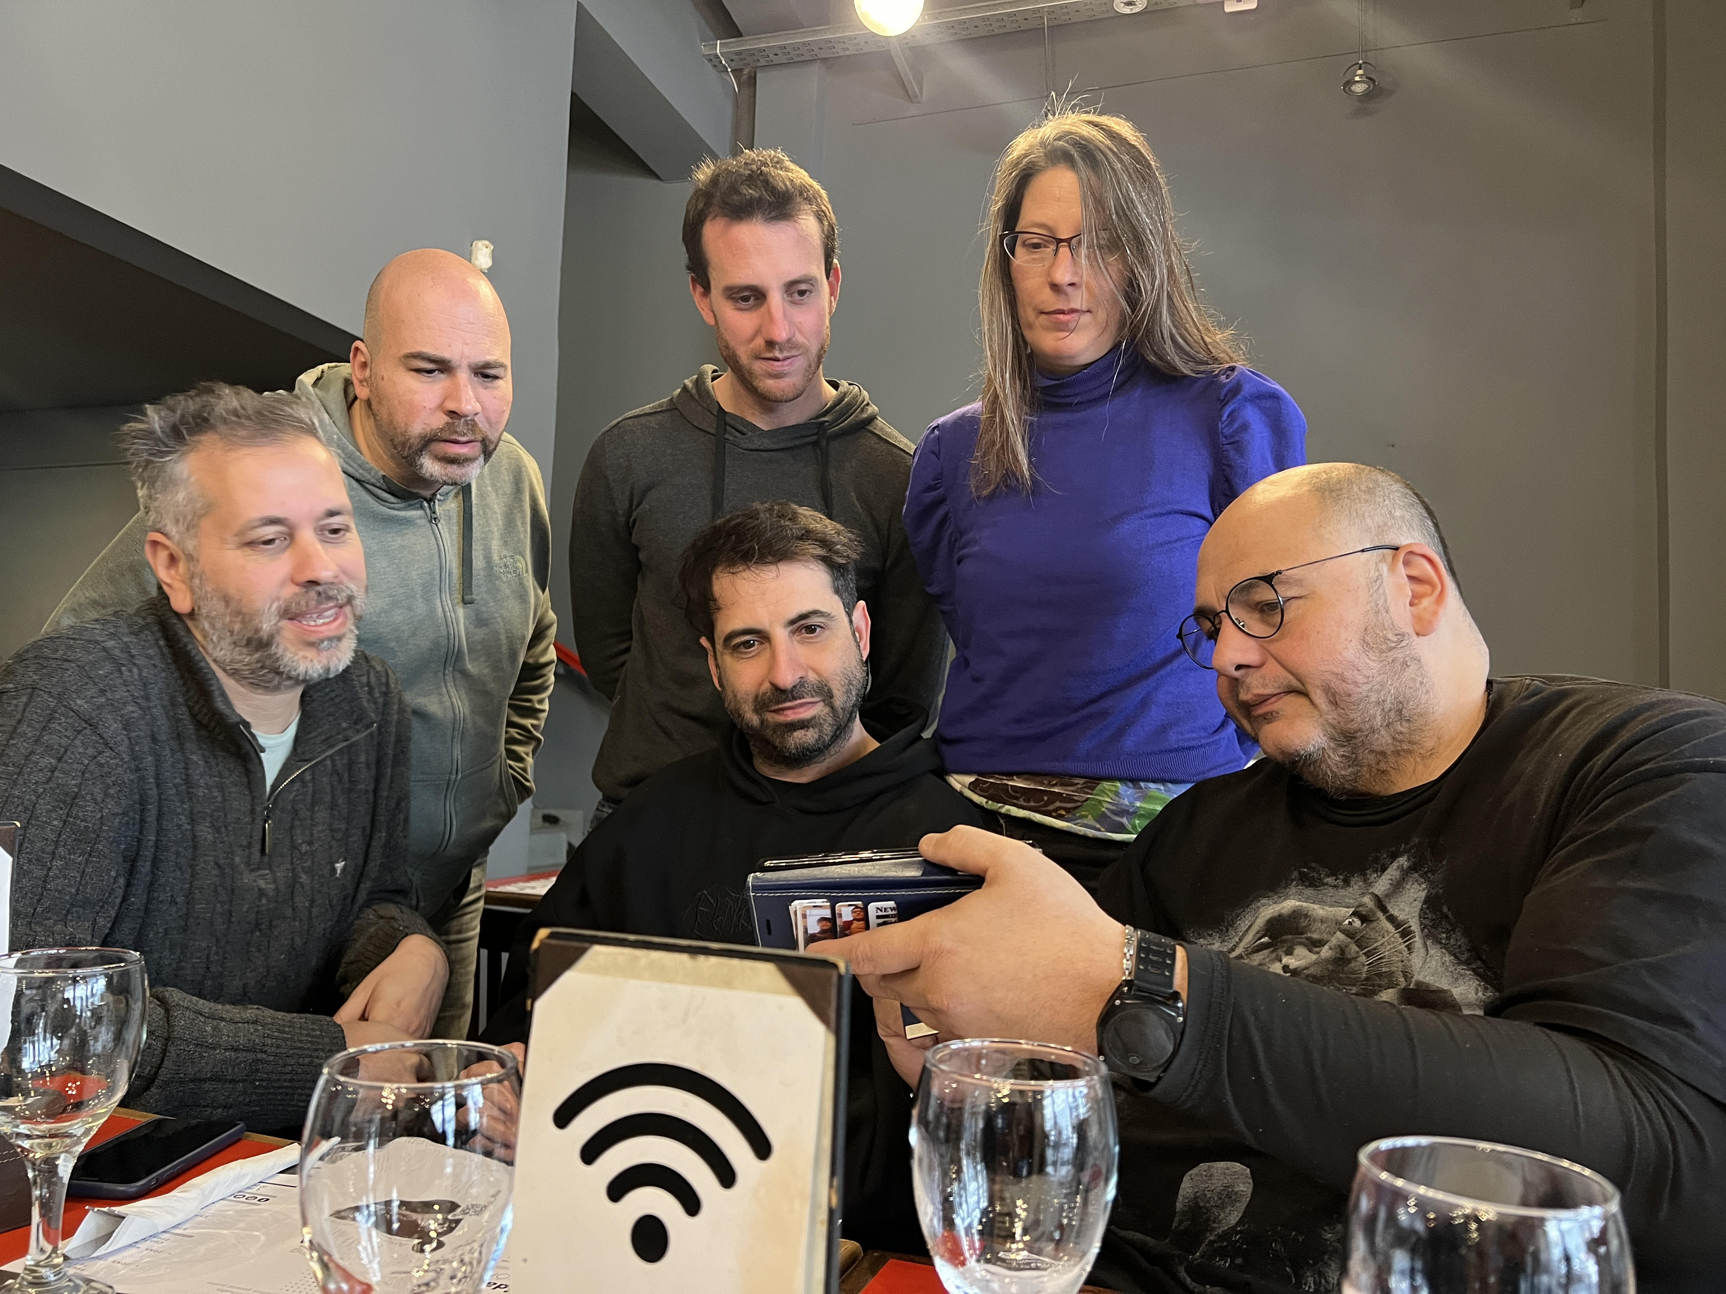
Director (in USA)
Ezio R. Massa
On the extreme left of image, sharing screen shots with crew.

Slide 11
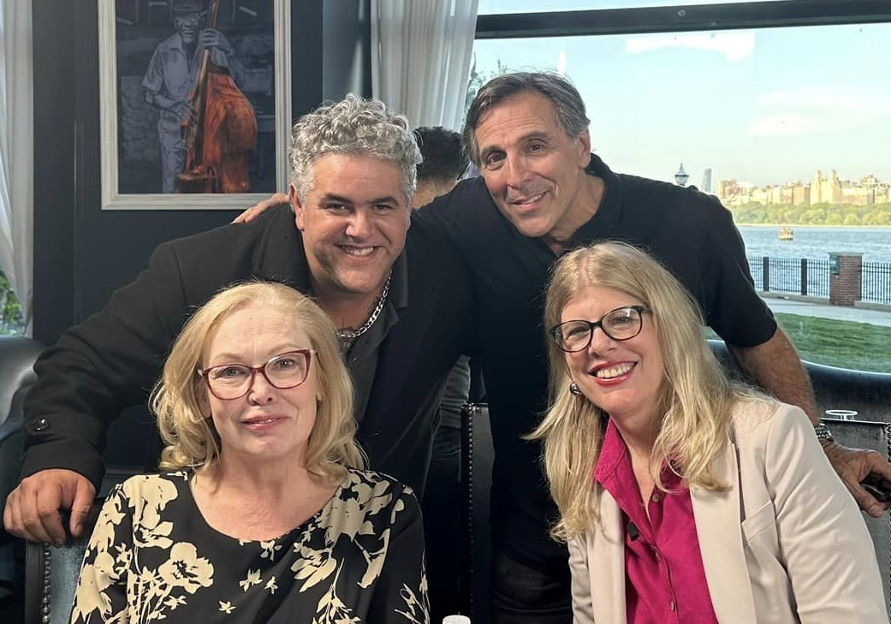
USA Cast:
Cathy Moriarty, Harry Chambarry,
Raul Daumas & Ashton Clay

Slide 12
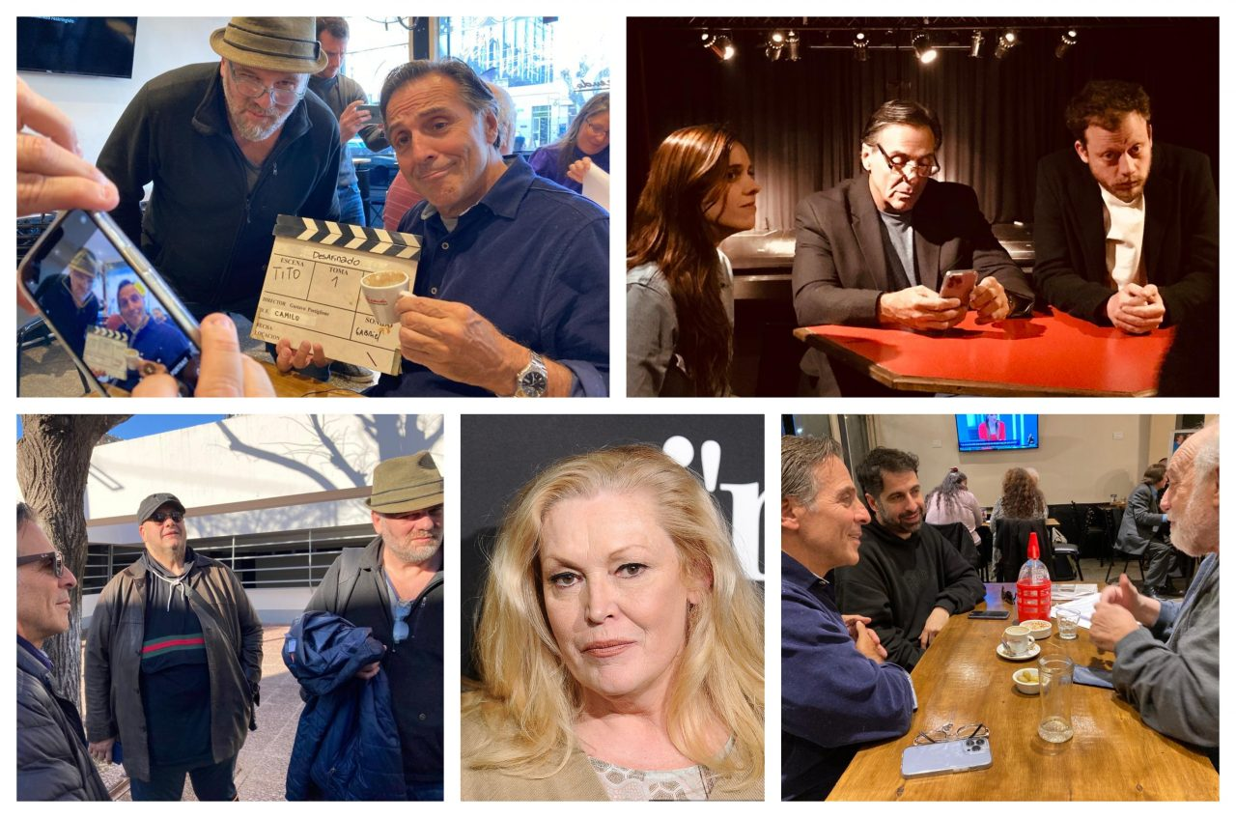

Slide 13
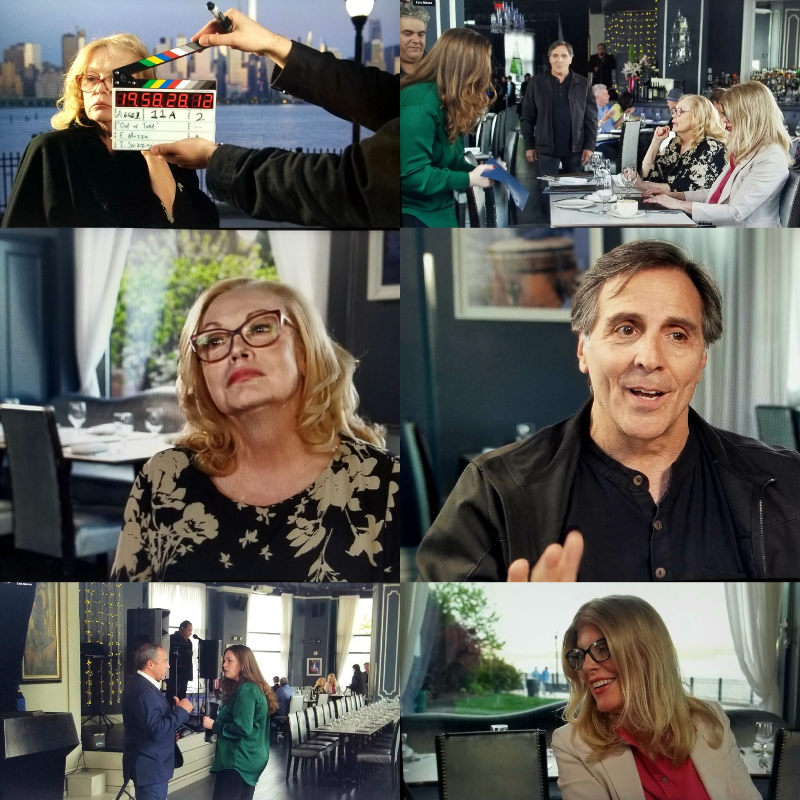

Slide 14
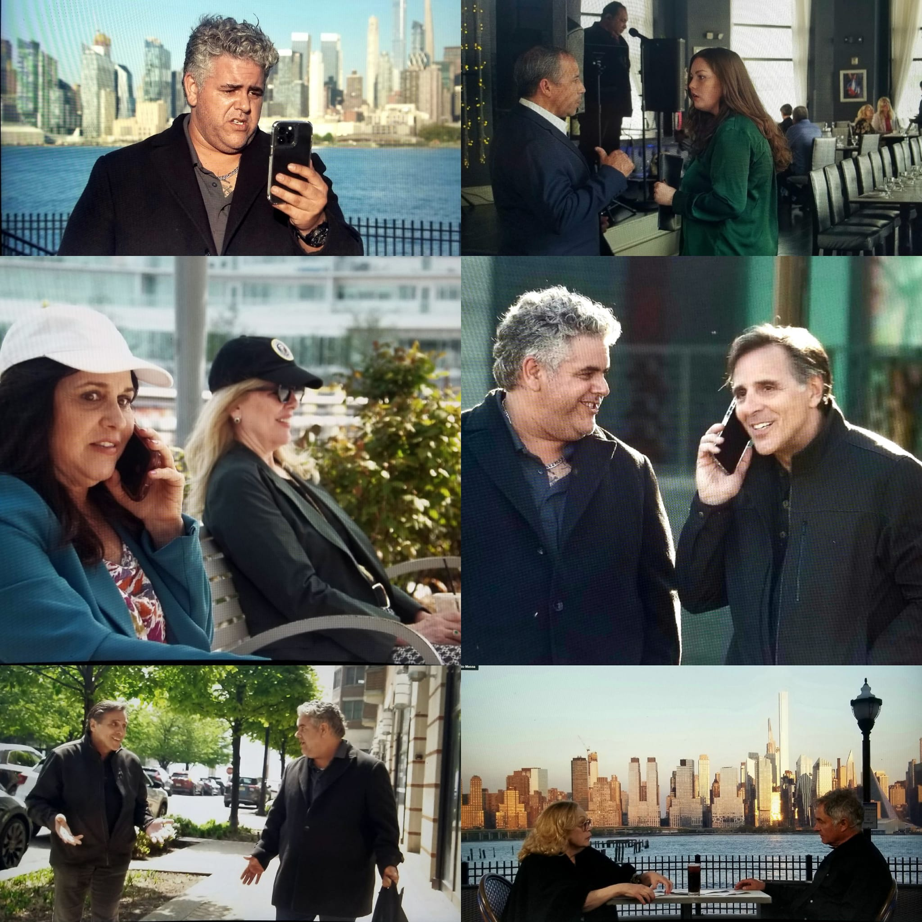

Slide 15
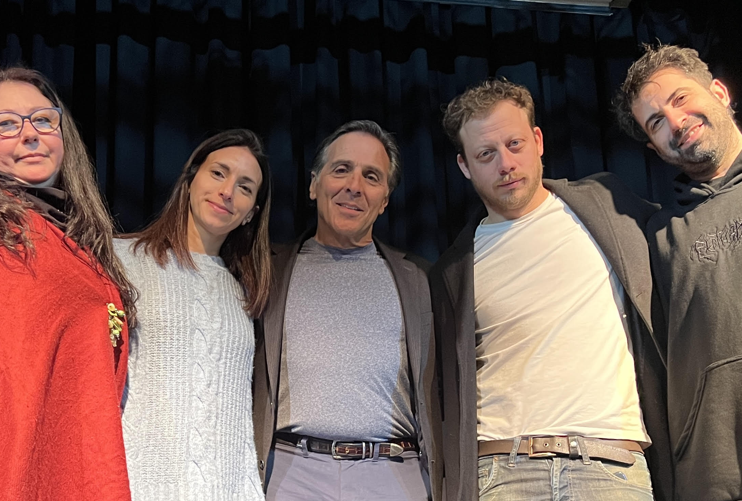
Actors on the set
The stage scene

Slide 16
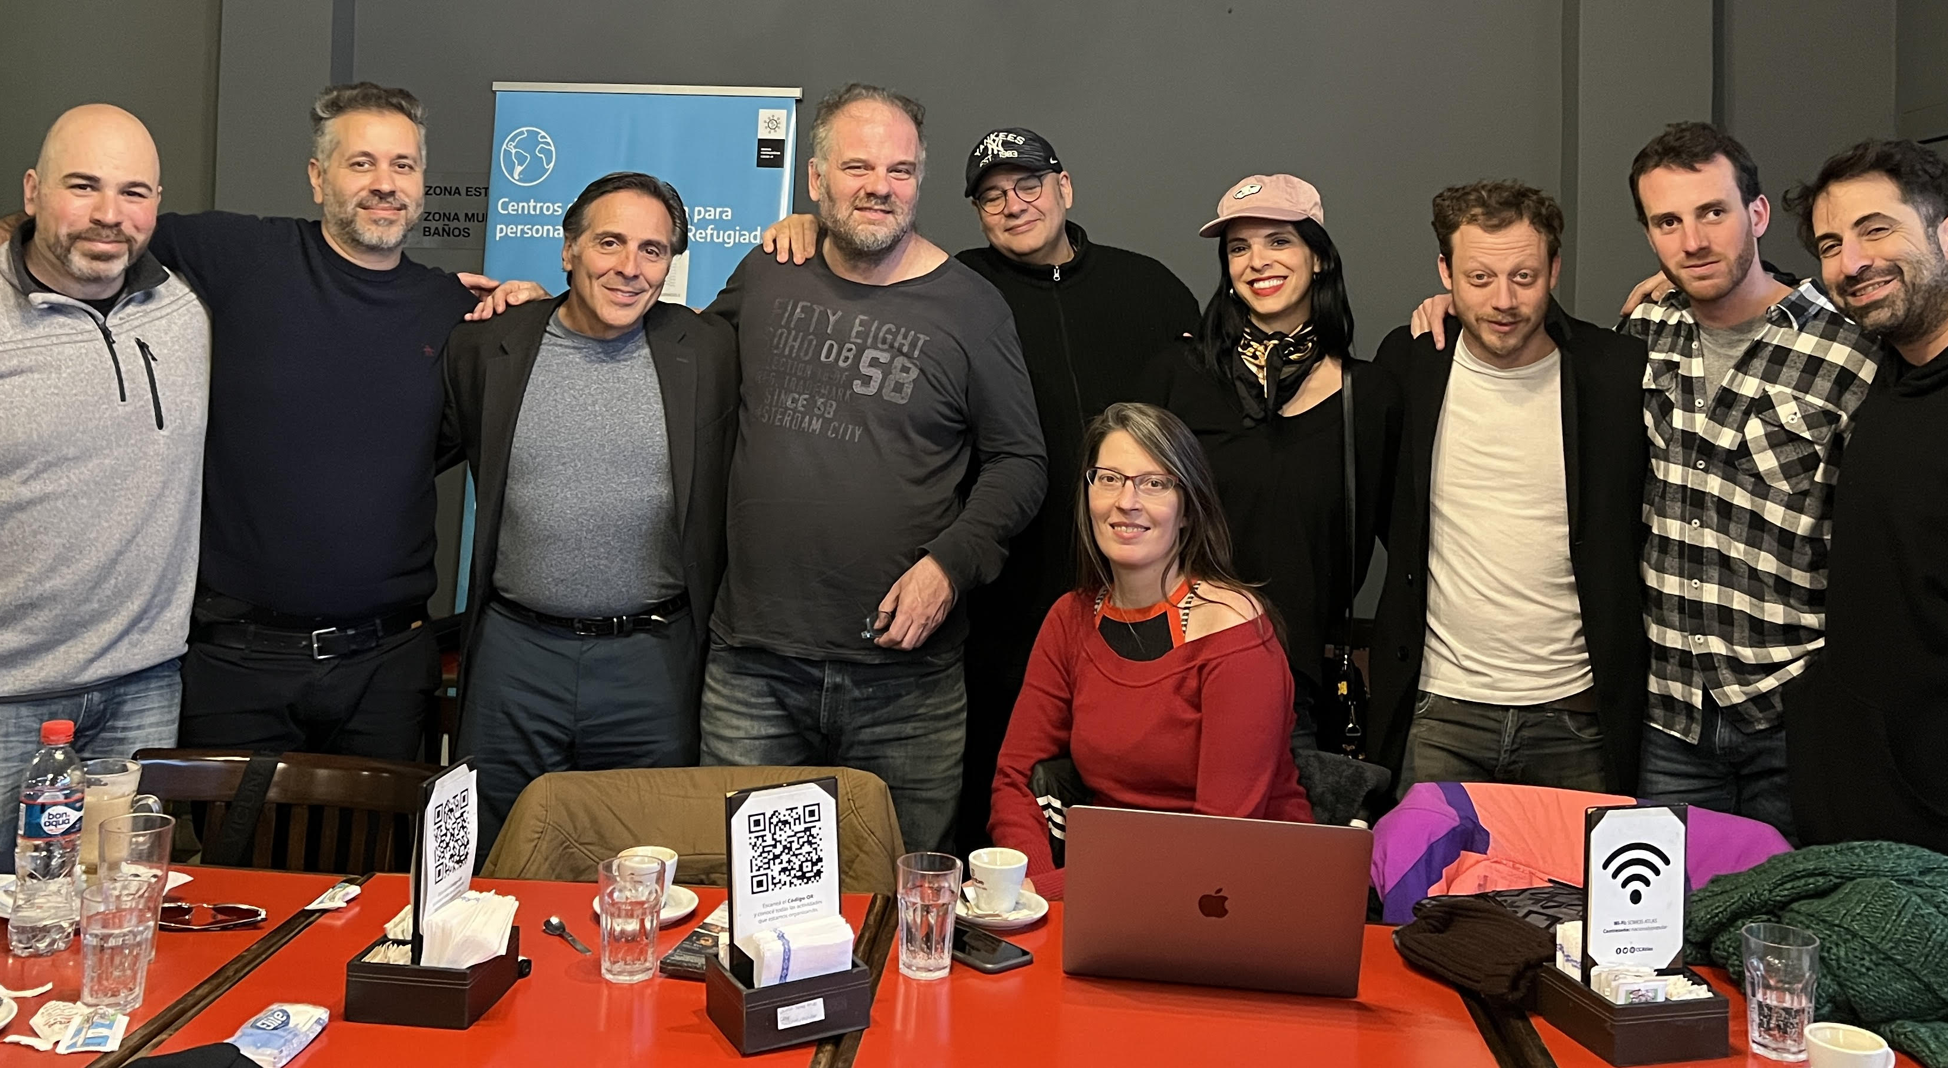
Crew and Cast
In Rosario, Argentina

Slide 17
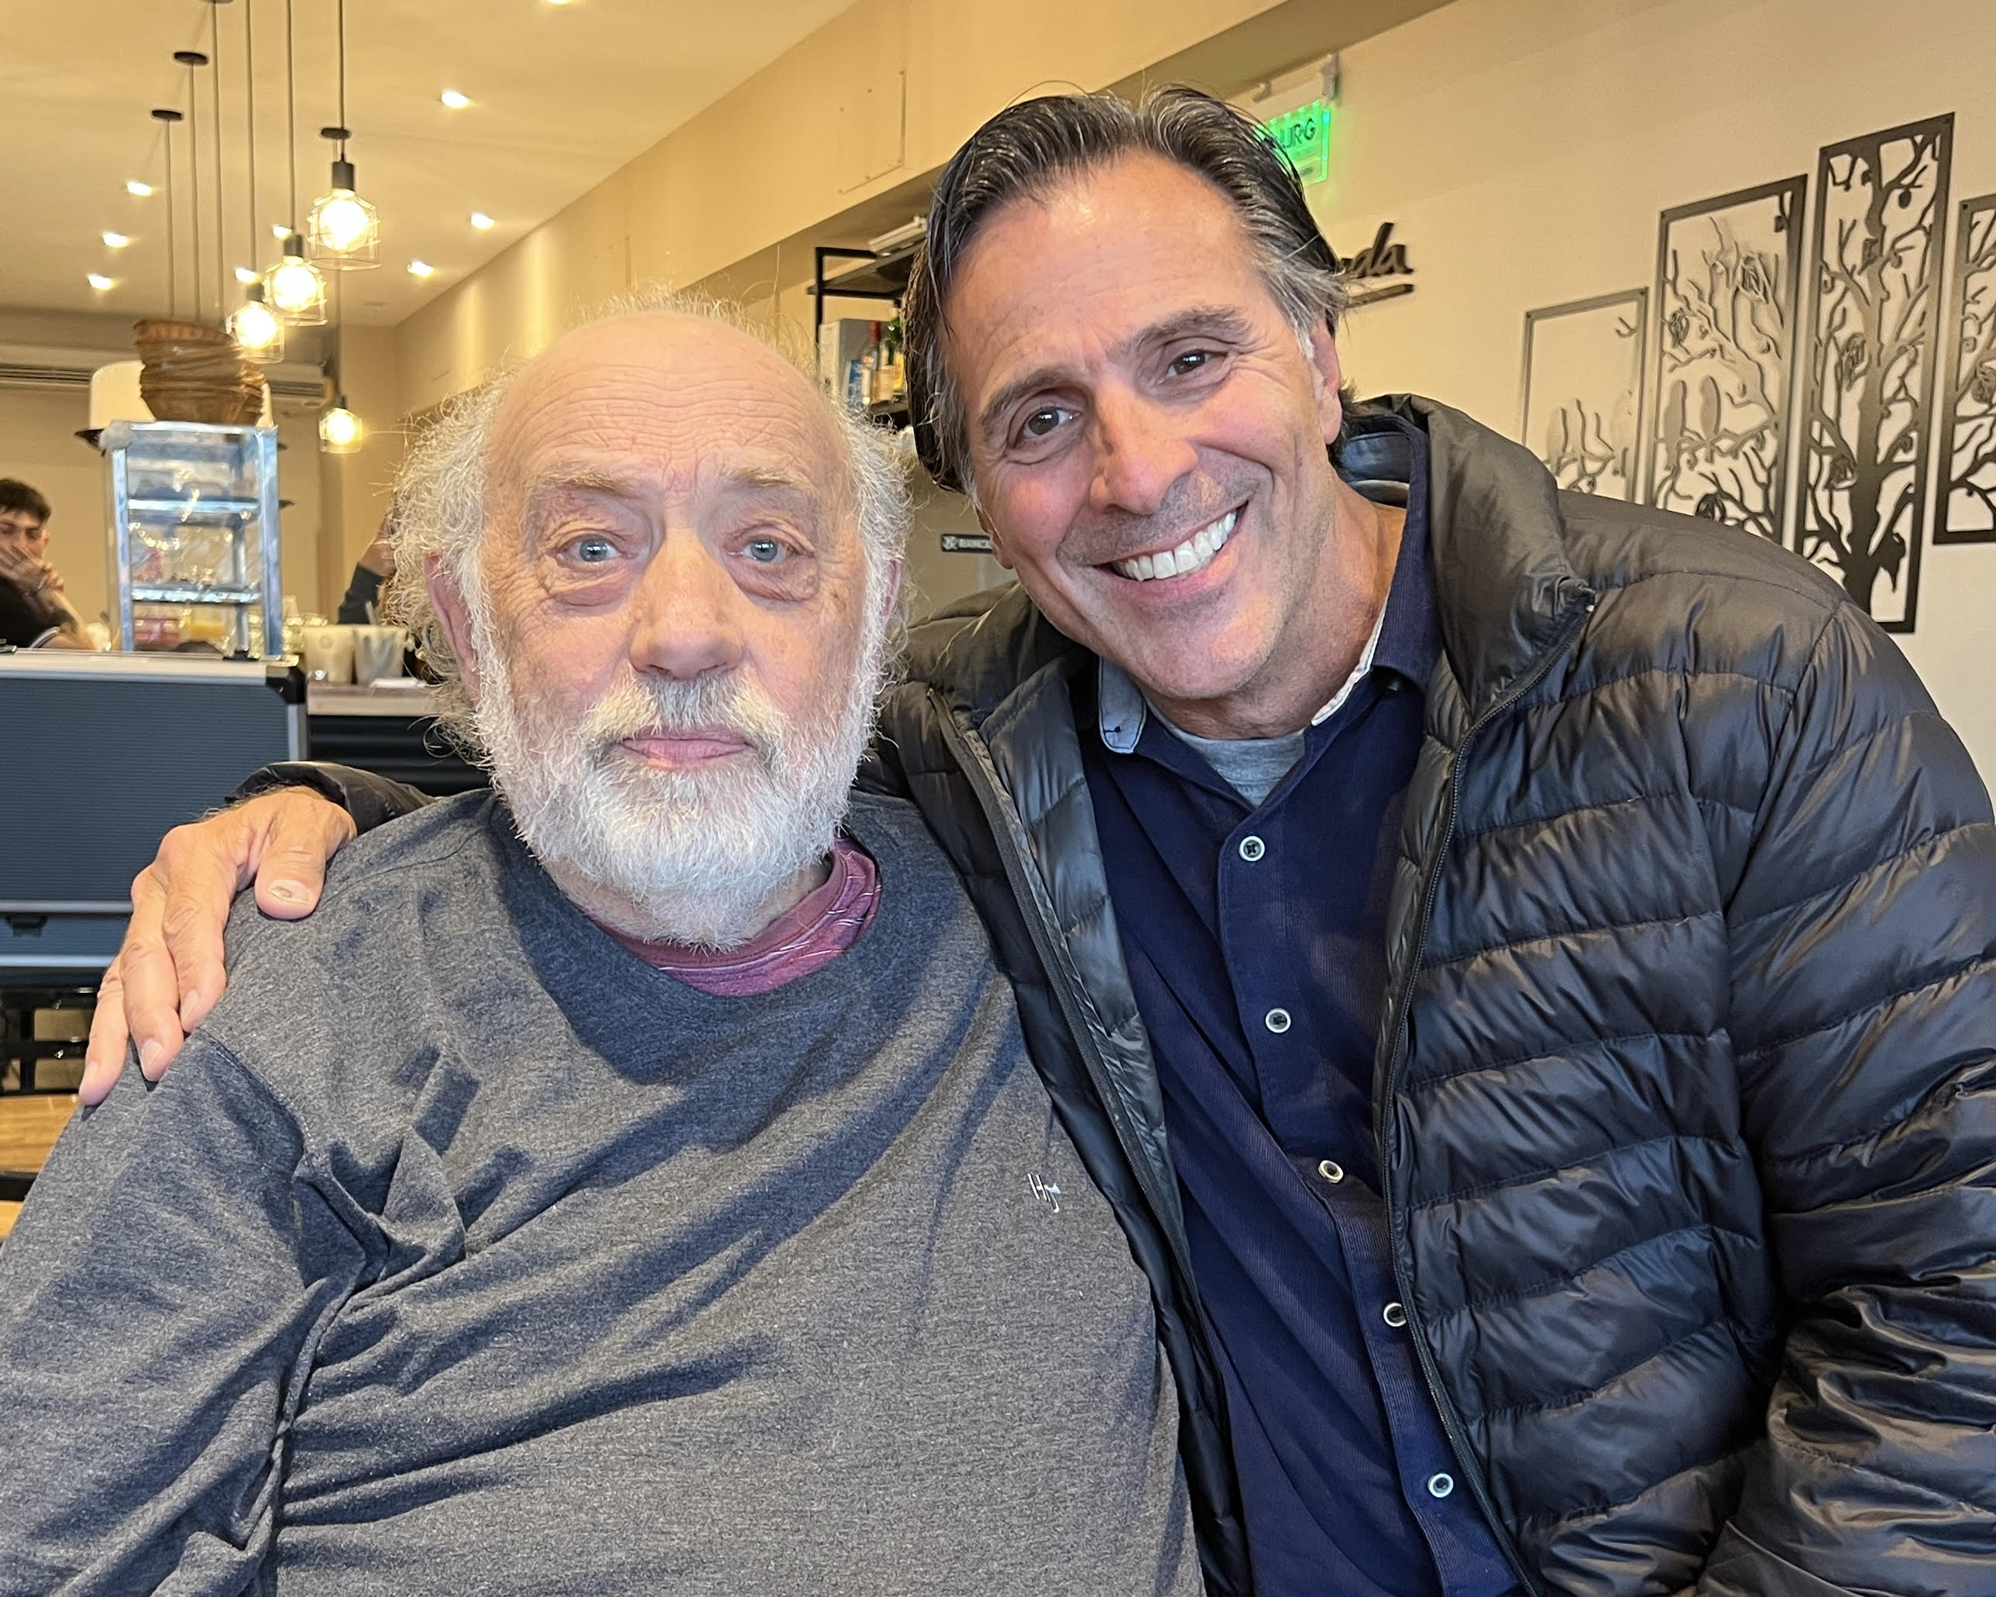
Tito Gomez and Harry
In the Café scene

