Slide 1
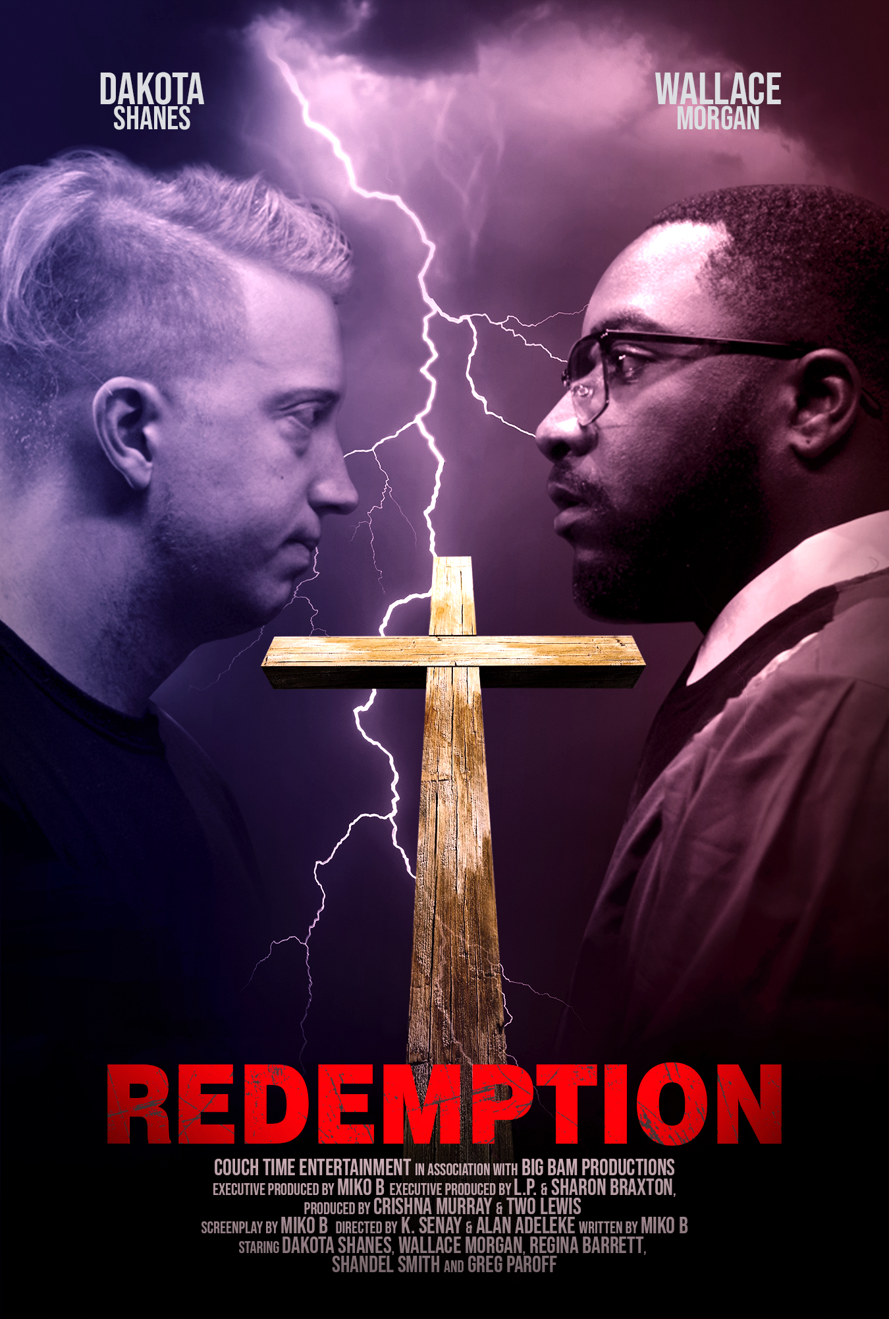
REDEMPTION

Slide 2

Logline: A sermon given by an old acquaintance, leaves a young man conflicted in carrying out a sinister premeditated plot.
Synopsis: Reverend DEONTE STREET (42) a handsome African American pastor and his church choir are preparing to celebrate their annual Family & Friends Day Celebration. While studying and composing his notes, Pastor Street finds himself struggling with the sermon’s message. Pastor Street’s message is revealed to him when he interrupts a disagreement between two rival choir members GERTY CHISOLM (50) and TERTULLUS JUNIOR(30) aka T.J.
Across town IAN(18) Caucasian male is listening to music while surfing the internet looking at different guns fueling his fascination with weapons. Ian’s father, is a well-known racist in their community, gift’s Ian a gun as he stands proud looking at his son. Ian opens the box seeing the gun instantly knows what is expected of him.
Later that night Ian attends the Family & Friends Day sermon, given by his childhood mentor and softball coach, Pastor Deonte Street. During the sermon Ian finds himself nervously grappling with a decision that will change his life and his father’s life forever.

Slide 3

REDEMPTION trailer

Slide 4
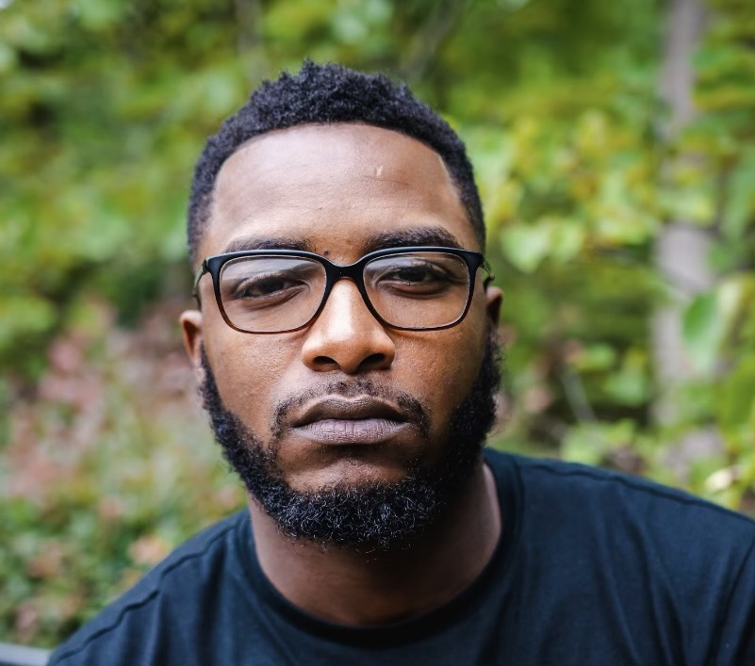
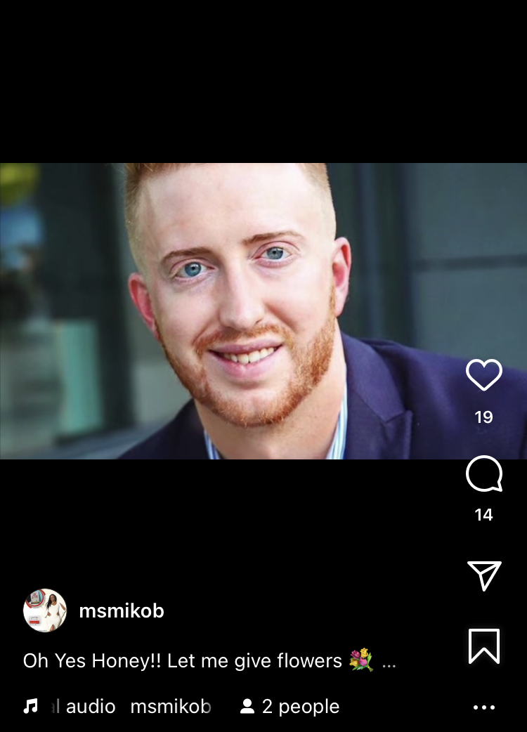
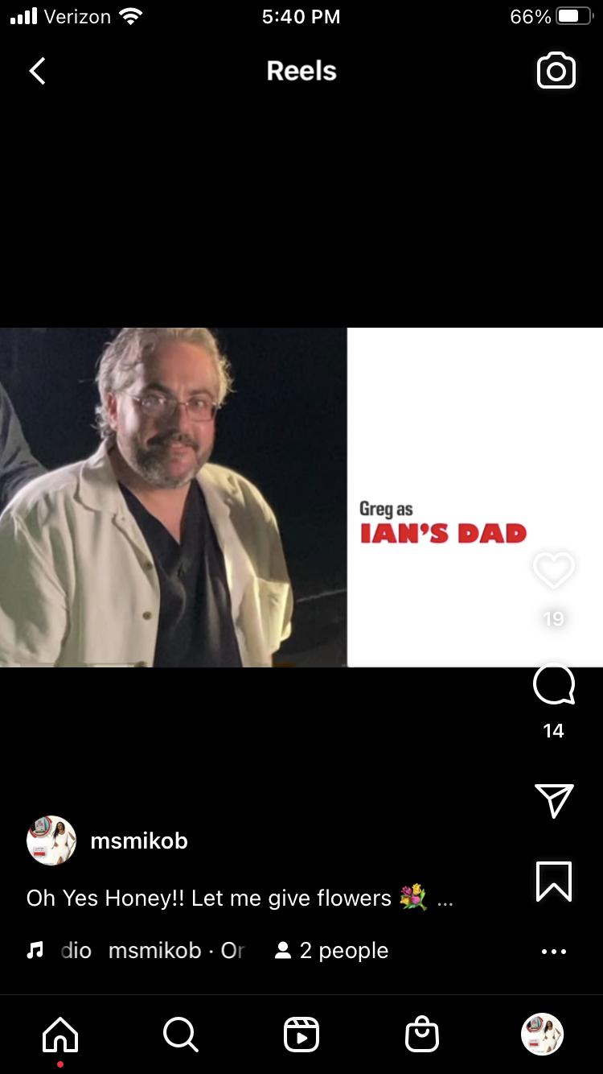

The Main Cast
Dakota Shanes as Ian
Wallace Morgan as
Pastor Street
Greg Paroff as
Ian’s Dad
Regina Barrett as
Sister Gerty Chisolm

Slide 5



Boss Bitches
EP & WRITER
Miko B
Producer
Crishna Murray
Director
K.Senay
Owner and CEO of Couch Time Books and Couch Time Entertainment.
Indie author of Love Letters of a Fool and Love Letters of a Foolish Man.
Screenwriter of and executive producer of
REDEMPTION.
Is an actress, screenwriter and executive producer.
Owner and CEO of Big Bam Productions.
Produced films REDEMPTION, Hi Hope, True Colors and Finding Me and more.
Writer of The Pink Fight for the BET Her Presents: The Waiting Room
Independent Autor of His Heart is Mine and Protect Our Babies.
Director of REDEMPTION.

