Slide 1

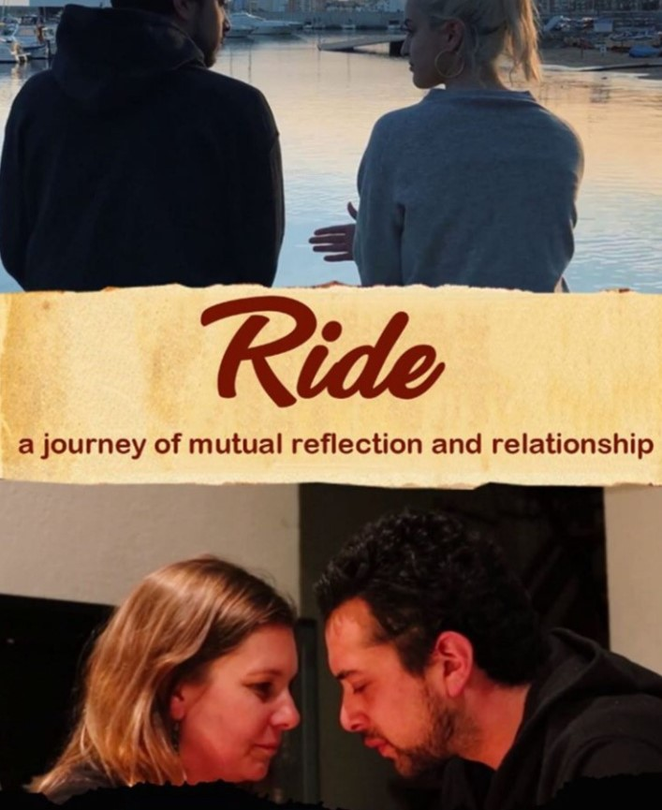

Slide 2
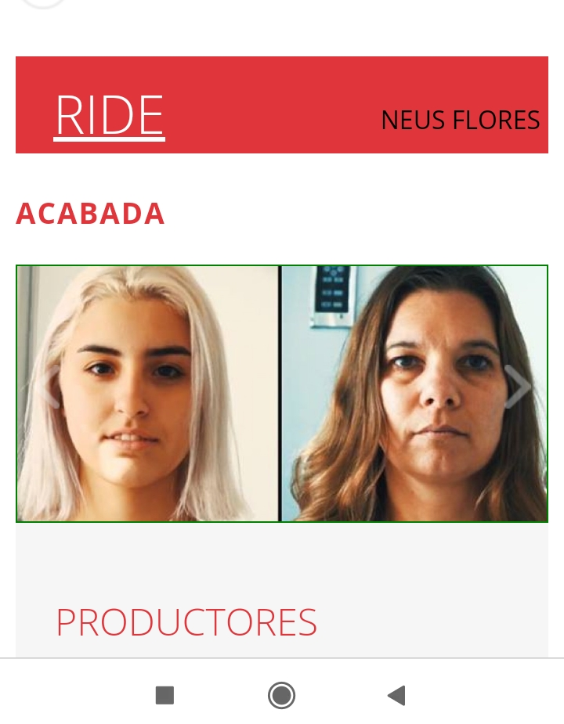
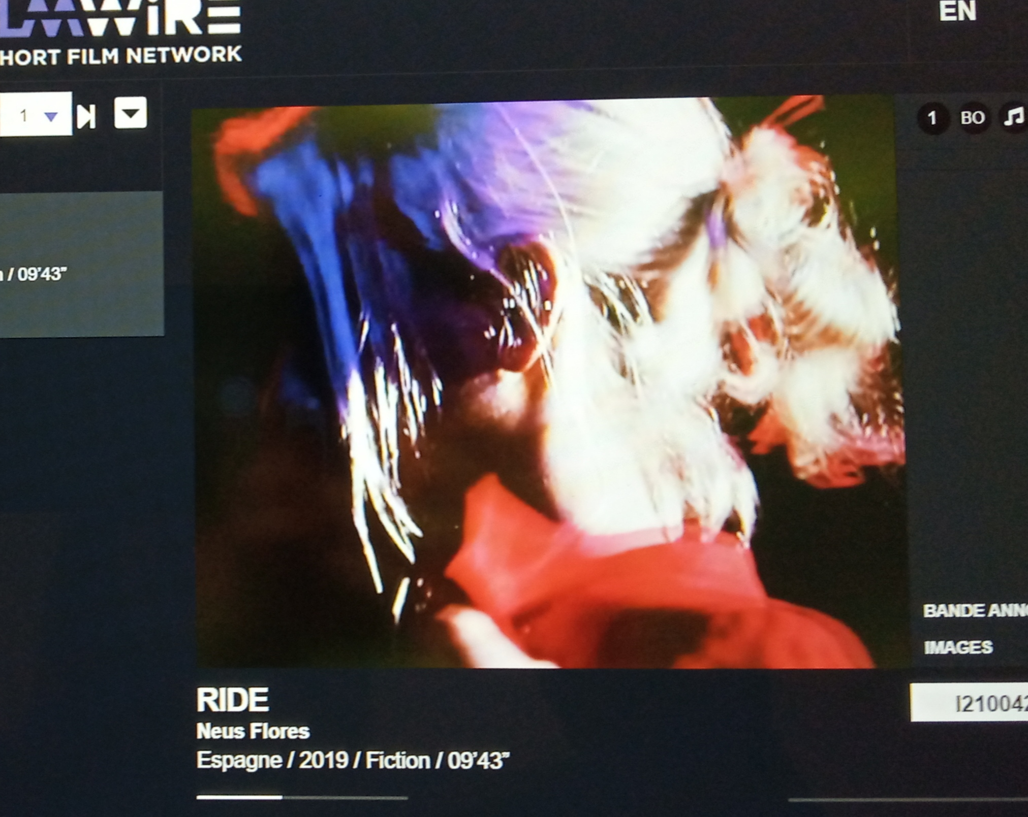
RIDE
Added to shortfilmwire market 2021 reference number I2100245 Clermont-ferrand
Added to Catalan films & tv catalogue 2021
Available for festivals on platforms:
Filmfreeway
Shortfilmdepot
Festhome
IMDB

Slide 3
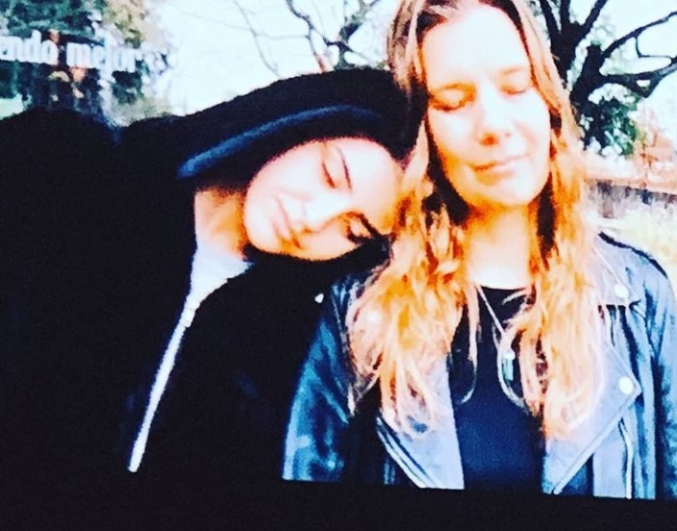
SYNOPSIS:
Emma and her daughter Alex struggle to understand each other.
Emma is having a hard time coping with her teenage girl, who sees life very differently and is turning into a bit of a rebel.
Emma realizes she has to take matters in her own hands and finds a way to bring their worlds closer together.

Slide 4

TECHNICAL SPECS
Running time | 9.43¨
Exhibition formats | DCP, HD CAM
Aspect ratio | SCOPE
Sound | STEREO
Shooting format | 4K
Colour
Year of production | 2019
Original languages | CATALAN, ENGLISH, SPANISH, SWEDISH
(WITH ENGLISH AND SPANISH SUBTITLED VERSIONS AVAILABLE on demand)

Slide 5
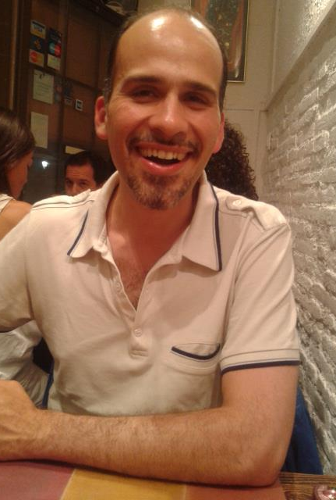
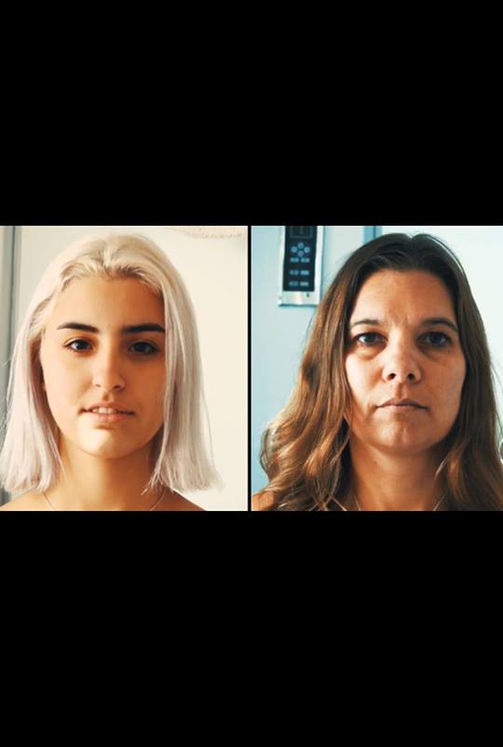

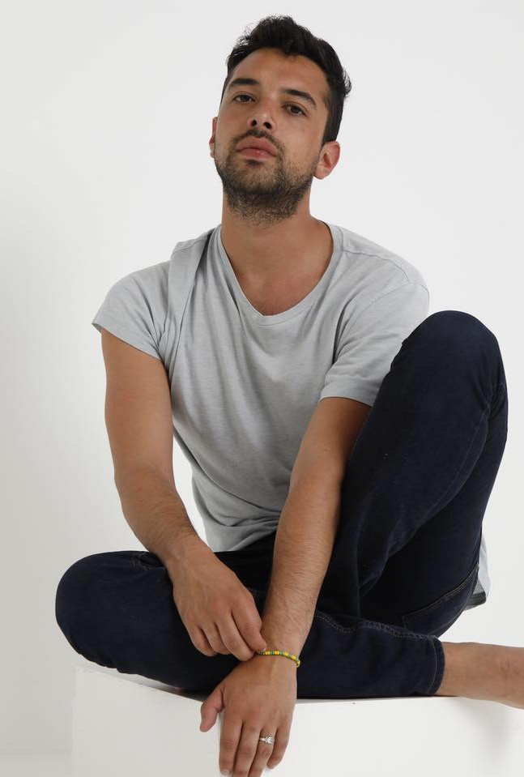
INTERNATIONAL CAST
Mari Arveheim:
Swedish actress and graphic designer.
Alba Manobens:
Catalan actress, student of advertising and PR, pole dance medalist, and model.
Lucas Cavazos:
American actor and Radio host of the RKB English Radio.
Santiago Malkuth:
Colombian actor, director of photography, and screenwriter.

Slide 6
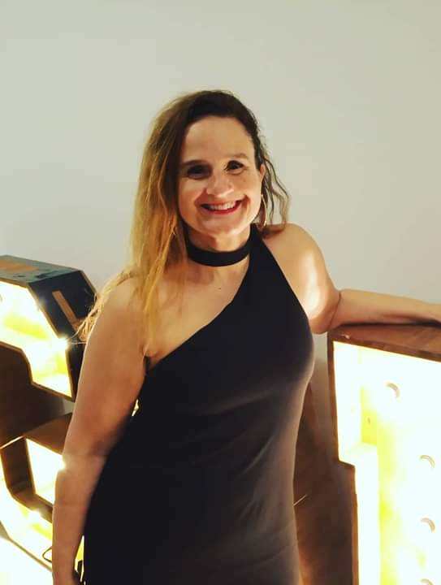
NEUS FLORES IS a filmmaker, AN EXPERT IN INTERNATIONAL CULTURE, AND A DIGITAL JOURNALIST
SHE DIRECTS her SHORT film ¨RIDE¨ FROM A FEMININE PERSPECTIVE TO FAMILY RELATIONS
BETWEEN MOTHERS AND DAUGHTERS.
Neus Flores – Director, producer
and scriptwriter
Contact details:
nfloresb@uoc.edu
+34 639514430
www.neusflores.com

Slide 7
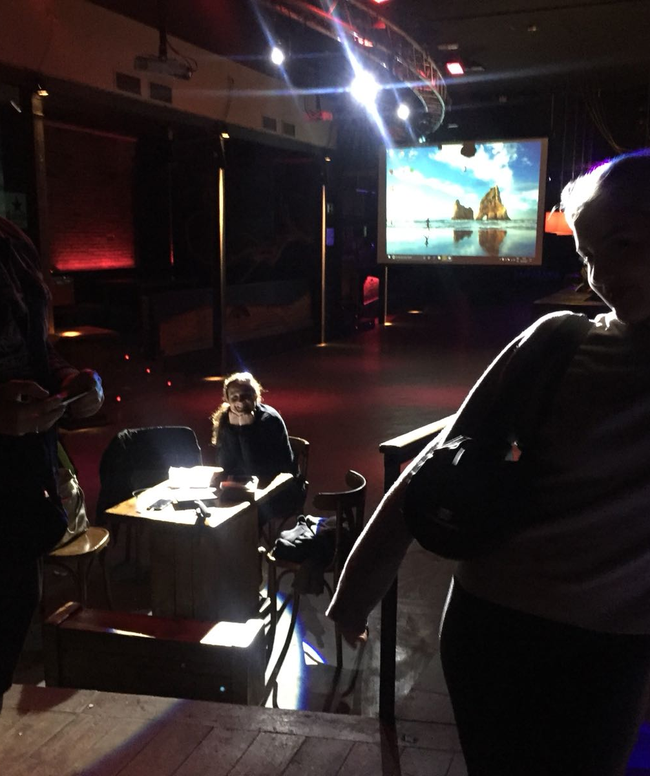
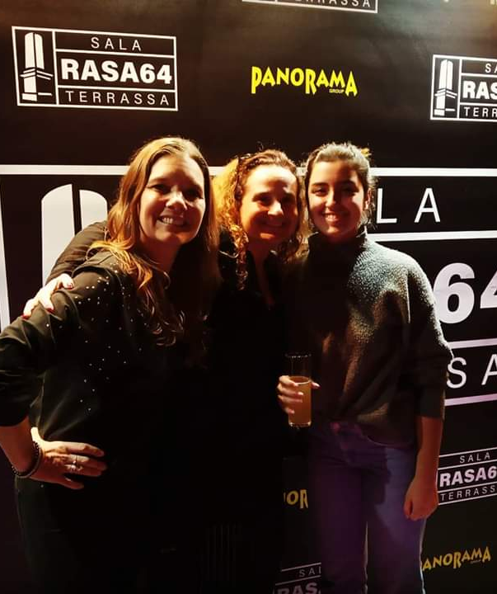
Making of
RIDE was shot in various Catalan locations in spain (terrassa, Barcelona, blanes, salt and Girona).
with an ORIGINAl script spoken in 4 different languages (Catalan, Swedish, English and Spanish),and subtitled versions in English AND SPANISH, available upon demand.
The original soundtrack was made on purpose by COMPOSER Antoni m. march to convey the emotions of both female characters.
With the valuable help of sala rasa 64 to shoot the cabaret scenes, and odd khuu´s kitchen to shoot the restaurant scenes.
And using the valuable teaching support of the new York film academy (NYFA) - usa

Slide 8
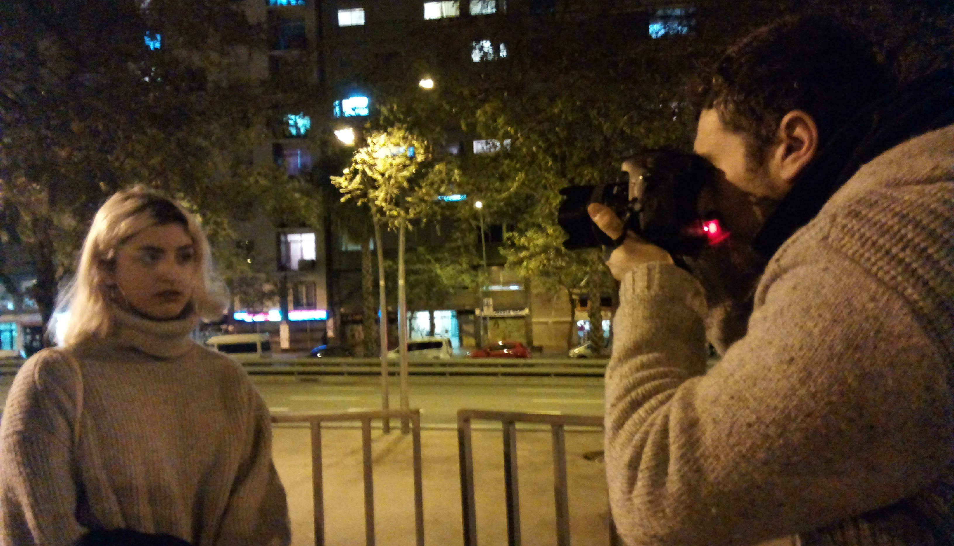
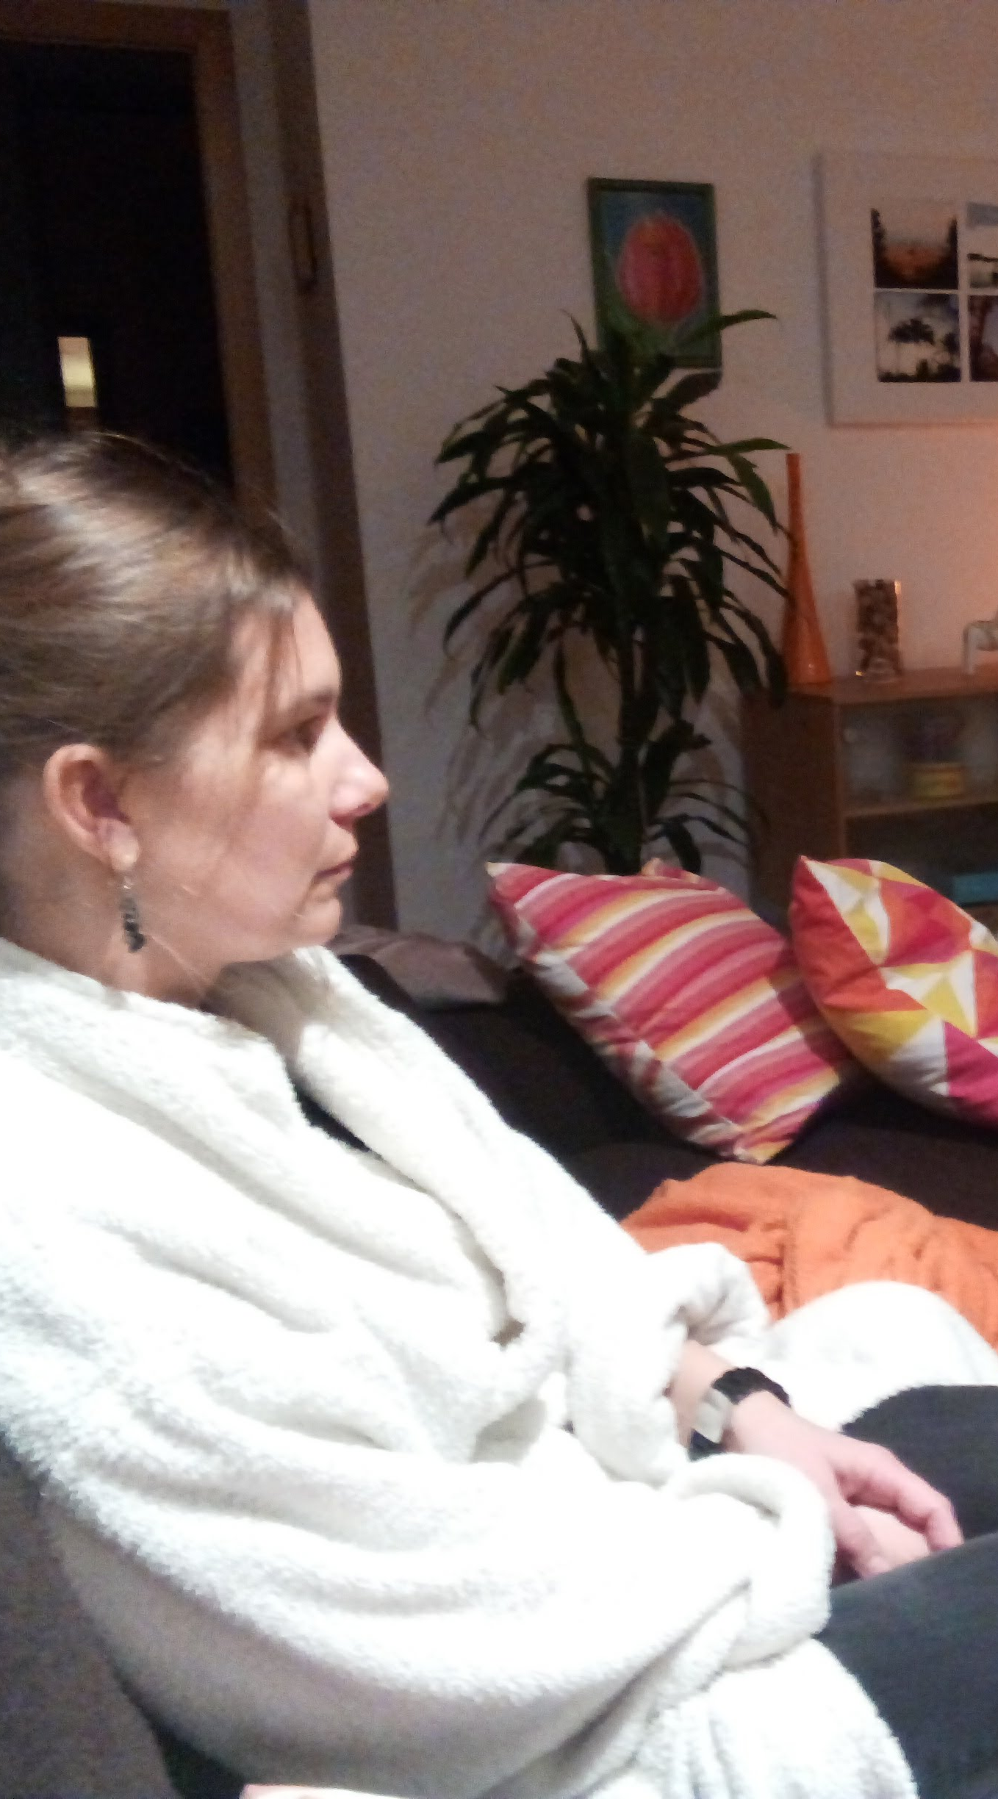
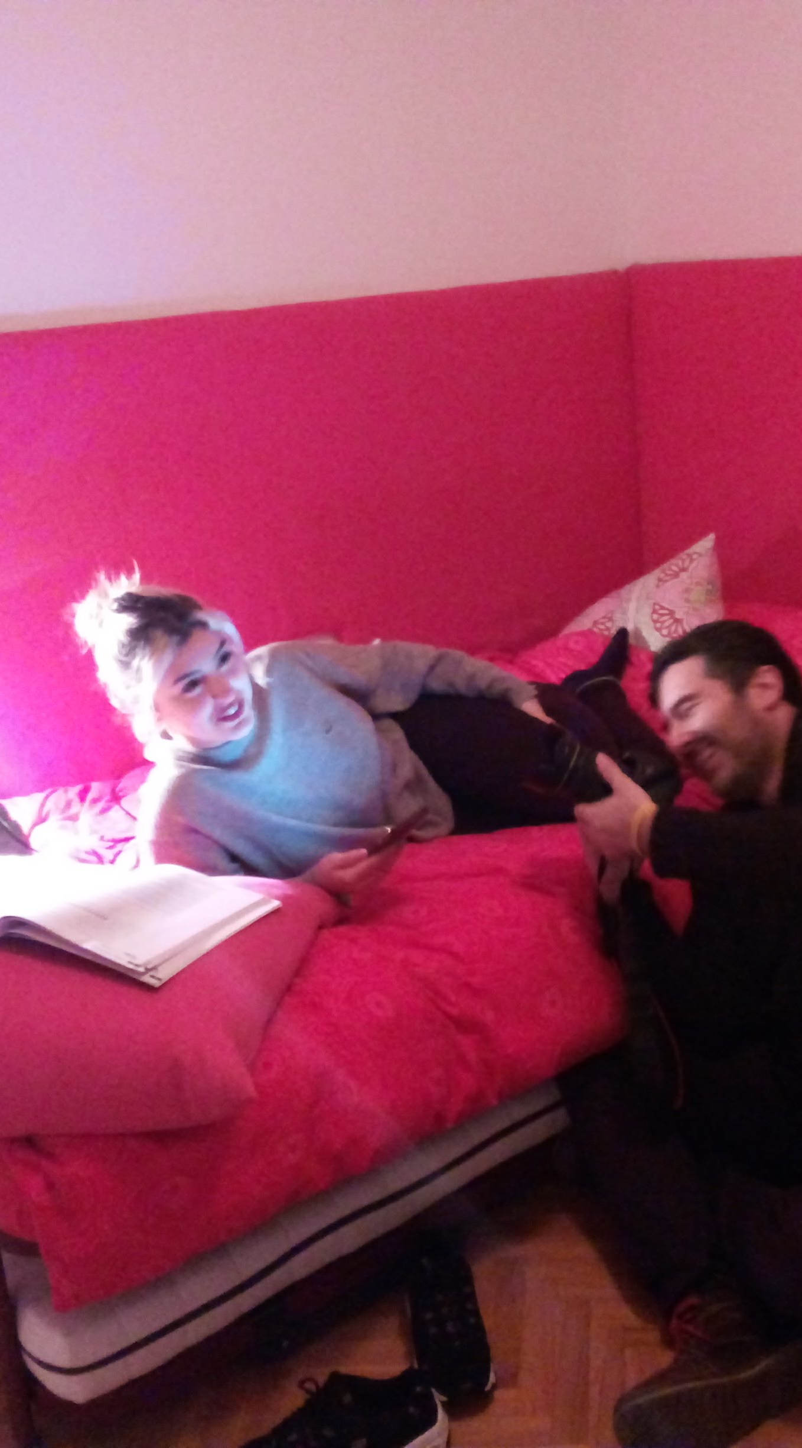
Various indoors and outdoors shots

Slide 9
What people say about ride:
¨I just watched your film and think you did a great job! It looks good and all makes sense visually¨
Debbie de Villa is a Production Designer in Los Angeles. Films she produced include ¨Motherhood¨, ¨Love the hard way¨ and ¨Audrey¨.
https://www.debbiedevilla.com/
"I like your film. And I thought music was perfect , Very David Lynch!! Perfect. "
Mark Pellington is Best Director at the 1992 Billboard Video Music Awards, and picked up four 1993 MTV Video Music Awards, including Best Director and Video of the Year. He is represented by UTA and 3 Arts Entertainment for film and television.
www.markpellington.com

Slide 10
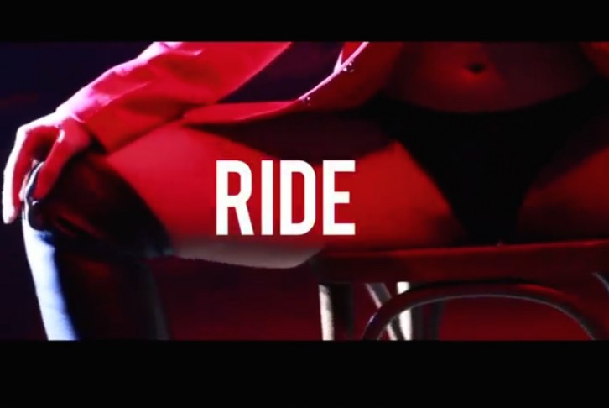
Press
https://www.makma.net/tras-la-verdad-de-ride-de-neus-flores/

Slide 11
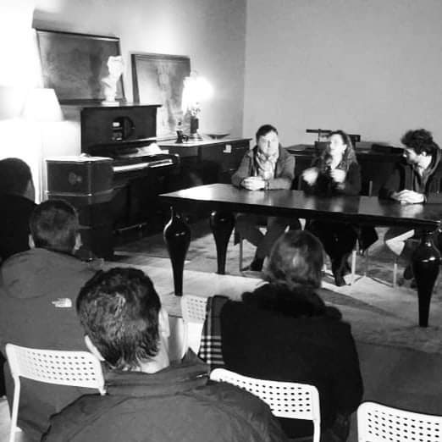
RIDE´S purpose: to debate
RIDE is a need to express how our human relationships can improve by sharing experinces that link us together.
Family bonds can also be stronger, if we try to understand and experience the teachings that our parents try to pass on to us.
Education, teenage rebel attitudes, mature relationships, etc.
All those subjects ready for debate are what RIDE provoques by having an open end, ready to be discussed.

Slide 12









