Slide 1

Exec. Producer
Arturo Mireles
Director
Todd Smith

Slide 2
Synopsis
Green Revolution examines the numerous benefits to modern society by an ancient plant, hemp. Through interviews with farmers, educators, lawmakers, and manufacturers, Green Revolution shows how replacing everyday petroleum based products, building materials, textiles, and many other products can be replaced by hemp and help reverse the effects of climate change. Green Revolution educates the public in the differences between cannabis and hemp through interviews and case studies, shows how some states don't recognize the legality of hemp, how international companies and countries are innovating with hemp, and how this one miraculous plant can help change our society.

Slide 3
RESEARCH

Slide 4
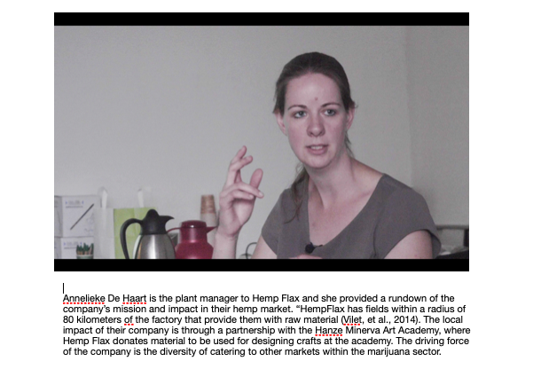
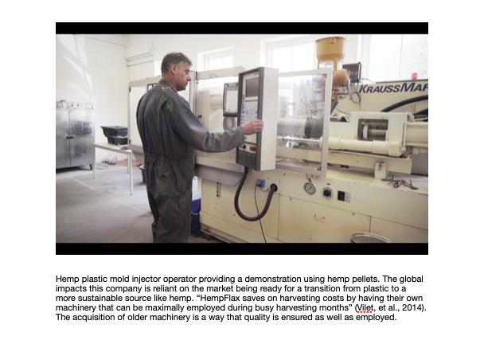

Slide 5
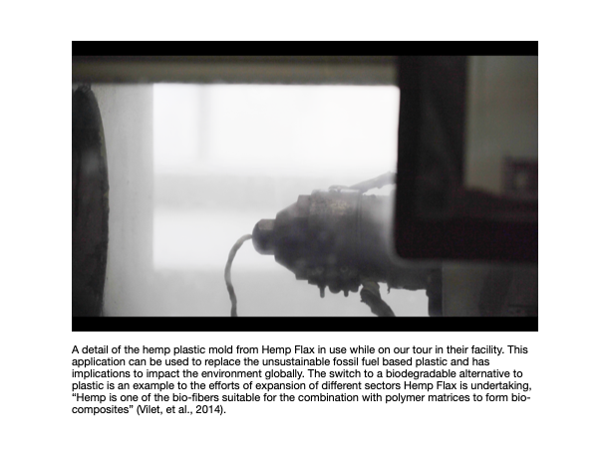

Slide 6
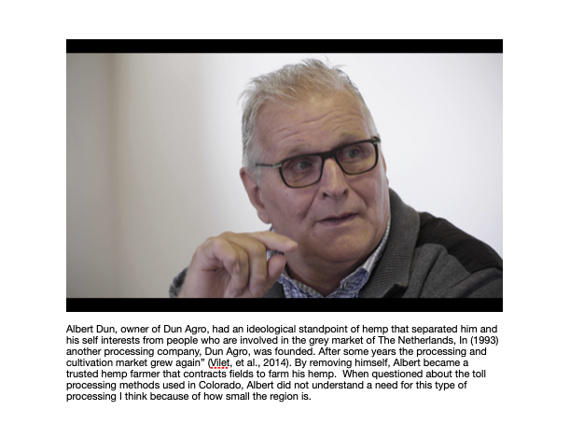
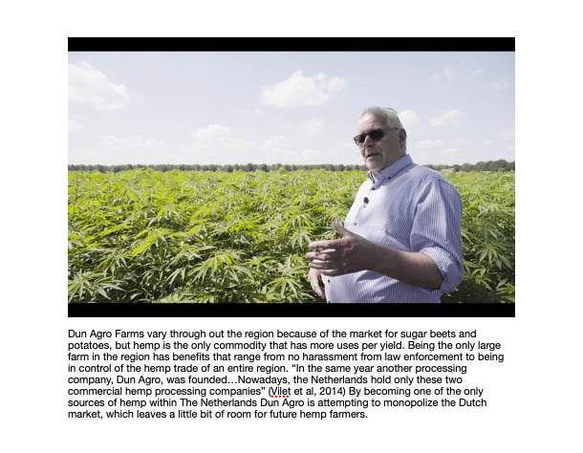

Slide 7
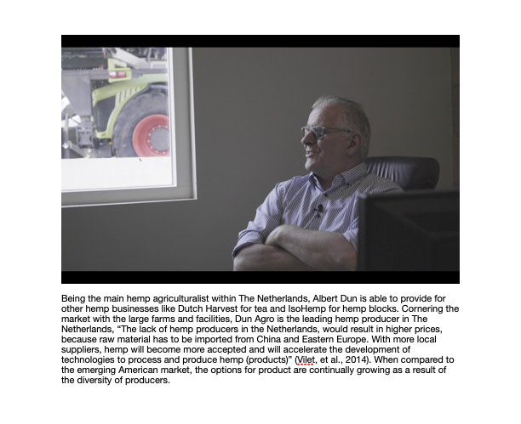

Slide 8
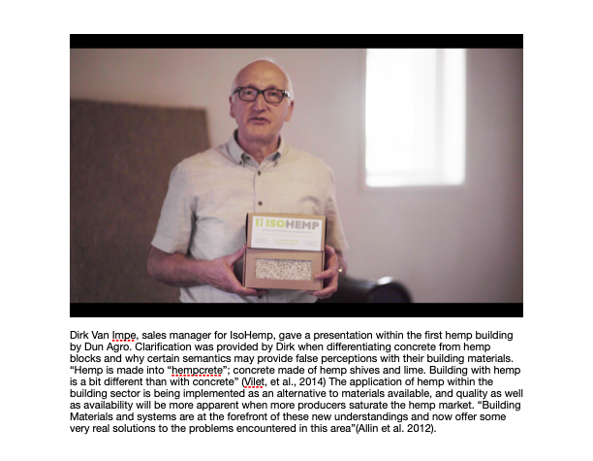

Slide 9
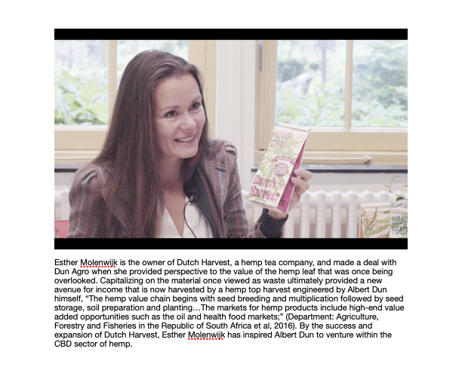
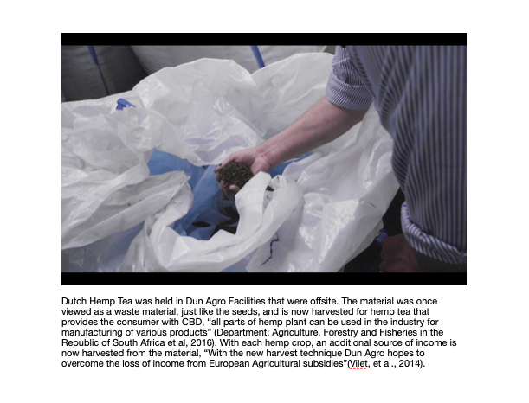

Slide 10
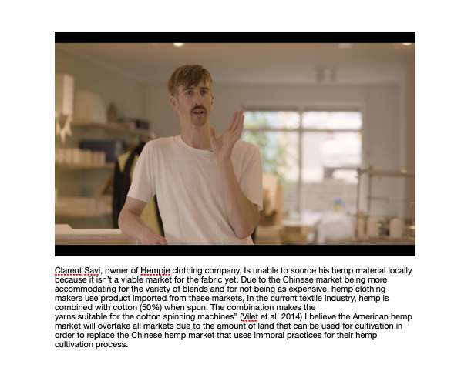

Slide 11
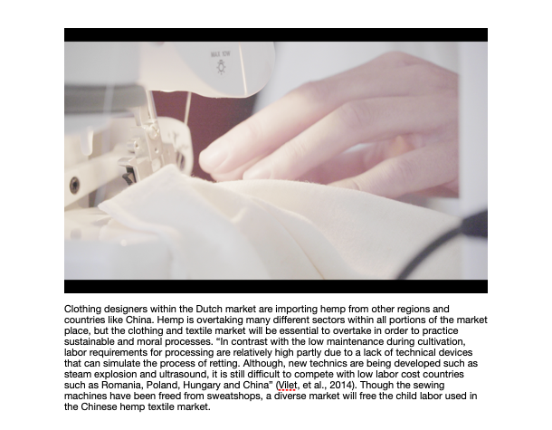

Slide 12
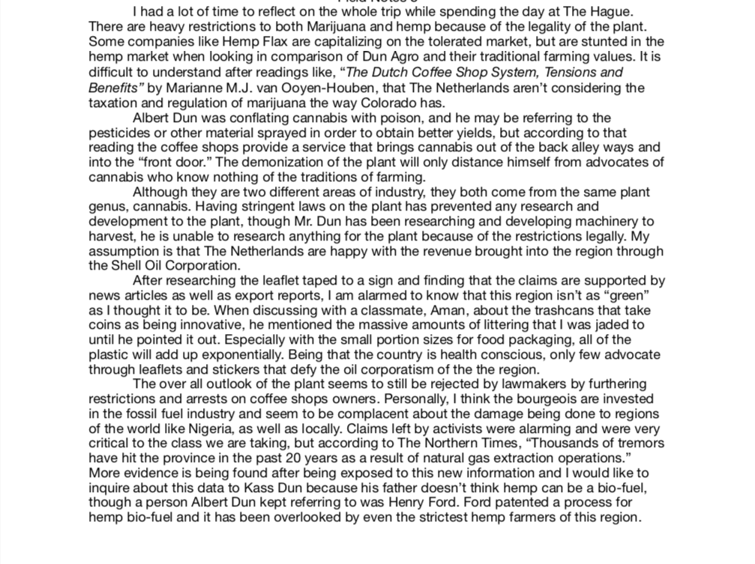
Field Note

Slide 13
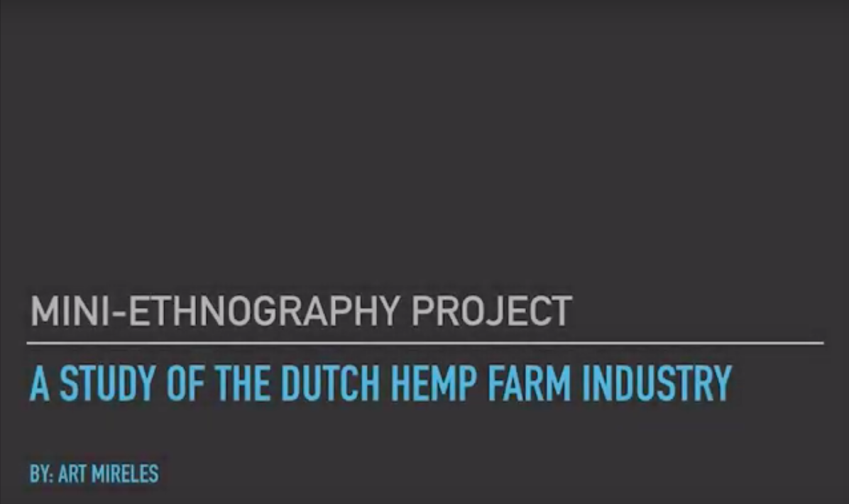
More analysis of Dutch Hemp Farming:
Ethnographic Research on the two leading Dutch Hemp Farms

Slide 14
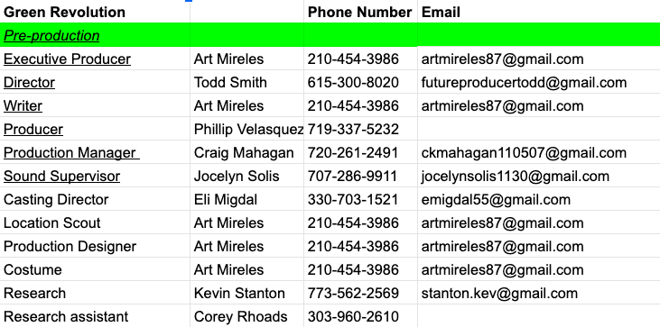
Crew

Slide 15
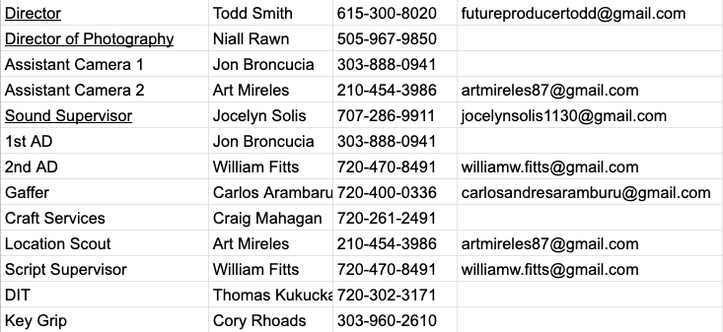
PRODUCTION

Slide 16
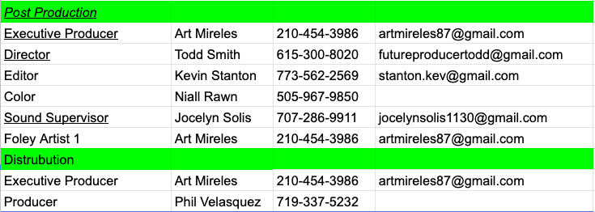

Slide 17
Risk Assessment

Slide 18
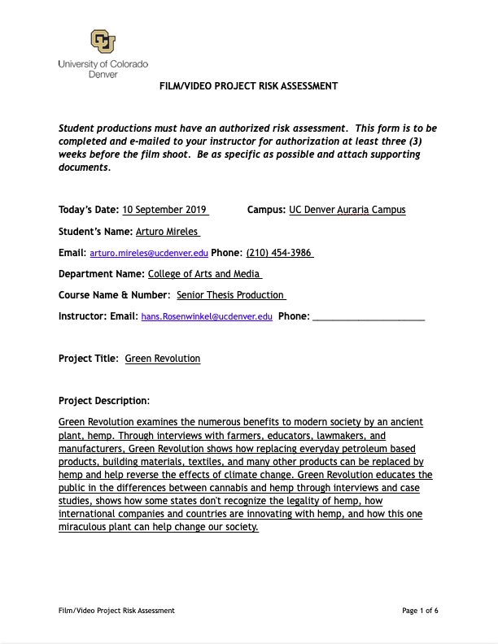
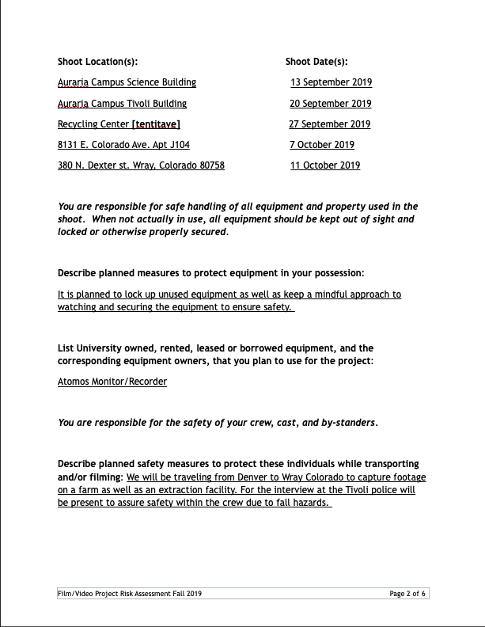
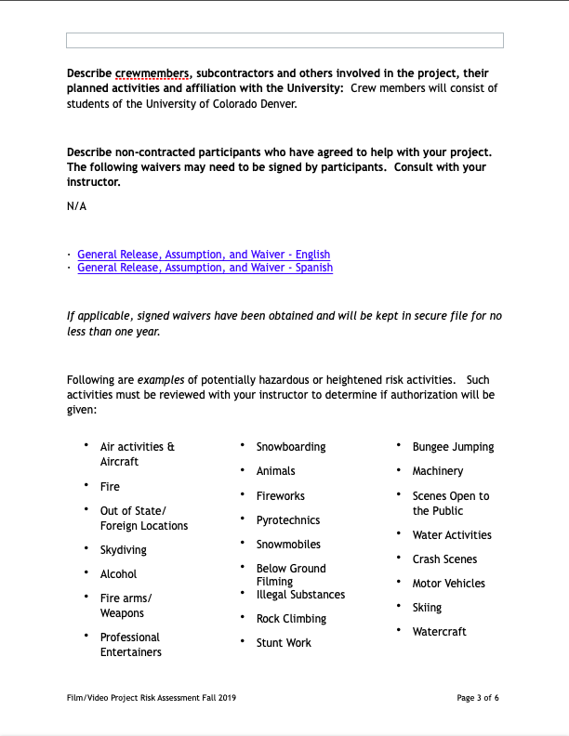
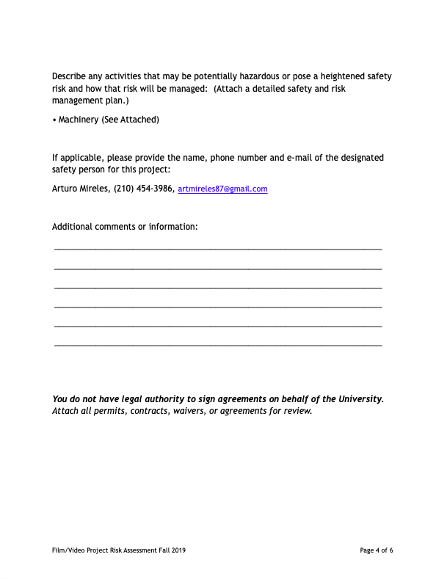
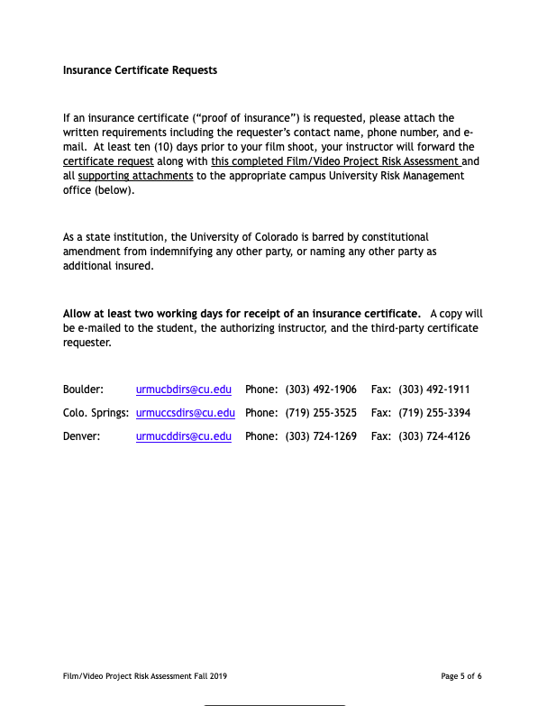
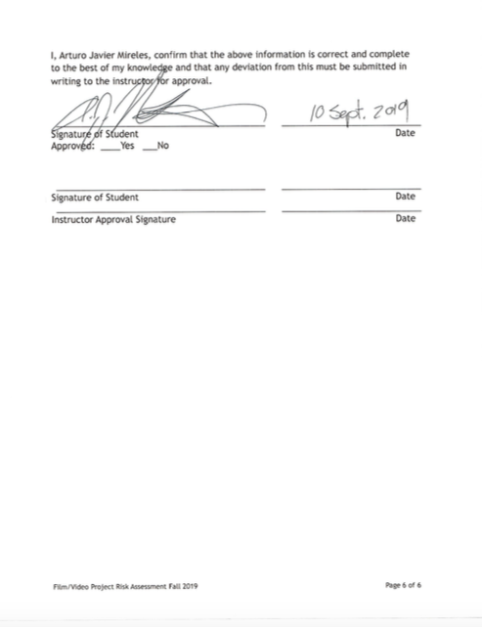
Risk Assessment

Slide 19
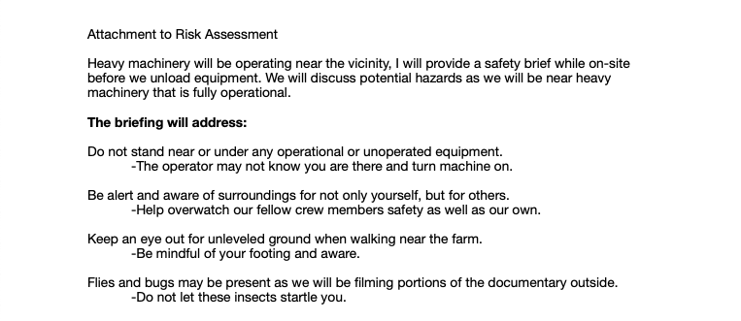
Risk Assessment Addendum

Slide 20
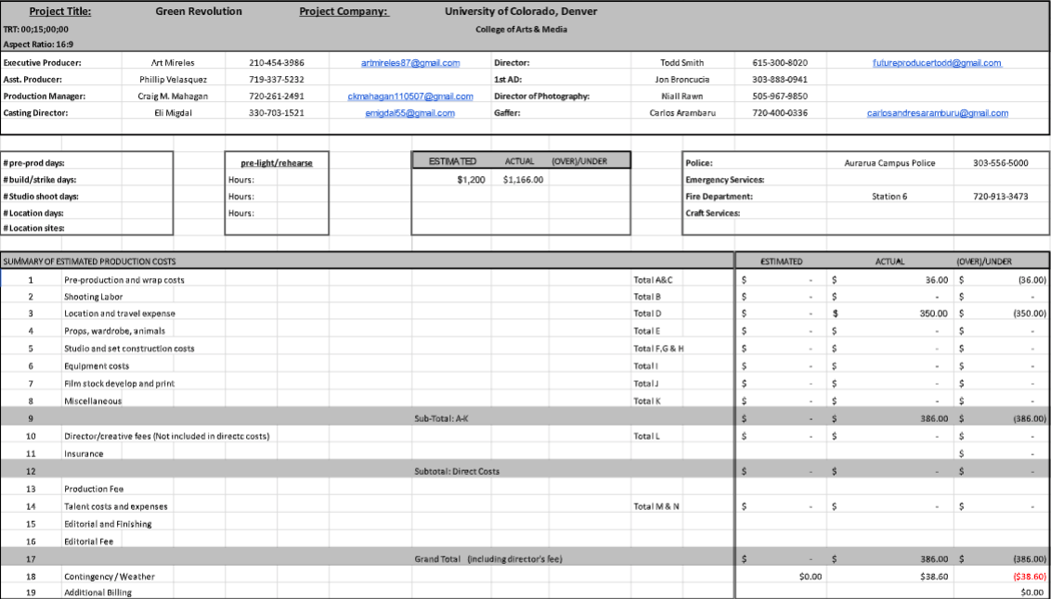
Budget

Slide 21
Equipment List
No Commercial Value:
Camera
Sony FS5 mk1
Sony A7Sii x2
Sony HDR 50 x2
DJI Osmo
Lenses
Sony Full Frame 24mm-240mm
Rokinon 24mm, 35mm, 50mm 85mm
N/D Filters 2,3,4 stops, UV filters, a Cir. Polarizer
Lighting
Britek 650w Halogen x 4
Smith Victor Cool 50 LED
Reflector Kit
Audio
TASCAM DR 70D
ZOOM H4N
Lavalier Mic x2
Shotgun and boom-kit
XLR Cables x 3
Stability
E-Image Tripod x 2
Travel Tripod x 2
Sandbags x 6
DJI Ronin
Shoulder rig w/Matte box
Fertile minds :
Lighting
Dracast
Grip
C-stand
Sound
Tascam

Slide 22
Releases

Slide 23
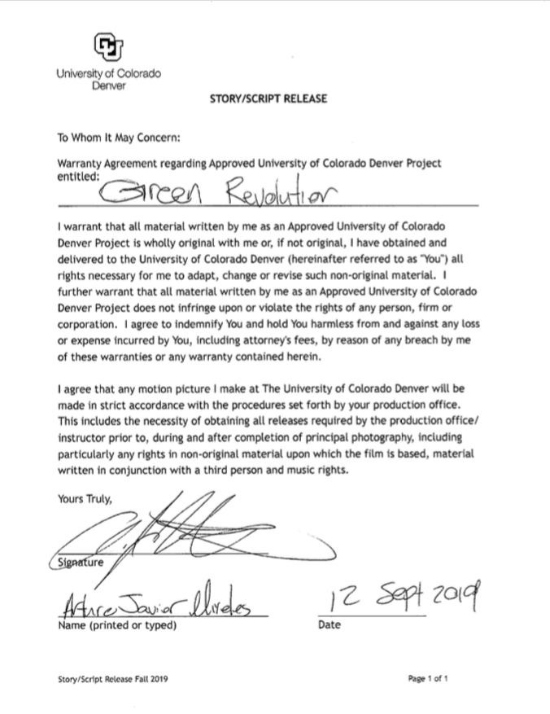

Slide 24
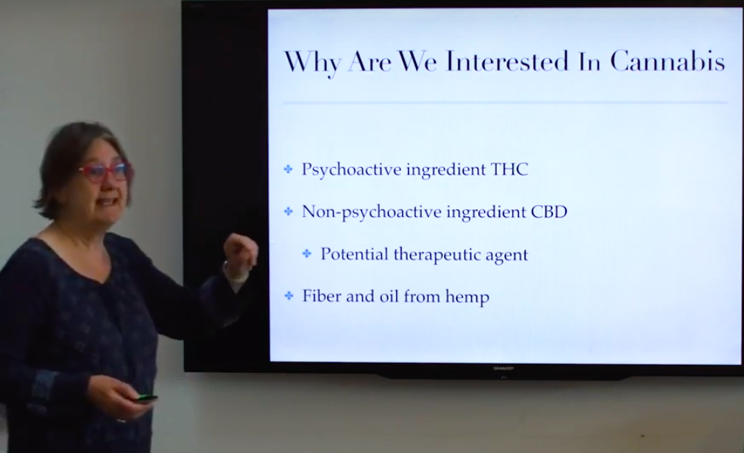
Dr. Vanessa Fishback 13 Sept 2019
Senior Instructor in the Department of Chemistry and Director of the Biochemistry program, developed and teaches CHEM 4421/5421 Cannabis Chemistry. Cannabis Chemistry is a one semester upper division or graduate chemistry course covering everything you would ever want to know about the science of weed.

Slide 25
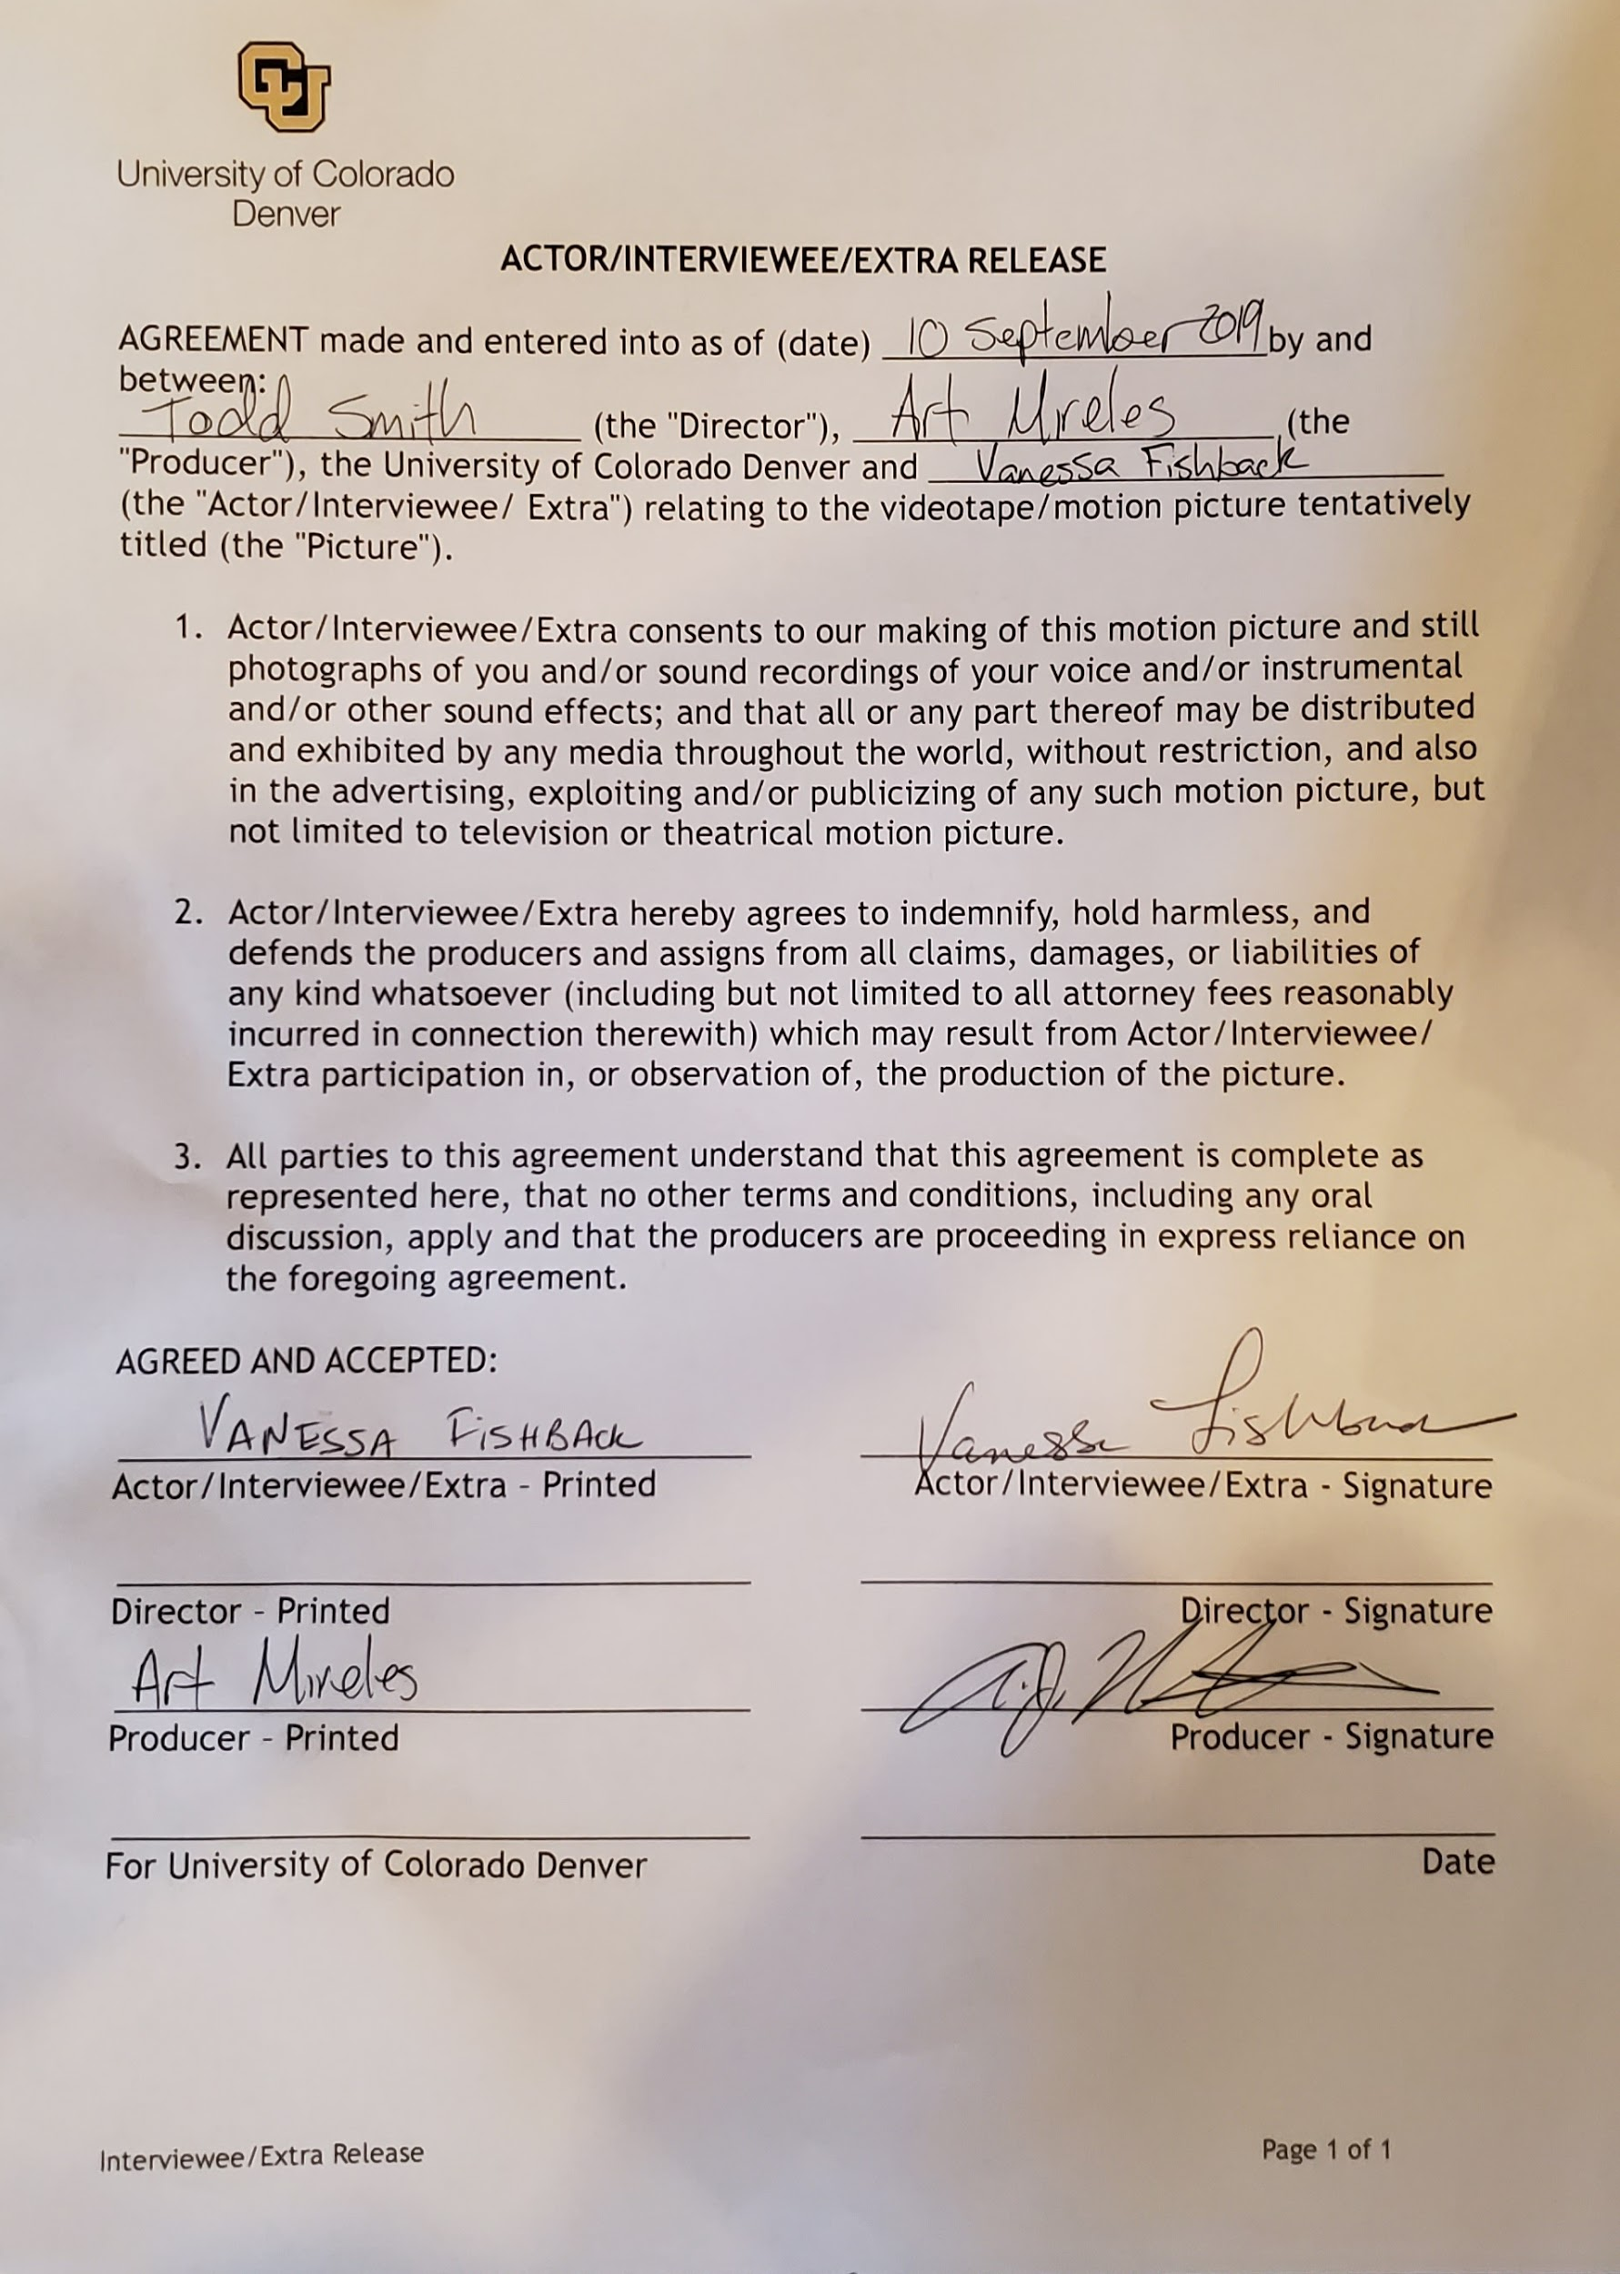
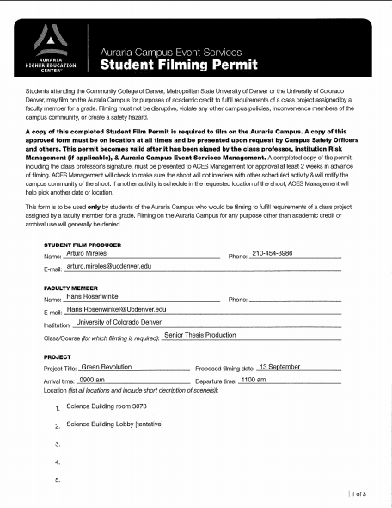
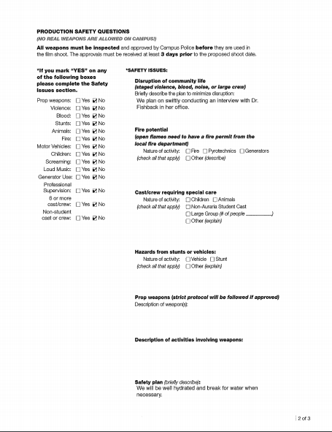
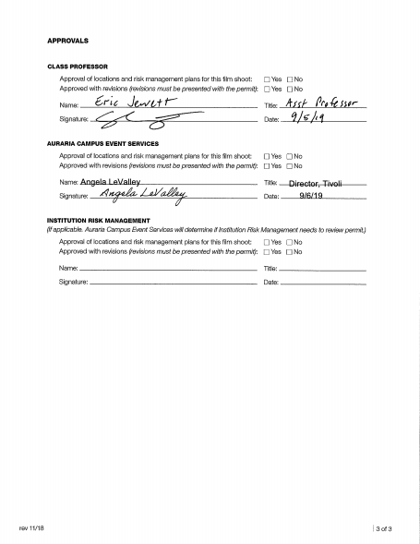

Slide 26
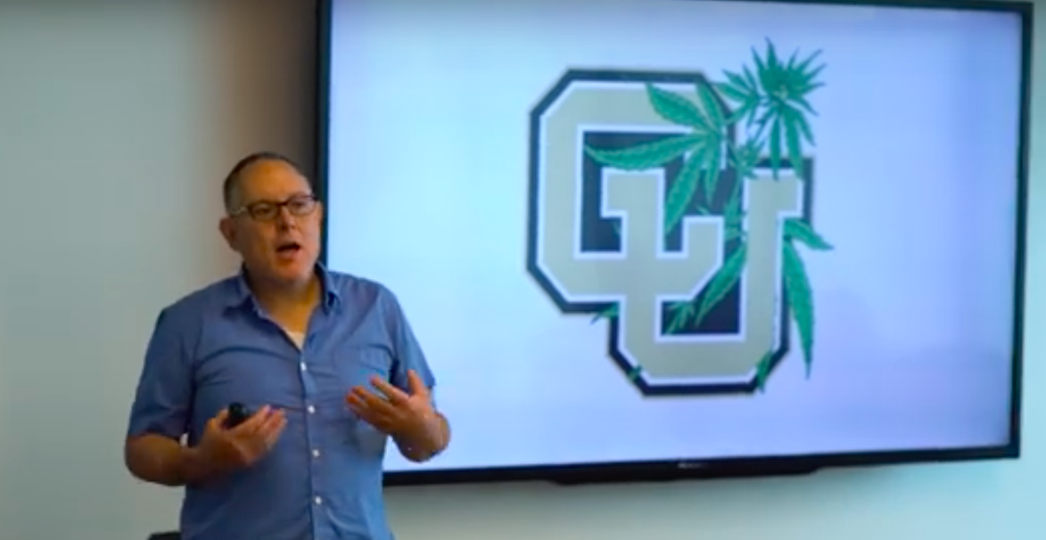
Dr. Marty Otañez 20 Sept 2019
Marty Otañez is a California-born cultural anthropologist and filmmaker. He is an Associate Professor in the Anthropology Department, University of Colorado Denver. Dr. Otañez’s research and advocacy extends to digital storytelling. In 2009-17, he conducted fifteen digital storytelling workshops with over 70 community members and administered university courses with digital storytelling assignments, creating over 375 digital stories.

Slide 27
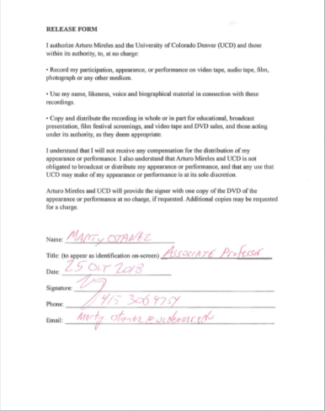

Slide 28
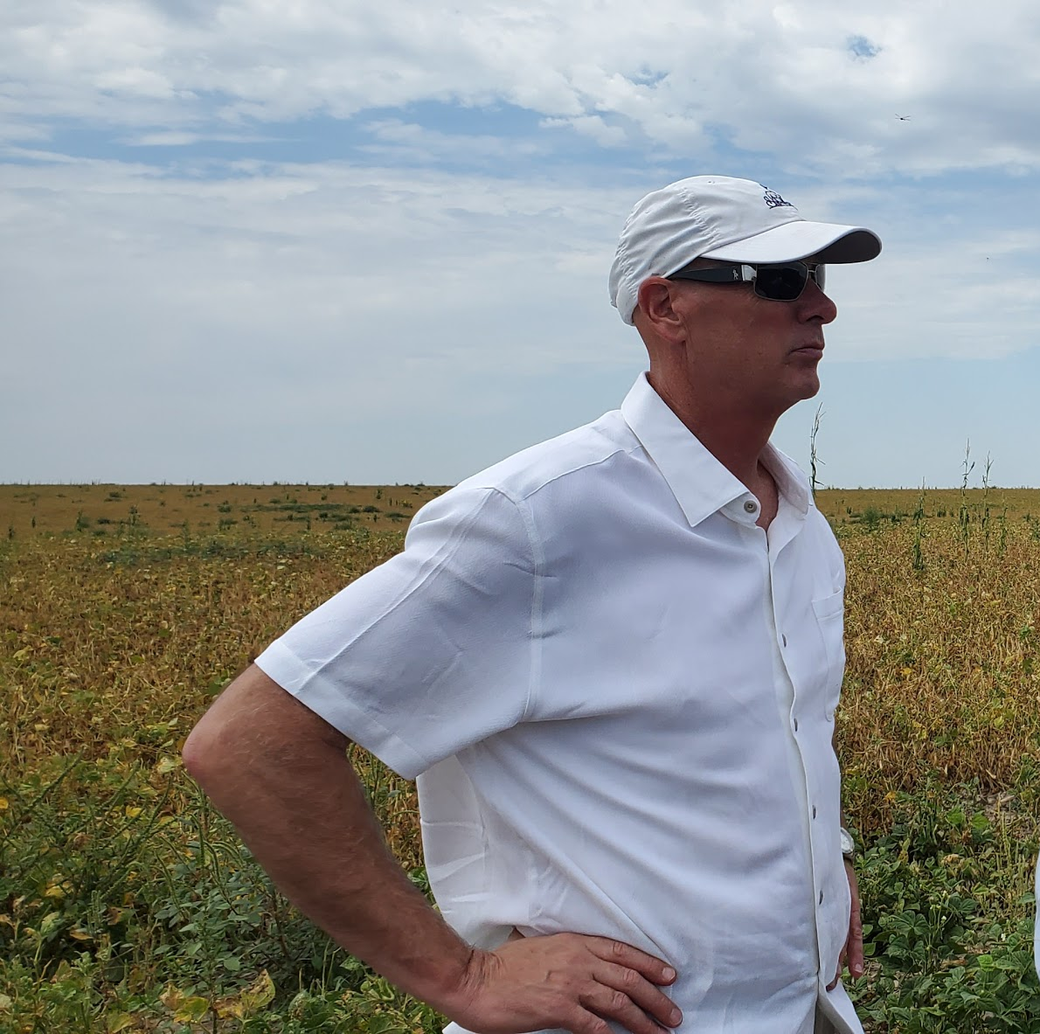
Ross King 11 October 2019
Ross King found interest in CBD after a car accident. After hemp helped him, he saw the value of the crop and ventured into the industrial hemp sector as he is starting up a vertically integrated hemp extraction facility that is driving commerce in the easter region of Colorado.

Slide 29
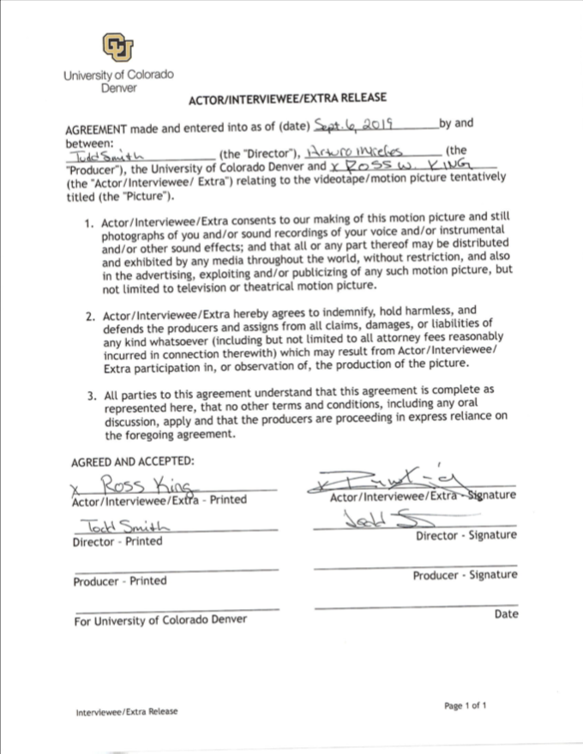
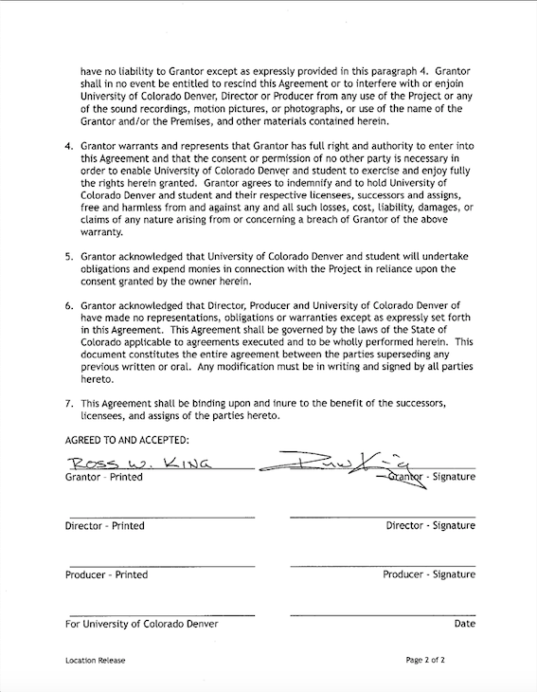
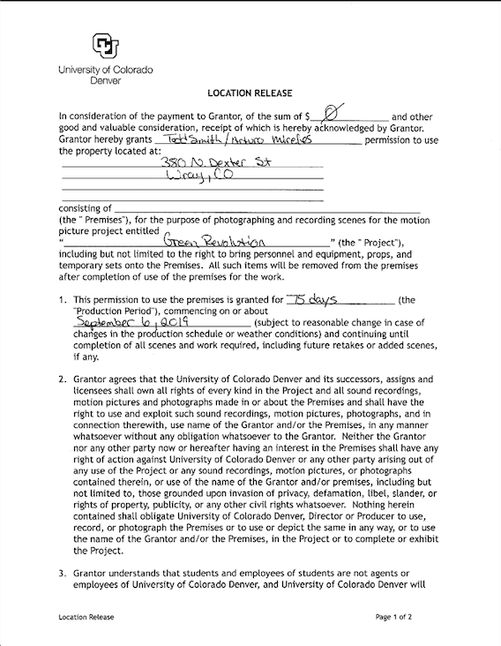

Slide 30
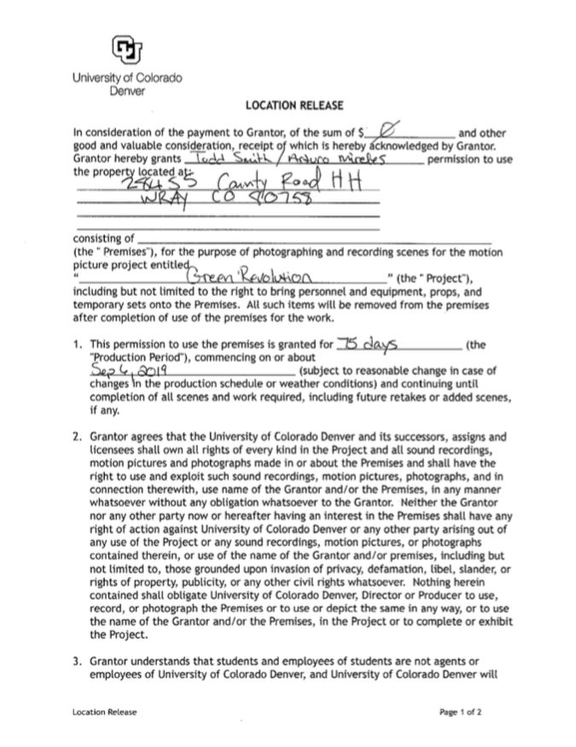
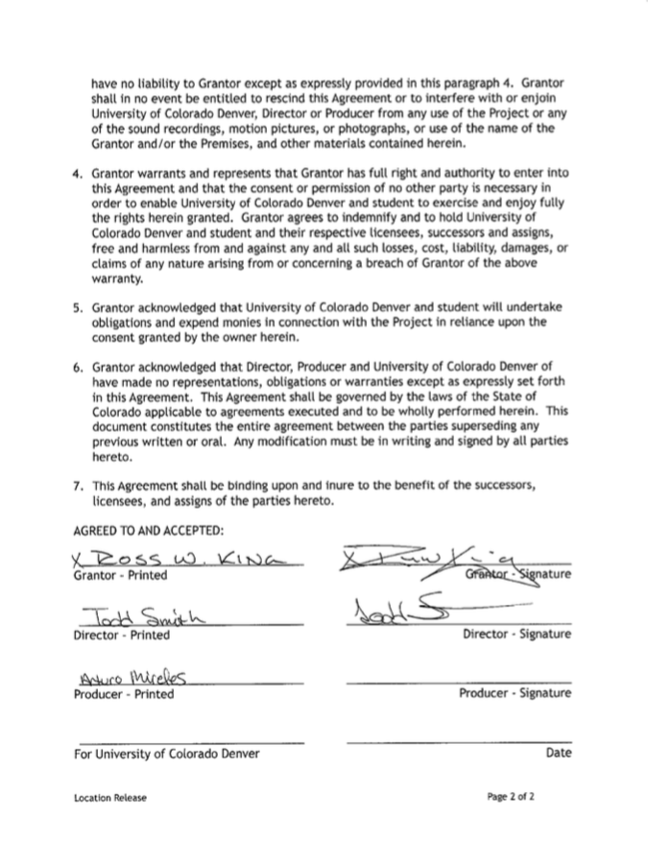

Slide 31
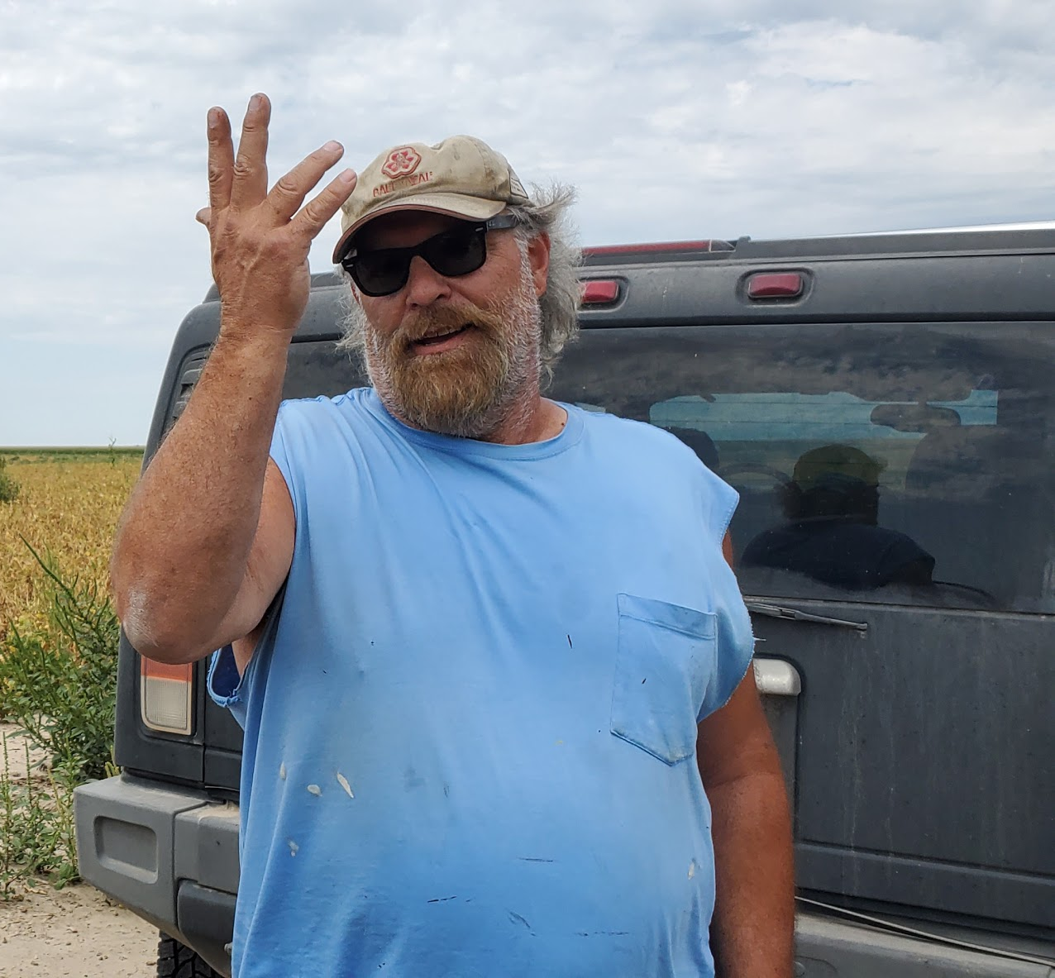
Stuart Ortner 11 October 2019
Stuart is the designer of the Kind Roots extraction facility and foreman of the crop fields.

Slide 32
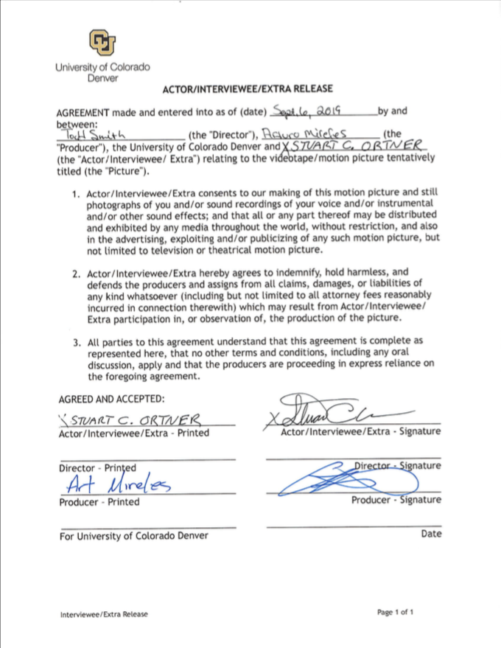

Slide 33

Food and Drug Administration TBA
The FDA has been contacted, but there is no representative for hemp at this time.

Slide 34
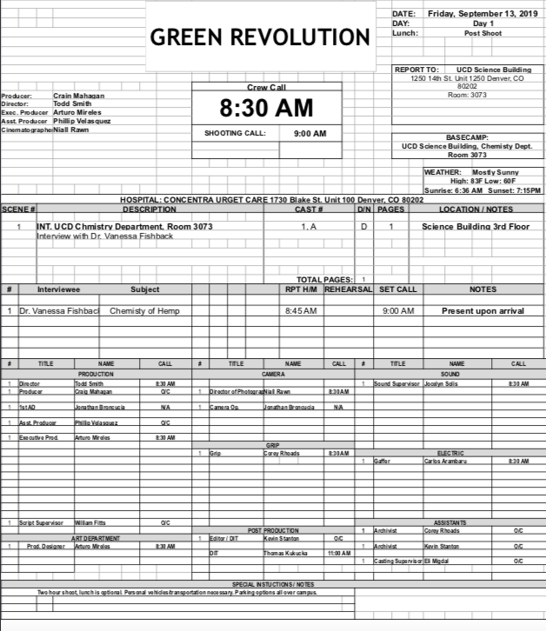
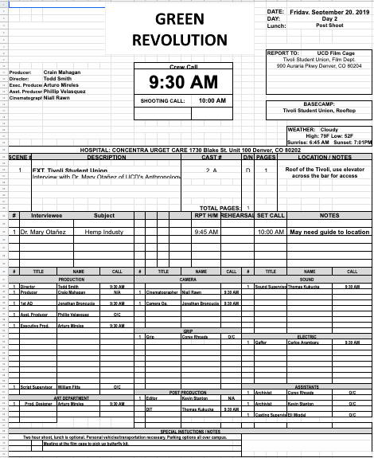
Call Sheets
September 13
September 20
October 11
October 18

Slide 35
LOCATION SCOUT

Slide 36
Science Building

Slide 37
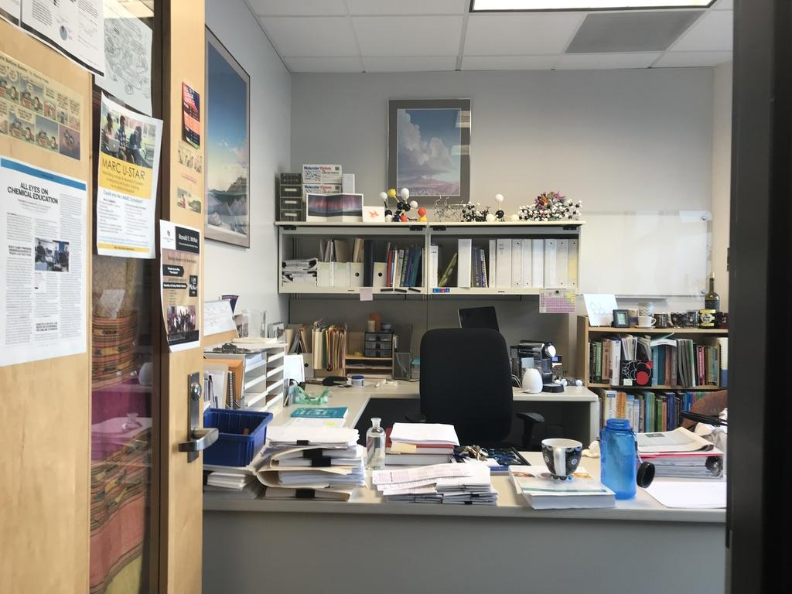
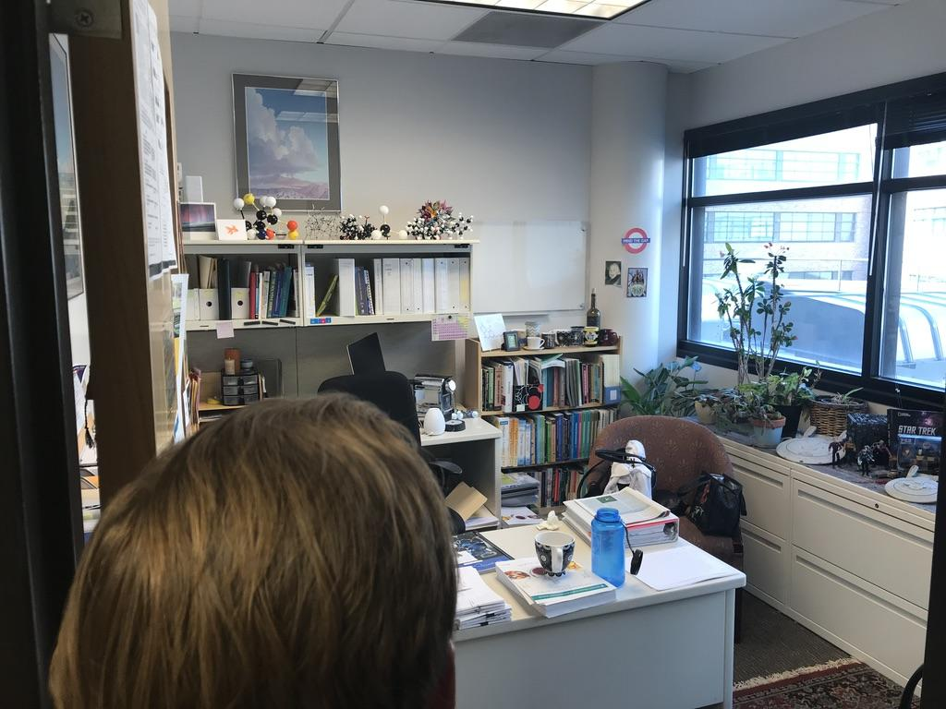
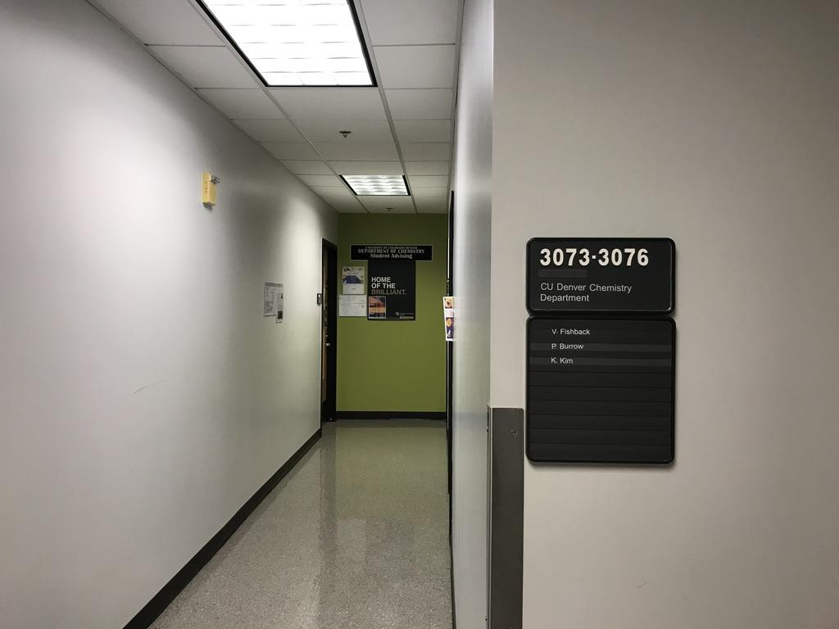
Science Building 1/5

Slide 38
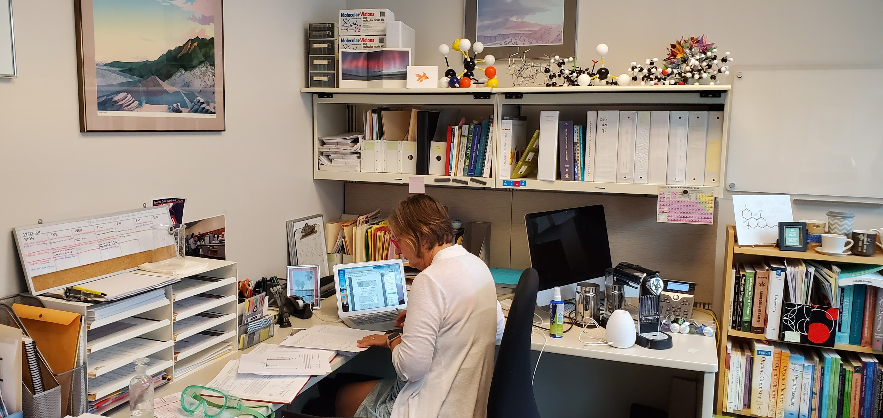
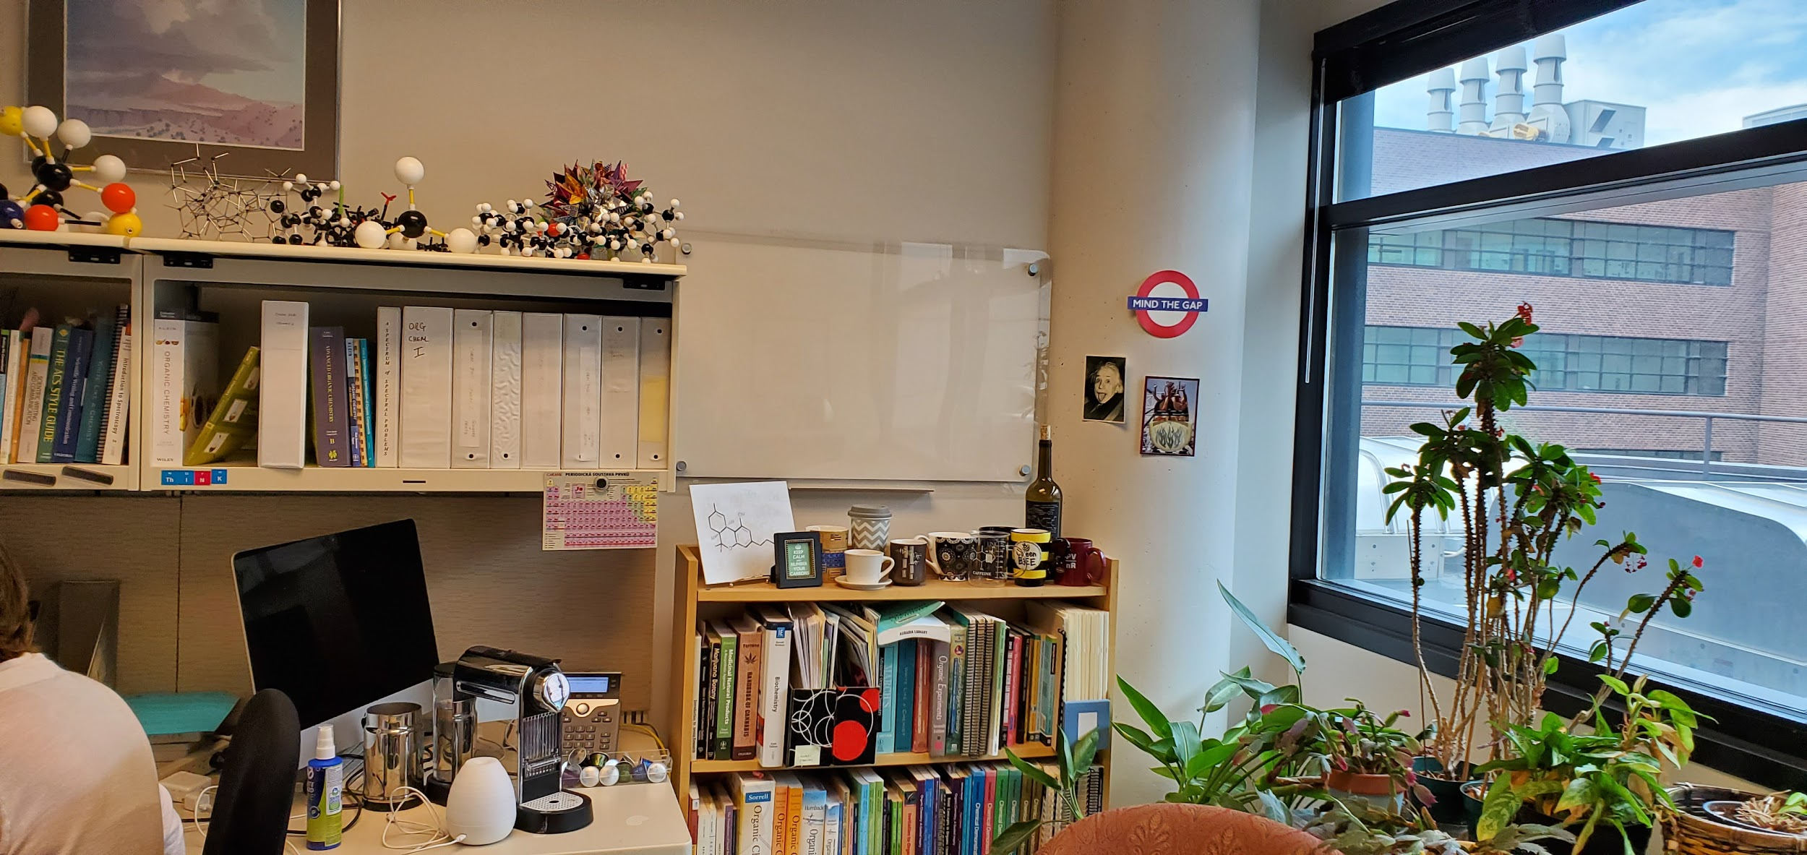
Science Building 2/5

Slide 39
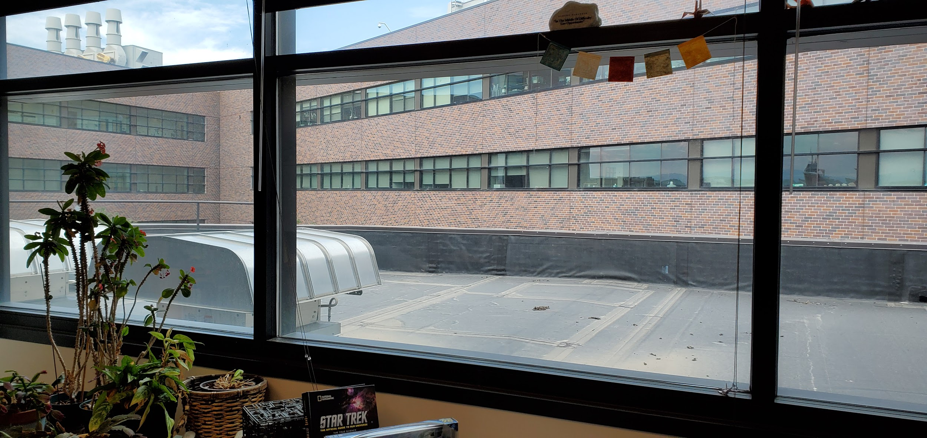
Science Building 3/5

Slide 40
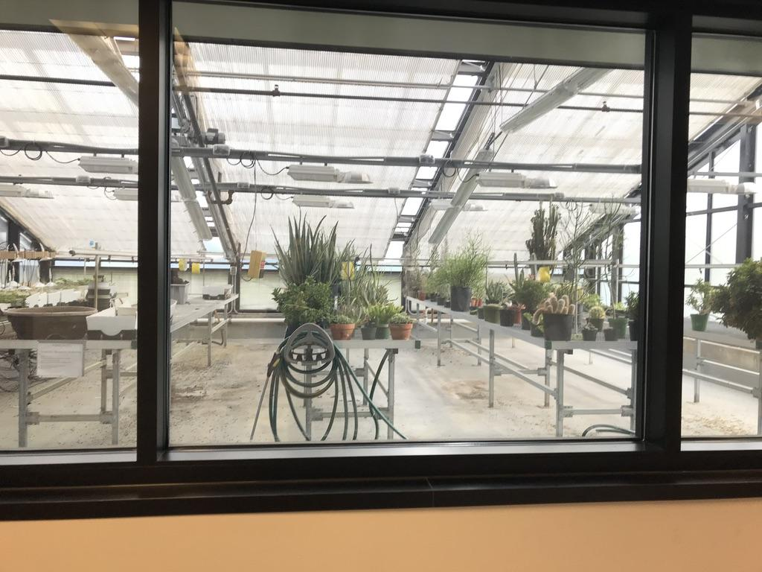
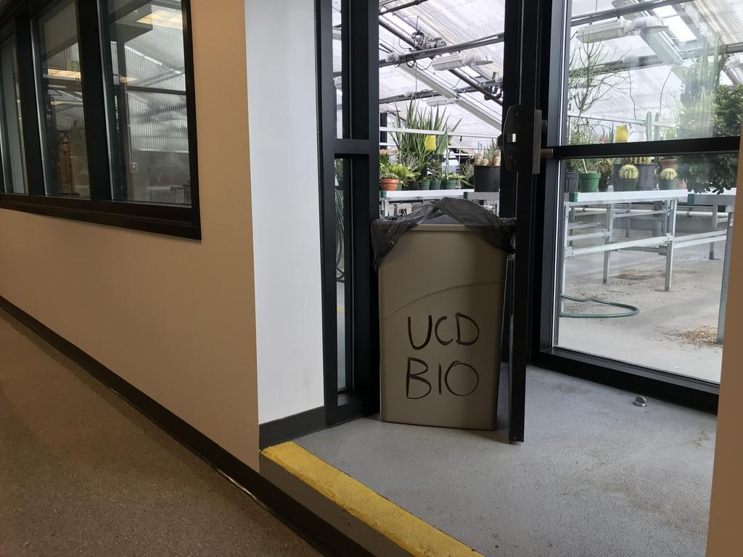
Science Building 4/5

Slide 41

Science Building 5/5

Slide 42
Tivoli Quad

Slide 43


Tivoli Quad1/2

Slide 44

Tivoli Quad 2/2

Slide 45
Extraction Facility

Slide 46


Kind Roots Botanicals 1/4

Slide 47


Kind Roots Botanicals 2/4

Slide 48


Kind Roots Botanicals 3/4

Slide 49


Kind Roots Botanicals 4/4

Slide 50
Farm

Slide 51

Kind Roots Botanicals Farm 1/4

Slide 52

Kind Roots Botanicals Farm 2/4

Slide 53
Kind Roots Botanicals Farm 3/4

Slide 54

Kind Roots Botanicals Farm 4/4

