Slide 1

Appleseed Ventures
Actors and Filmmakers
Hide Your Love Away
2021

Slide 2
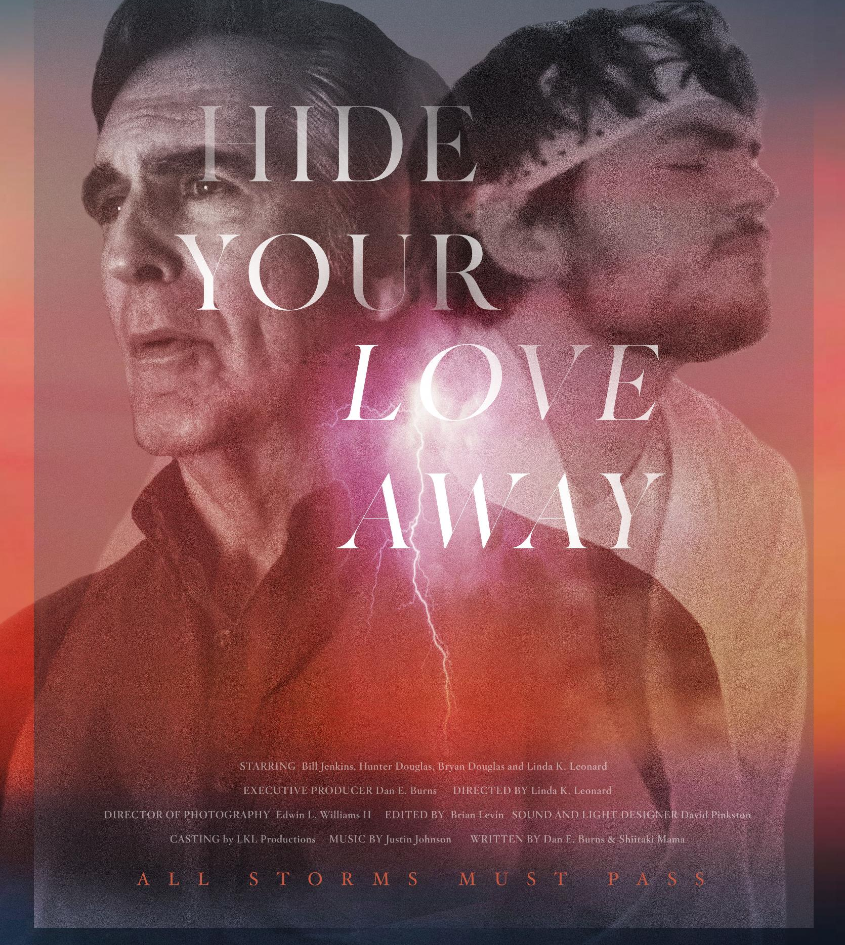
Autism, Suicide, and Hope
When a bullied, abandoned, autistic teen threatens suicide, his group home manager, an autism dad, must throw him a lifeline or sink in the storm.

Slide 3
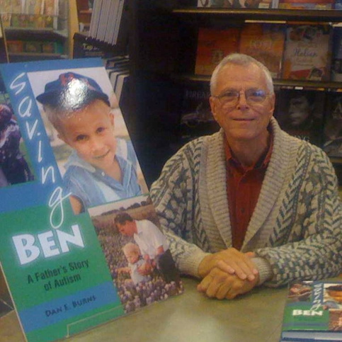
Dan E. Burns Writer/Producer
Dan E. Burns has been writing, producing, and directing documentary, educational, dramatic, and promotional films for over 50 years. While in school, he wrote and produced "A Time to Mend," a documentary about disabled children. He then wrote and produced the Eastman Kodak Company annual newsreel. Funded by Canada Council for the Arts, he wrote directed, and produced "Survival in the City" and "A Place in the Country," films about urban migration showcased on CBC.
Dan is an advocate for his son with autism, Ben. He co-founded a ranch for teens and young adults with autism in Austin, and wrote Dispatches from the Front, serially published in 2016, based on that experience. In 2020-21, with co-writer Shiitake Mama, Dan wrote and produced a short dramatic film, “Hide Your Love Away,” based on his experience working with teens and young adults on the autism spectrum. His production company, Appleseed Ventures, are considering producing a six-episode web series to include “Hide Your Love Away.”

Slide 4
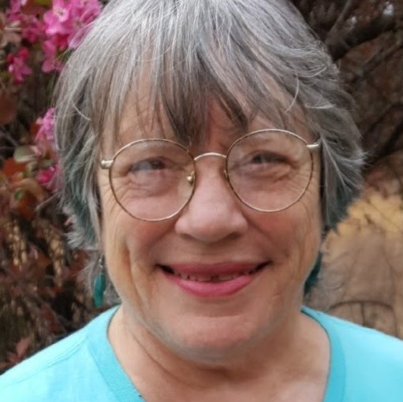
Shiitake Mama Co-writer
Co-writer Shiitake Mama, formerly Sandra Dutreau Perky Williams, PhD, has garnered national and international recognition for her essays, poems, scripts, and educational materials and films. A theatre professional for over 30 years and a theatre Artist in Residence, she has directed, taught, and developed scripts and improvised productions for university and community theatres. Her work in public schools focuses on at-risk kids, using improv and theatre games. She has collaborated with co-writer Dan Burns on numerous autism-related projects, including Saving Ben, A Father’s Story of Autism. www.shiitakemama.com

Slide 5
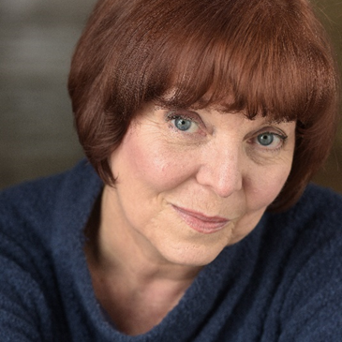
Linda Leonard Director
& Maggie
Linda K. Leonard has been a professional Director/Actor for more than 40 years in every medium of the Arts. Film, Theatre, Commercial and Industrial and Musical Theatre. She has received Critics Forum Awards, Leon Rabin Awards, Critics Choice Awards and many others, Linda is a member of Actors Equity, SAG/AFTRA, Women in Film and WAPN and is dedicated to the process of creativity and empowerment and healing. She is honored to bring our story to the screen.

Slide 6
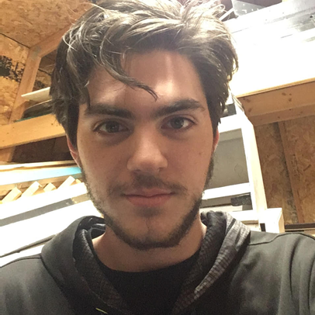
Starring
Hunter Douglas as Zero
Hunter Douglas is a graduate of Grand Prairie Fine Arts Academy and a current BFA Acting major at Oklahoma City University. Regional DFW credits include roles such as Will in American Idiot (Junior Players), Sky in Mamma Mia! (NTPA Repertory Theatre), and Ellard in The Foreigner (Tarrant Actors Regional Theatre)

Slide 7
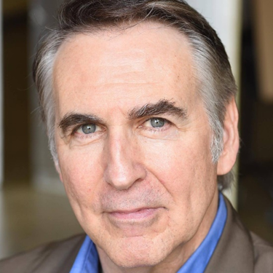
William Jenkins III as Josh
On stage, Bill Jenkins (Josh) has been a member of Actors’ Equity for 37 years. He is also active in film, TV, commercials & voice dubbing for Japanese Anime. He has played opposite Diane Keaton, Josh Brolin & was directed by Oliver Stone. He has portrayed three American Presidents, received two Critics’ Forum Awards, a Theatre Three Patrons’ Favorite Award & is deeply grateful for his beloved ‘partner in crime’, Linda Kay Leonard.

Slide 8
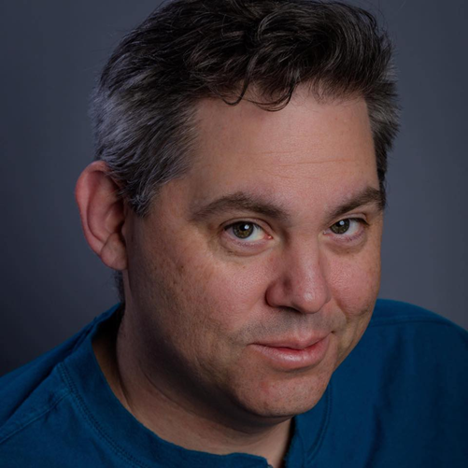
Bryan Douglas as Buck
Bryan Douglas is a DFW area actor and theatre technical designer. Graduated from Park University in 1998. Apprenticed as an actor with Vassar College NY Stage & Film’s apprentice program. Represented by Grit Talent.

Slide 9
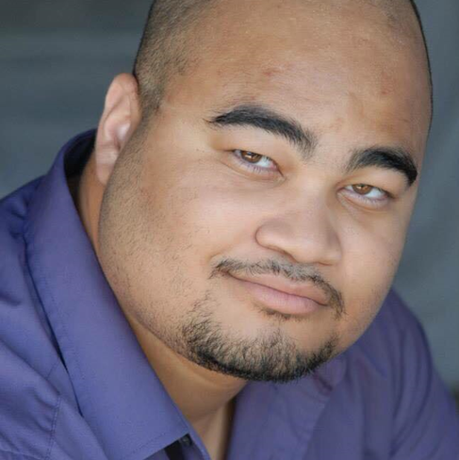
Edwin L. Williams II Cinematographer
Edwin L. Williams II started his acting and filmmaking career in 2014. He has an Associate in Acting Performance degree from KD Conservatory in Dallas and has appeared in feature films, TV commercials and short films. He has produced short films and web series through his company Digital ELW Productions.

Slide 10
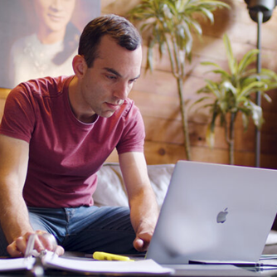
Brian Levin - Editor
Brian is a director, producer, and editor based in Los Angeles. He runs a boutique production company called Forge and Discover, which is focused on helping creatives bring their stories to life. As an editor, Brian has had a lot of success crafting a variety of different films, from feature length narratives to broadcast and short documentaries. He's been editing films since an early age, and has carried that passion for filmmaking with him from childhood until now. Though the technology may have changed, his enthusiasm has not. You can learn more about Brian at www.forgeanddiscover.com

Slide 11
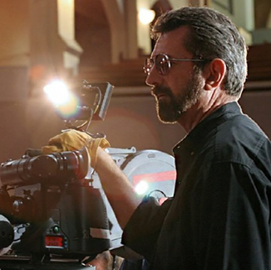
David Pinkston – Lights and sound
David has been a professional cinematographer and freelance editor since 1980. His film and video projects include features, shorts, documentaries, commercials and web base interactive videos for corporations. He has a Master of Fine Arts in screen writing and directing from the Vermont College of Fine Arts and additional training from the American Society of Cinematographers and the IMAX Corporation.

Slide 12
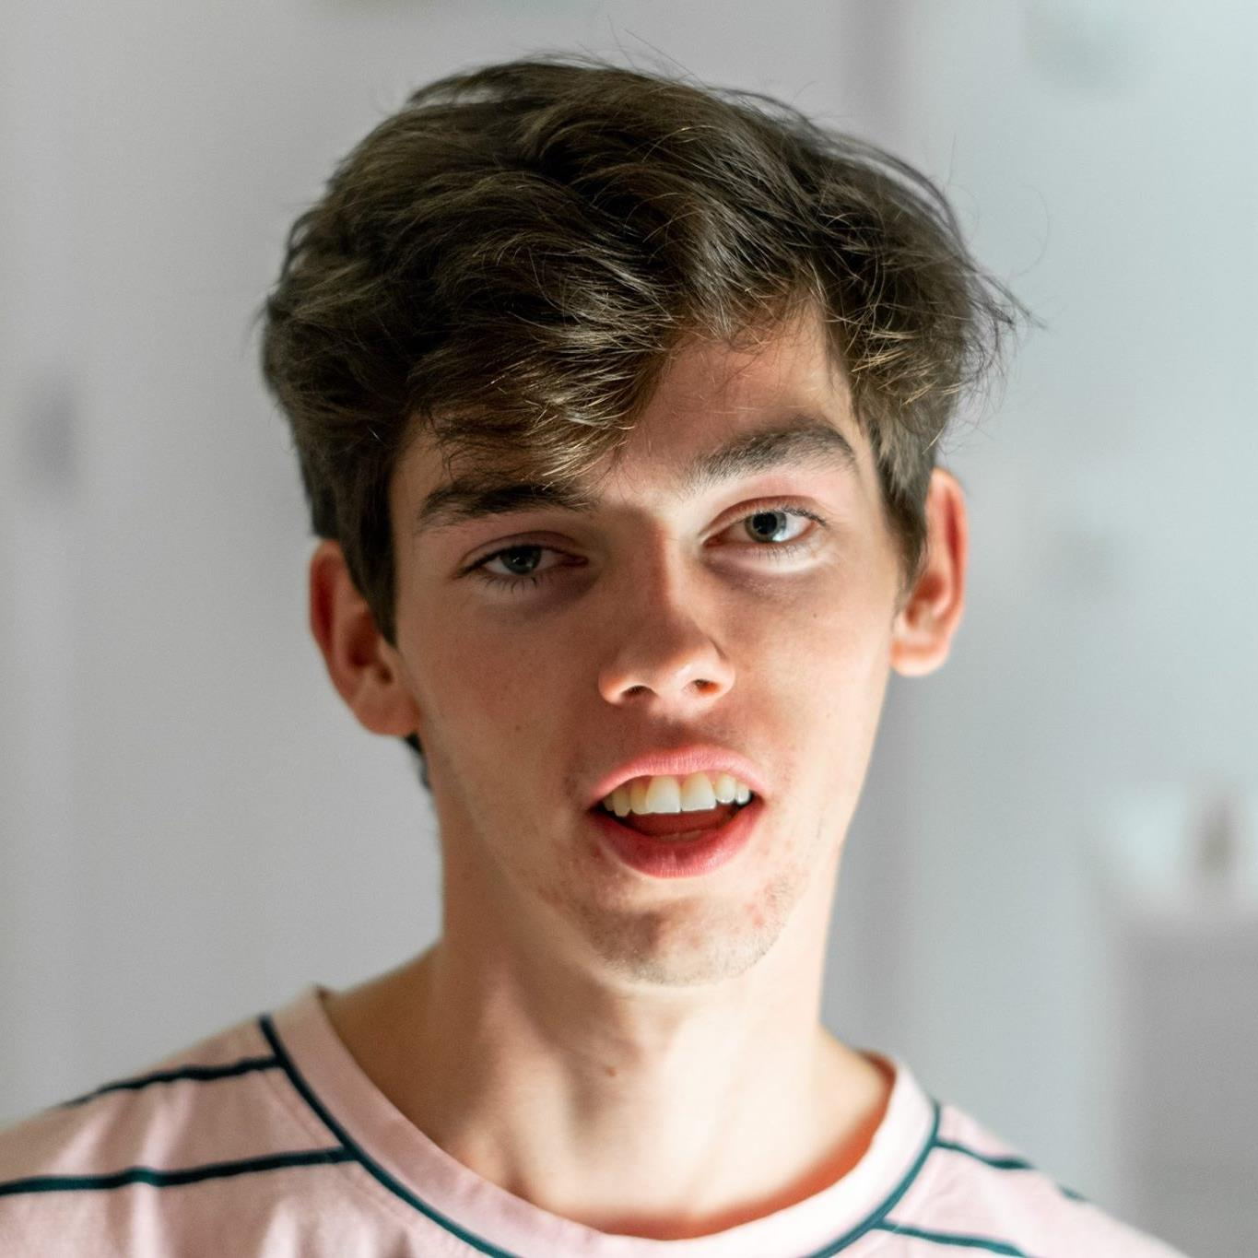
Ben Klewais – Visual Effects
Ben Klewais is a VFX artist from Belgium. He has a background developing mobile apps and websites from his degree in Multimedia.
In 2017 he did an internship in Los Angeles to pursue his interest in visual effects and since then has been working with social media creators Zach King and Aaron’s Animals.

Slide 13
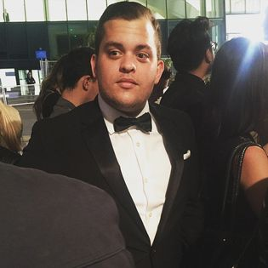
Andrew Adams - Poster
Creative Director at Atomic Productions
Past: Total Frat Move
Studied at The University of Texas at Austin
Attended from 2008 to 2012
Lives in Dallas, Texas

Slide 14
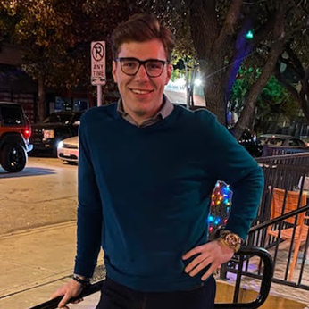
Justin Johnson – Composer and Lyricist
Justin Johnson has been a resident of Dallas, TX for 8 years. An implant from Texarkana, TX, He has performed at numerous venues with multiple bands as a vocalist. It was only recently that he decided to take on composing and producing his own music. “I have so enjoyed working with this amazing cast and crew of highly talented individuals! I look forward to many more projects together.”

Slide 15
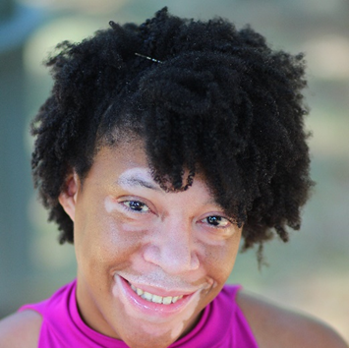
Ilyssa Pettigrew - Voiceover
Ilyssa Pettigrew is a native Texan who is also an actress, writer, and an audio-technician for evening voiceover classes at KD conservatory. She makes her voiceover debut in the film “Hide Your Love”

Slide 16
Headshots & Bios
Appleseed Actors and Filmmakers
END

