Slide 1
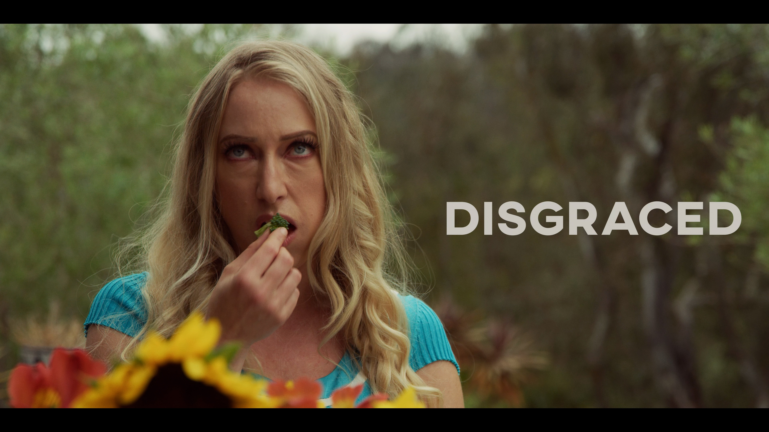
The Web Series
Created by Victoria Vertuga & Eric Williford

Slide 2
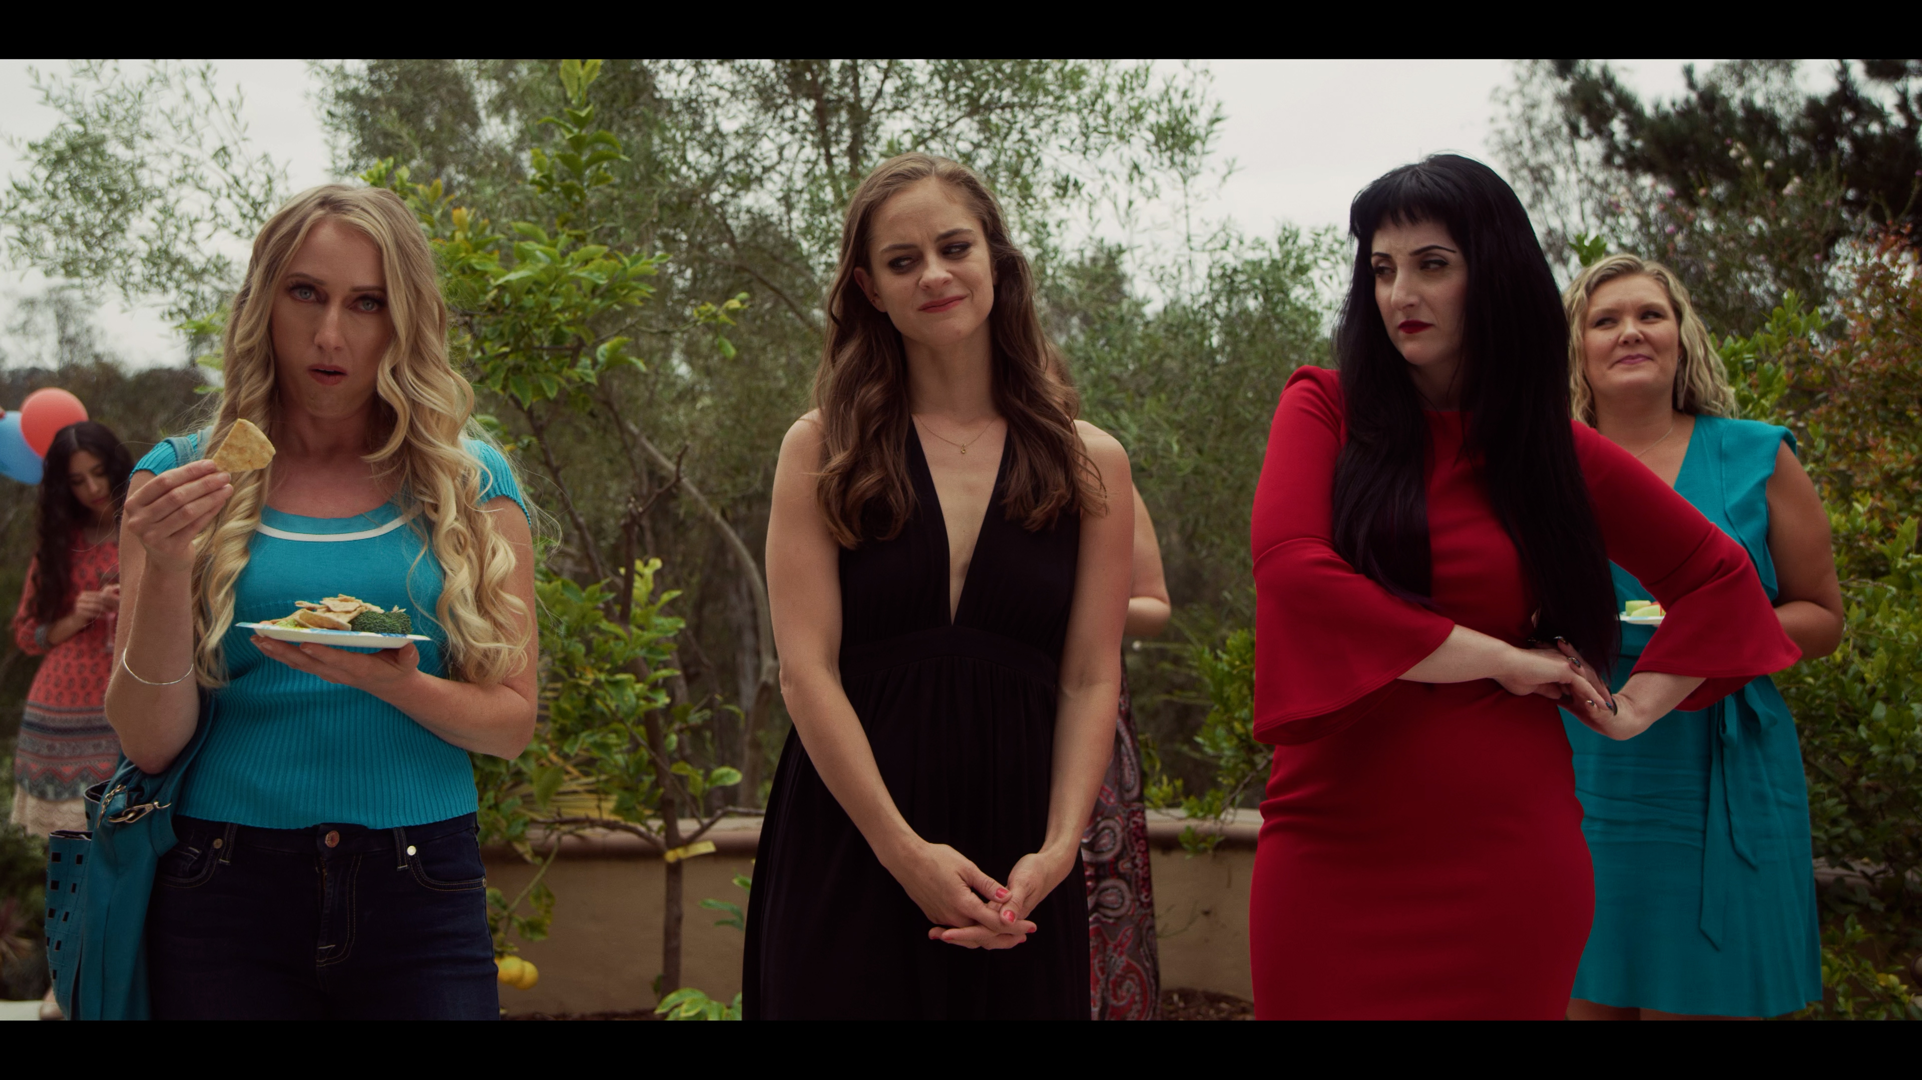
Logline:
5 years after her big break turned out to be a big flop, a struggling actress asks herself how much humiliation she’s willing to endure for another chance to make it.
DisGraced The Series

Slide 3


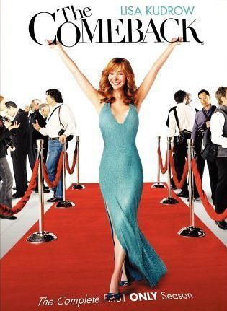
COMPS

Slide 4
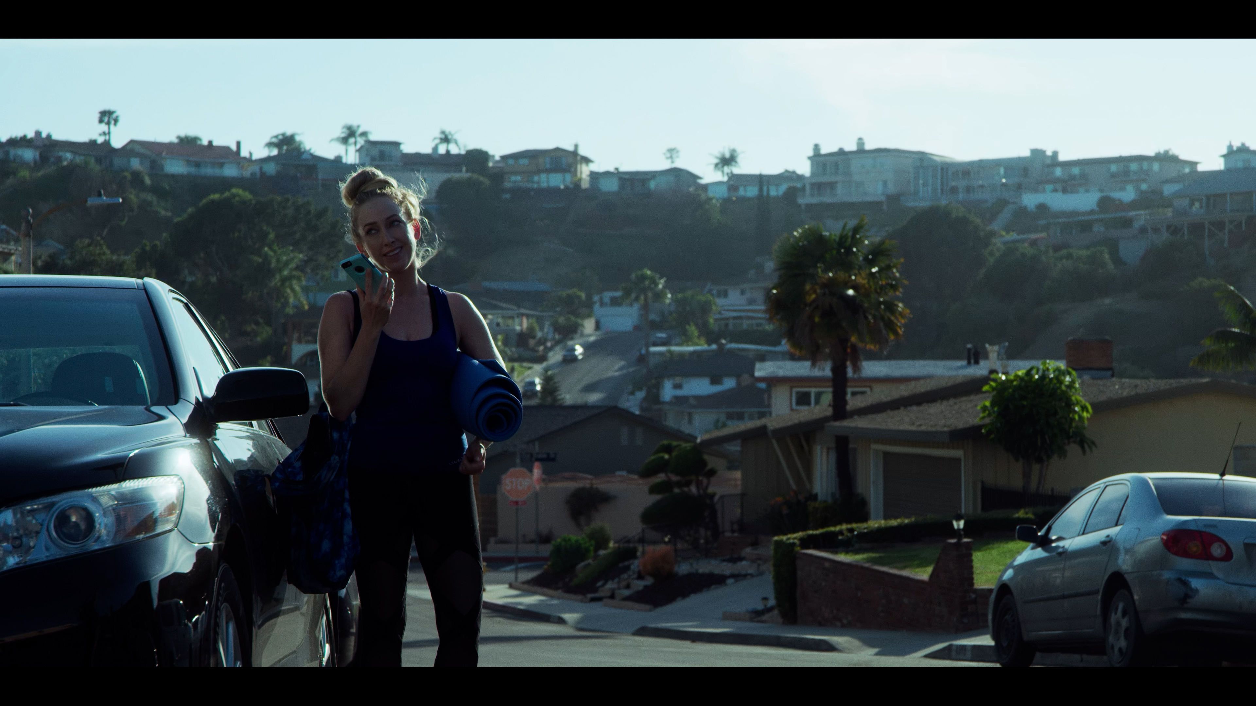
The Deets
Darkly Comedic Webseries
Season 1:
8 episodes
<10 min runtime per episode
Half Hour Single Cam Pilot Script In Progress

Slide 5
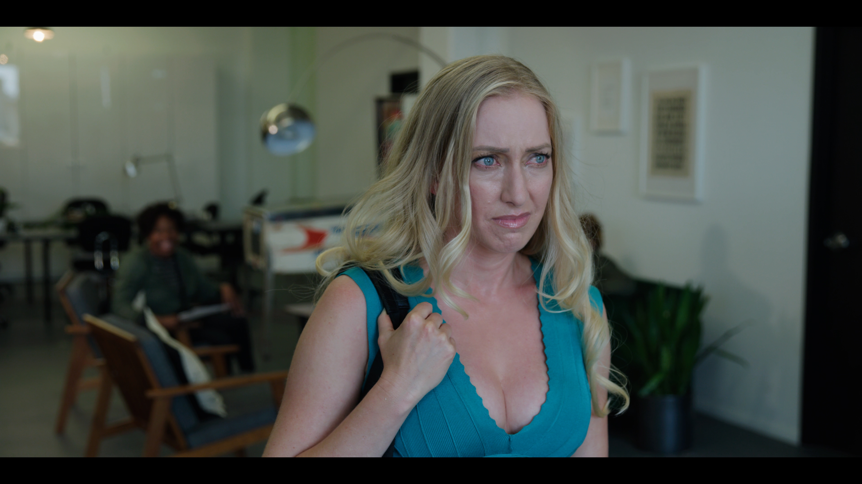
PILOT SYNOPSIS
Grace Greene is having a very, very bad week. There have been many like it in the years since her fall from, well, grace, after her brief 7.5 seconds of fame due to securing the female lead in the third installment of an action franchise. Now, it’s five years later and she’s attempting to claw her way back to the middle. This particular bad week’s bundle of delights include finding out her little brother’s “influencer” girlfriend is getting a deal with HBO, getting an audition for the role of “beautiful woman” only to find out it’s actually for the role of “once beautiful woman,” going on a very, very awkward date with a guy who turns out to be a fan, and getting slut shamed during an agency meeting. Fed up, she decides to take her best friend’s advice and attend a session with a pseudo therapist.

Slide 6
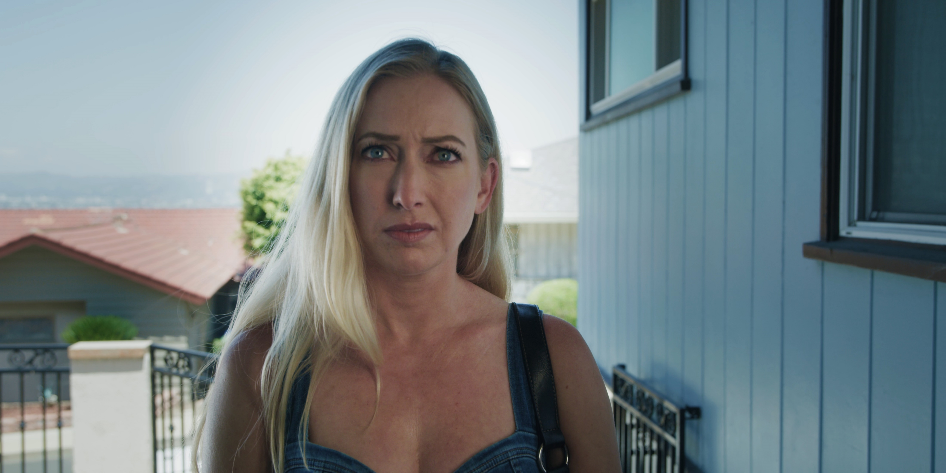
GRACE GREENE
Not quite a has been, more an almost was. Touted to be the next Hollywood It Girl, her 15 seconds of fame only lasted about 2.5. Still harboring anger and resentment about being blamed for the movie’s failure and endlessly slut shamed for her nude scenes while her former co-star blew up to serious stardom. Constantly trying to find the line between standing up for herself without being a total bitch and being polite and professional without letting people walk all over her.

Slide 7
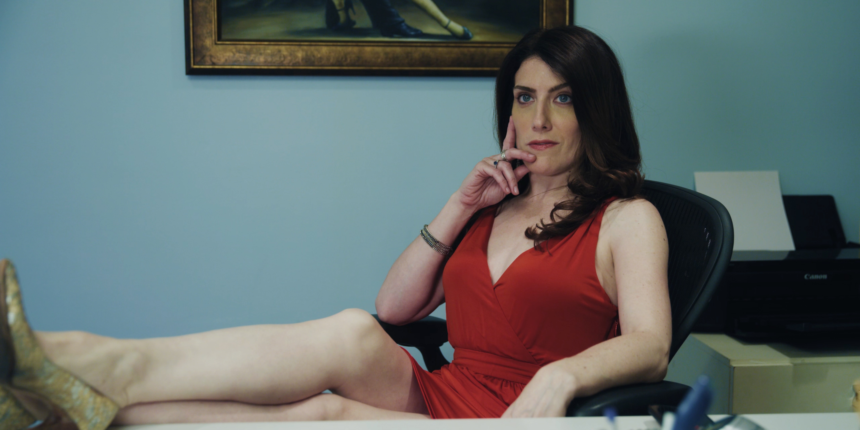
PAULINA
Agent to the stars, or at least to the wannabe stars. Self-absorbed is putting it nicely. Knows everyone who is anyone and knows exactly how much she should suck up to them. If you’re a no one, then she has no time for you. Almost every time we see her, she is being manicured, massaged, buffed, styled, fed, or otherwise catered to by an endless parade of poor, mistreated employees.

Slide 8
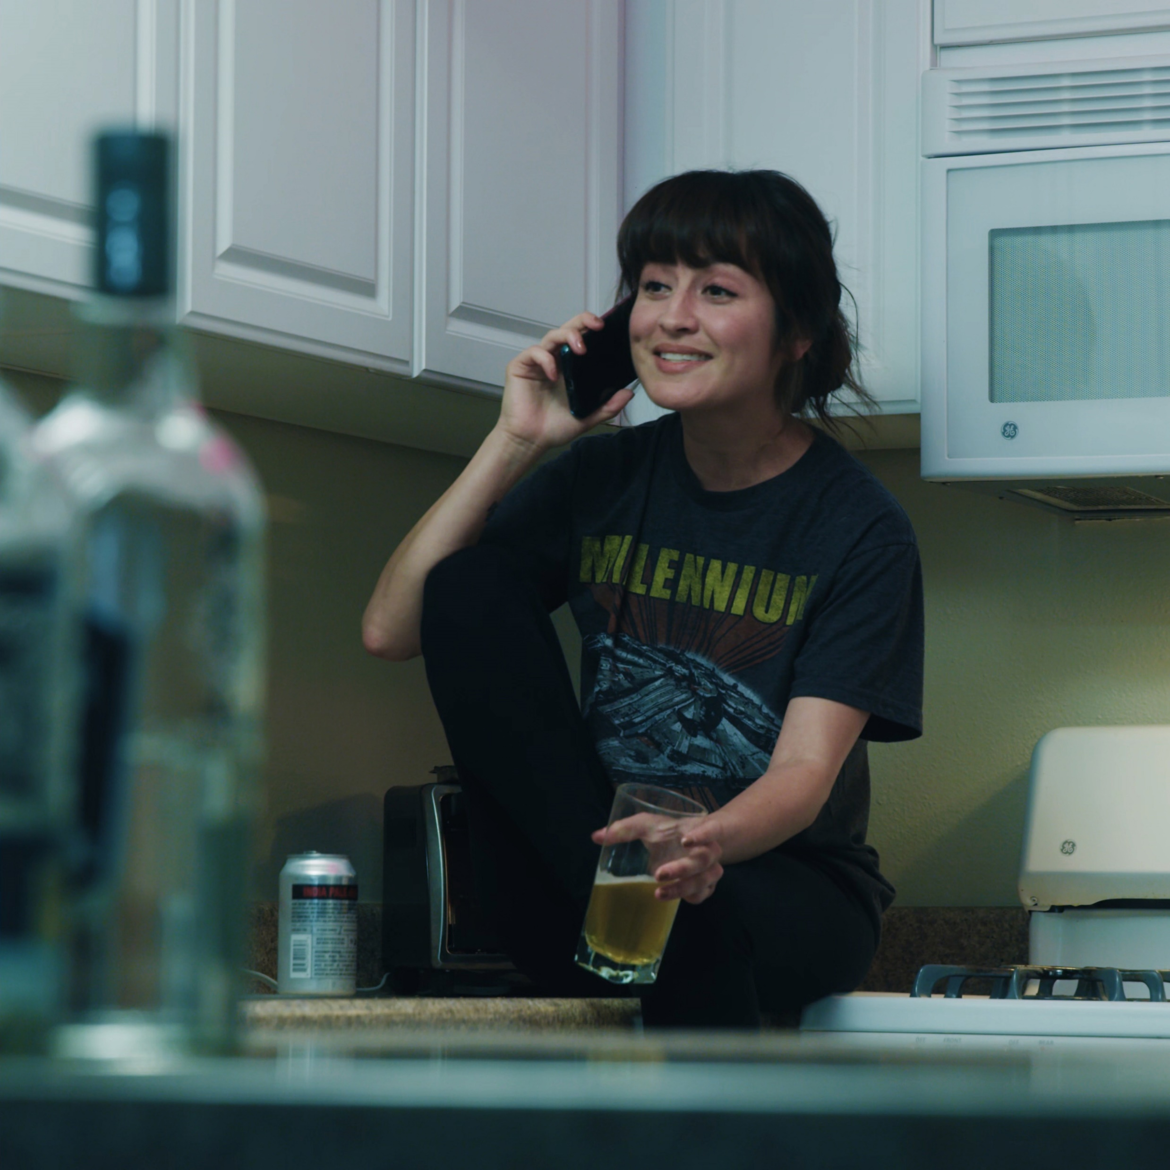
FOOTSY
The yin to Grace’s Yang. As laid back and worry free as Grace is neurotic and tightly wound. Has her own “weed delivery” business and has a large rolodex of clients. Non-conventional in every sense of the word. If she was a man, she’d be called a “ladies man.” “Lady’s lady” doesn’t quite have the right ring to it.

Slide 9
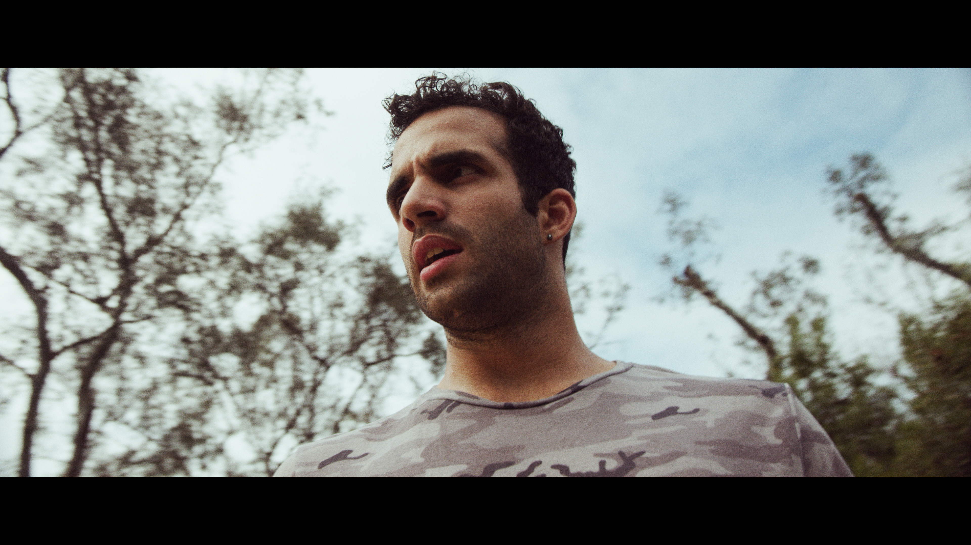
DEREK DASHEN
Derek was Grace’s co-star on Quick and Angry 3. He went on to become one of Hollywood’s most in demand action stars while Grace became persona non grata and the face of the movie’s failure. Charming and charismatic but not the sharpest tool in the shed.

Slide 10
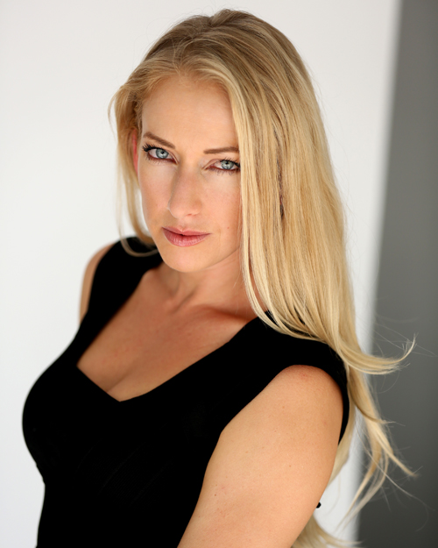
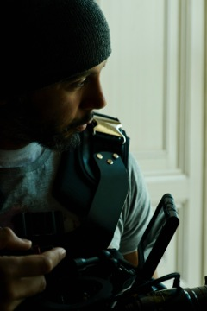
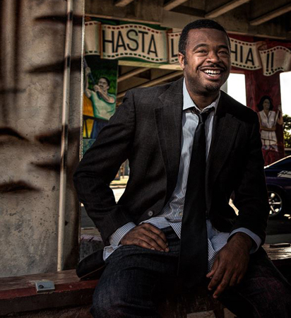
THE TEAM
VICTORIA VERTUGA
ERIC
WILLIFORD
FRANKLIN
GUERRERO, JR.
CREATOR/ DIRECTOR/
PRODUCER/STAR
CREATOR/DIRECTOR/PRODUCER
DIRECTOR/DP/
EDITOR
Notes:
Photo by Unsplash

Slide 11

VICTORIA VERTUGA
Creator/Director/Producer/Star
Sick of playing endless variations of “hot blonde #3” and “the chick the lead actor hooks up with” Victoria ventured into writing. She is now a writer/director/producer/lover of slashes.
Together with her writing partner Eric Williford, they have penned multiple pilot and feature film scripts. Their pilot “The Other City” was recently a semifinalist at the highly competitive Austin Film Festival, and their pilot “Tithes” was recently a semifinalist at The Script Lab.
Notable credits include: Dexter, Days Of Our Lives, If Loving You is Wrong and The Trap on Netflix.
When not acting, writing, or producing she is a core team member of the nonprofit Angel City Pitbulls which is a resource for everything pitbull in Los Angeles with a particular emphasis on serving the South LA community of pitbulls and the people who love them.
Notes:
Photo by Filipe de Rodrigues on Unsplash

Slide 12
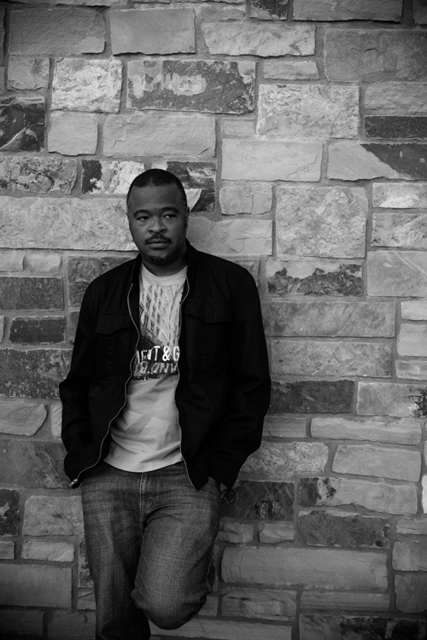
ERIC WILLIFORD
Creator/Director/Producer/Editor
After graduating from the University of North Carolina at Wilmington, Eric Williford produced and wrote his first feature length project, the supernatural horror film “The 8th Plague”. This film was immediately picked up for distribution by Anthem Pictures.
Immediately upon the release of “The 8th Plague”, Mr. Williford produced another feature-length horror film titled “CARVER”.
On March 4th 2008, “CARVER” was released worldwide to overwhelming critical acclaim and a cult following amongst horror fans. The film was released domestically by Allumination Filmworks and Internationally by Dream Entertainment.
His webseries “Dollar” was nominated for best writing at the 2018 Brooklyn Webfest.
“Anora”, a feature length horror screenplay written by Mr. Williford, was a semifinalist in the 2018 Screencraft Horror Screenplay Competition.
In September of 2018 Mr. Williford released the horror short film “We Accept Cash”, a film that he co-wrote, directed, edited, and co-produced with his producing partner Victoria Vertuga. The film played at the 2019 Short. Sweet. Film Fest and the 2019 Hollywood Comedy Shorts Film Festival.
Notes:
Photo by Filipe de Rodrigues on Unsplash

Slide 13
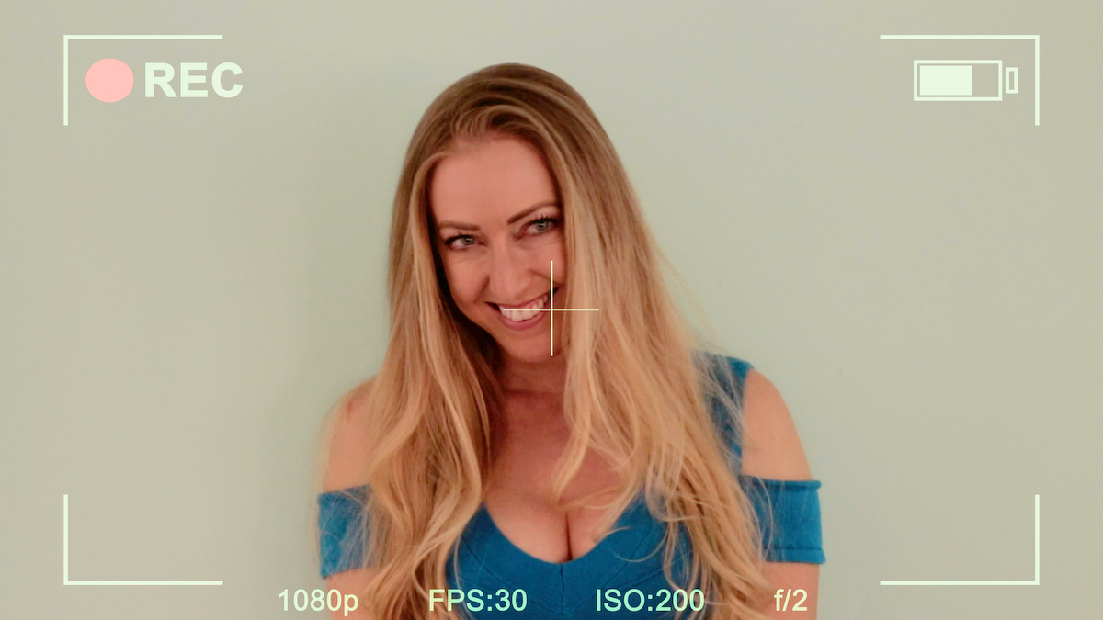
Creator’s Statement
At first glance, DisGraced may seem like yet another show about Hollywood and acting. And, sure, on some levels, it is. But what it’s really about is learning how to be an active participant in your own life instead of just letting life happen to you. Grace’s journey begins with her simply letting the waves and whims of the industry push her around, letting other people define her and dictate who and what she should be. The series follows her as she finally learns to control her own narrative and her own destiny. DisGraced is a show for anyone who has ever felt frustrated and powerless in their life. It’s about finding the inner strength to take the reins and take control.
But it is about Hollywood, right?
Yes. But this is not Entourage. DisGraced is told from an unapologetic and undeniable female POV. DisGraced explores the mundane but seemingly countless and endless forms of sexism that an actress faces in the industry. It examines the non-glamorous, unsexy life of someone who has fallen back down to the oh so undesirable position of low man, or woman, rather, on the totem pole. It is not glitz and glamour and red carpets. It’s being told you’re too fat, too old, not sexy enough, too sexy, too dumb, too blonde, too whatever and also not whatever enough day in and day out. It’s about how the industry tries to define actresses based on their looks or their histories and the many ways their pigeonholed.

