Slide 1
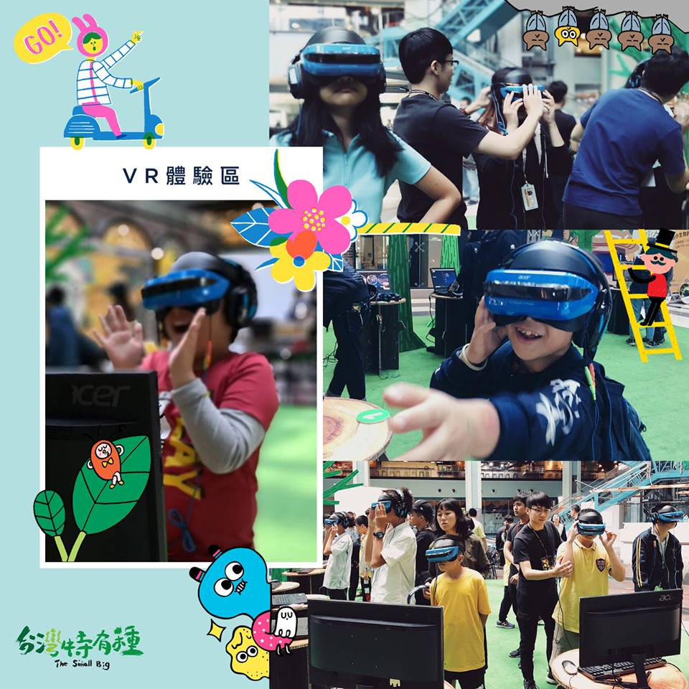
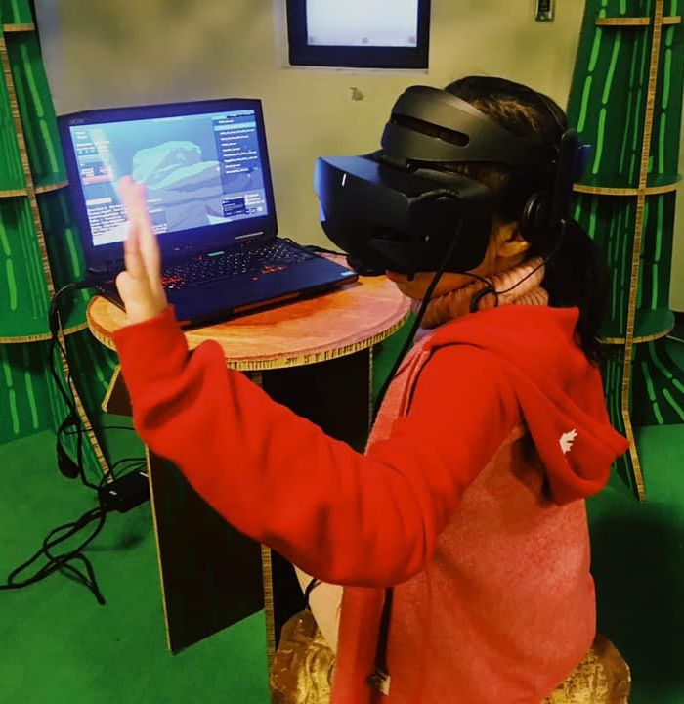

Slide 2
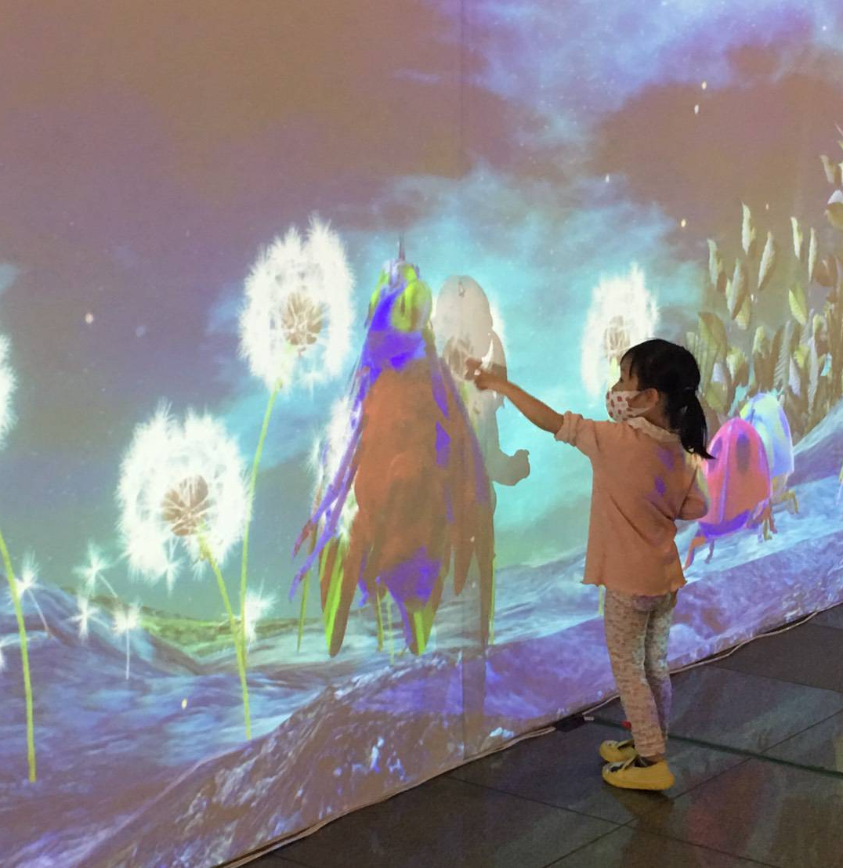
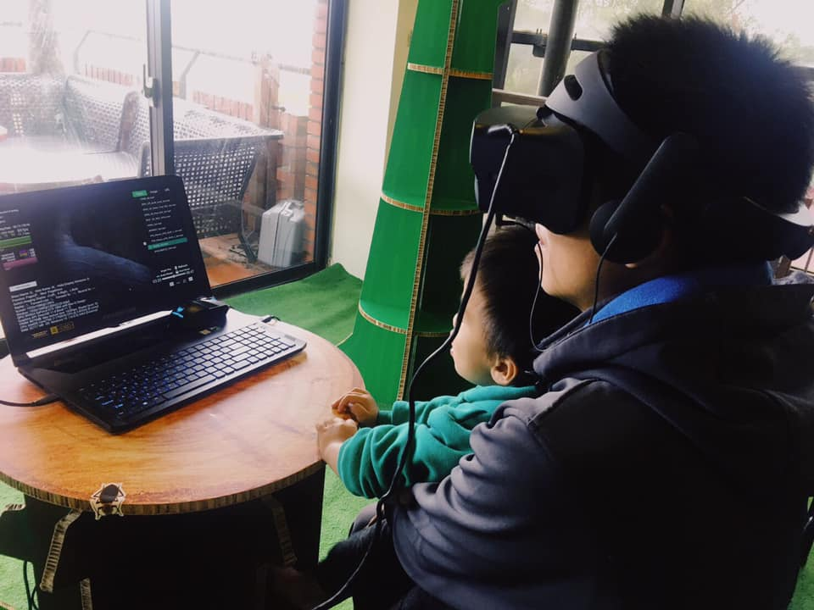
VR screening takes place at
National Taiwan Science Education Center.
More than 3,000 people attend event during 10 days. Both kids and adults enjoy the VR screening experience.

Slide 3


"The Small Big Micro Version" also published book in the content of biological knowledge for the youth to carry out as study book when they went for field observation.

