Slide 1


BIENVENIDOS AL GRAN

Slide 2
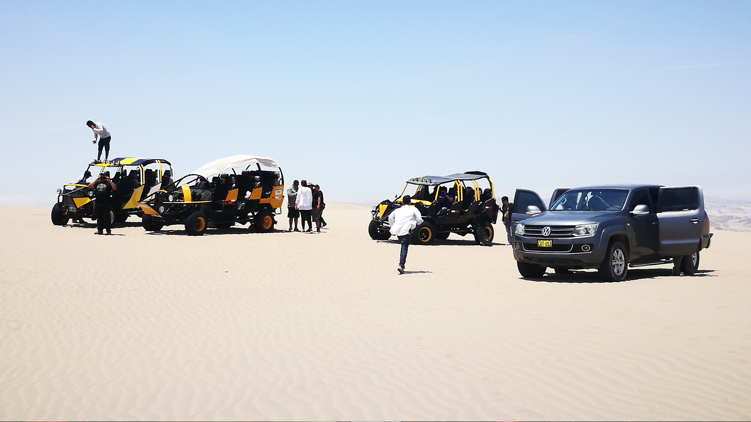
SYNOPSIS
In an extravagant hotel surrounded by the Peruvian desert, an introvert pre-adolescent in the middle of a family trip will have to overcome his lack of confidence and the bully of his school to win the heart of the girl of his dreams. In this adolescent journey, Guillermo will discover the allies he least expected: a crazy lifeguard, his childish side and his family.

Slide 3
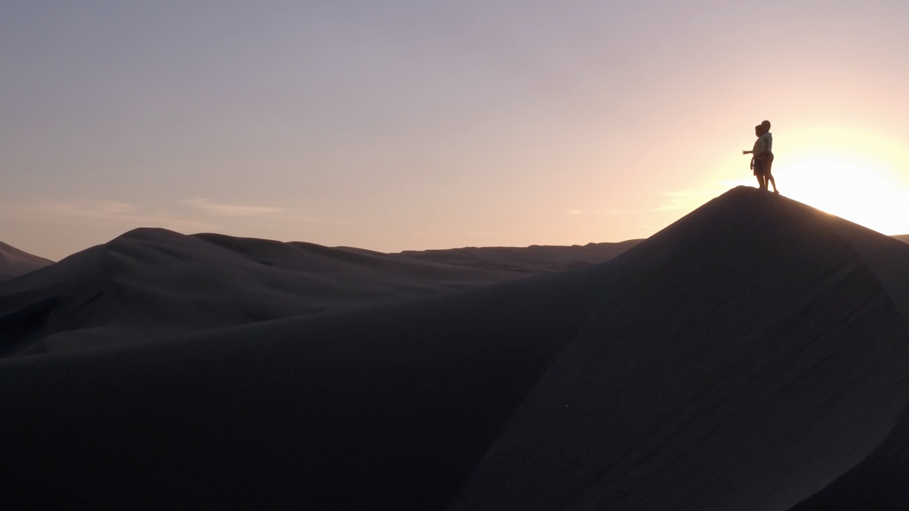
Insights
THE INNOCENCE OF
FIRST LOVE
--------------
Which brings us to unique moments in our life.
SELF-ESTEEM IN ADOLESCENCE
--------------
Which leads us to moments of confusión.
FAMILY
--------------
That even in spite of problems is always united.

Slide 4
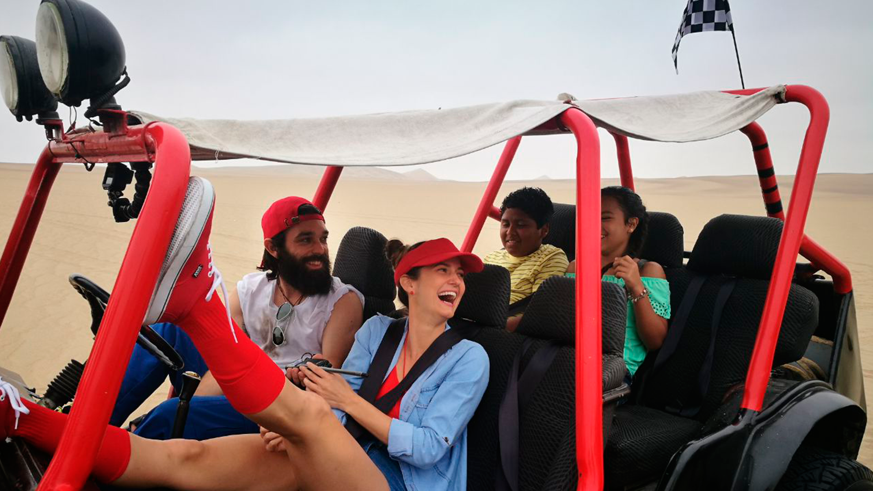
INVITED
ACTORS

Slide 5
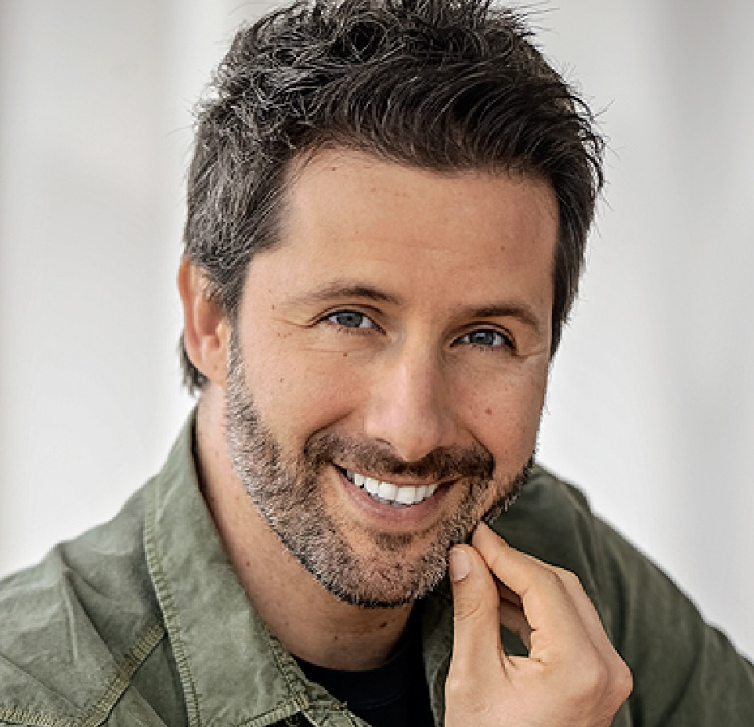

MARCO ZUNINO
CAROLINA CANO
ANIMATOR - MARC ANTHONY
GISELLA - LIFEGUARDS

Slide 6

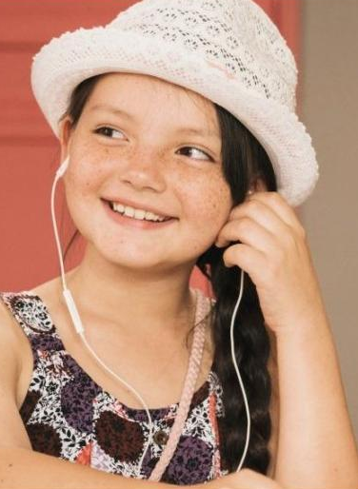
KATIA CONDOS
FRANCISCA ARONSSON
CAROLINA - AUNT
LUCÍA - COUSIN

Slide 7
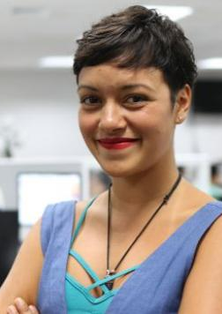
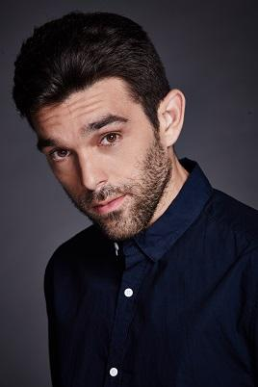
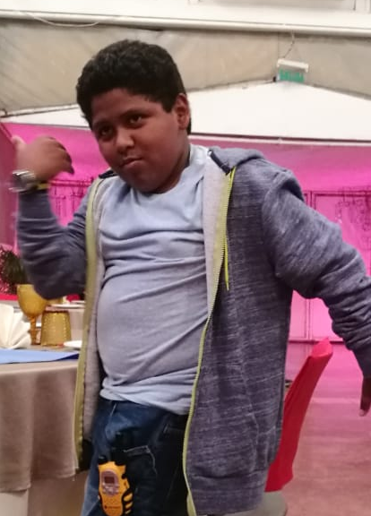

JELY REATEGUI
ANDRES SALAS
KAREEM PIZARRO
FABIANA VALCÁRCEL
ANDREA – ROMANTIC INTEREST
CARMEN - RECEPCIONIST
ENRICO – BUGGY DRIVER
GUILLERMO - PROTAGONIST

Slide 8
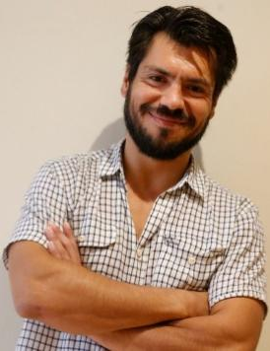
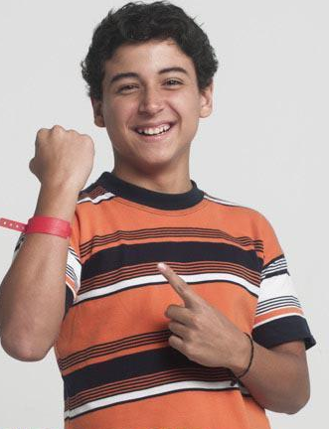
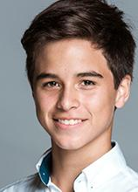
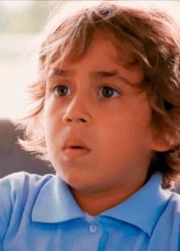
PIETRO SIBILLE
MARIANO GARCÍA
BRANDO GALLESI
MATIAS RAYGADA
CESAR – ADMINISTRATOR
RODRIGO - COUSIN
NAHEL - BULLY
BERNARDO - COUSIN

Slide 9
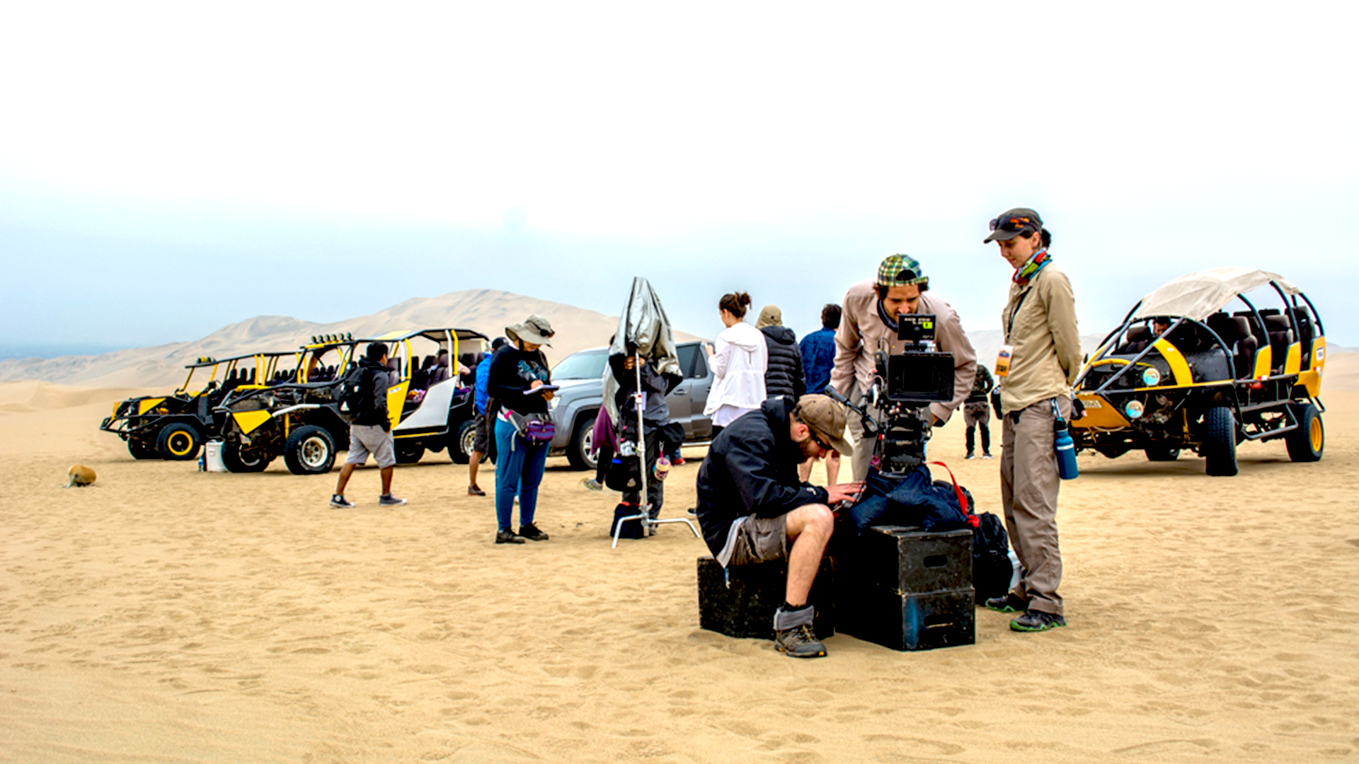
TEAM

Slide 10


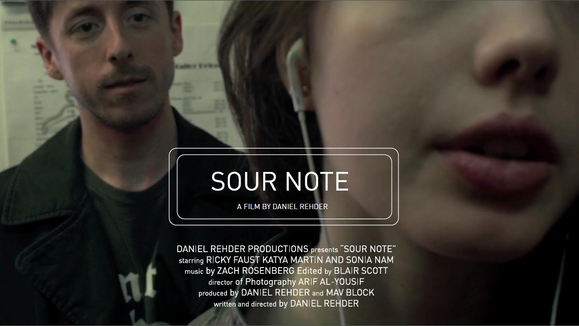

DIRECTOR,
WRITER AND PRODUCER
Daniel Rehder
He graduated from NYU in 2015 having directed several short films. In 2016 he produced the feature film “El Candidato” which won several awards worldwide and premiered in Peruvian cinemas.

Slide 11






PRODUCTION
Jorge Olivas
and Carlos Linares
Film, television and advertising producers with more than 20 years of experience.

Slide 12







DIRECTOR OF PHOTOGRAPHY
MUSIC
La Sound Facktory
Julián Estrada
La Hora Final (2017), Siete Semillas (2016), No Estamos Solos (2016), El Vientre (2014).
“El Hueco” (2016) short film winner of the prestigious festival Clermont-Ferrand, Cebiche de Tiburón (2017), Siete Semillas (2016), No Estamos Solos (2016), “Como en el Cine”.
Notes:
TOCAR LOS OTROS TEMAS DE MUSICA

Slide 13
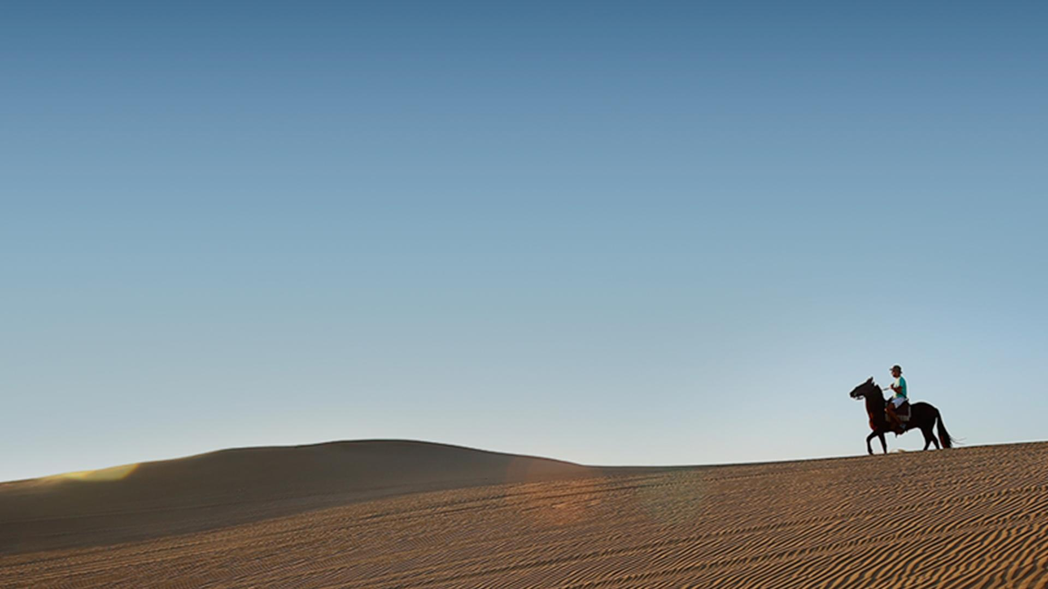





THANK YOU

