Slide 1
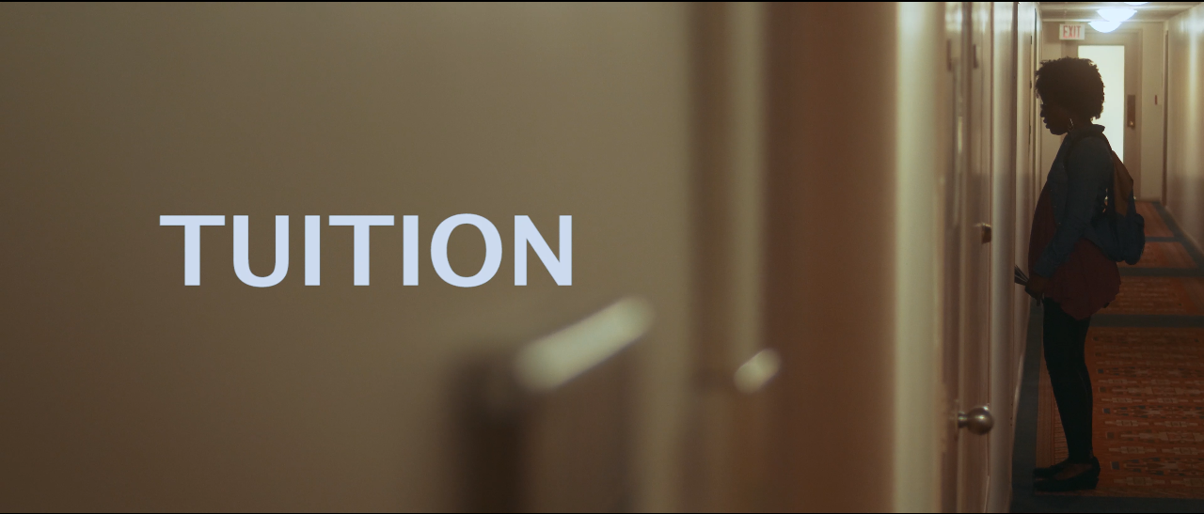
KOMATIK FILMS PRESENTS:
A SHORT FILM BY KELVIN OMORI

Slide 2
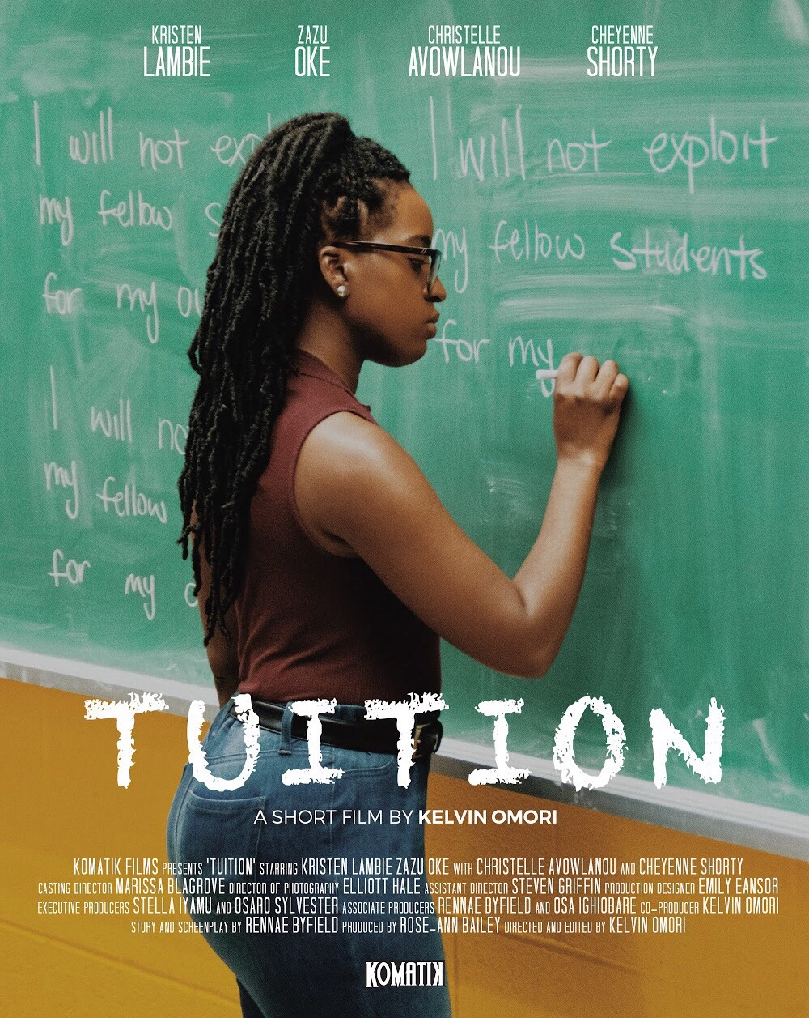
TUITION
[Narrative Short]
Running Time: 27 minutes
Directed By: Kelvin Omori
Written By: Rennae Byfield
Produced By: Rose-Ann Bailey & Kelvin Omori
Production Company: Komatik Films
Edited by: Kelvin Omori
Cinematographer: Elliott Hale
Production Designer: Emily Eansor

Slide 3

LOGLINE: A struggling finance student looks to her former friend turned escort to help her make
money for her looming tuition deadline, however, the business deal costs more than she bargained for.

Slide 4
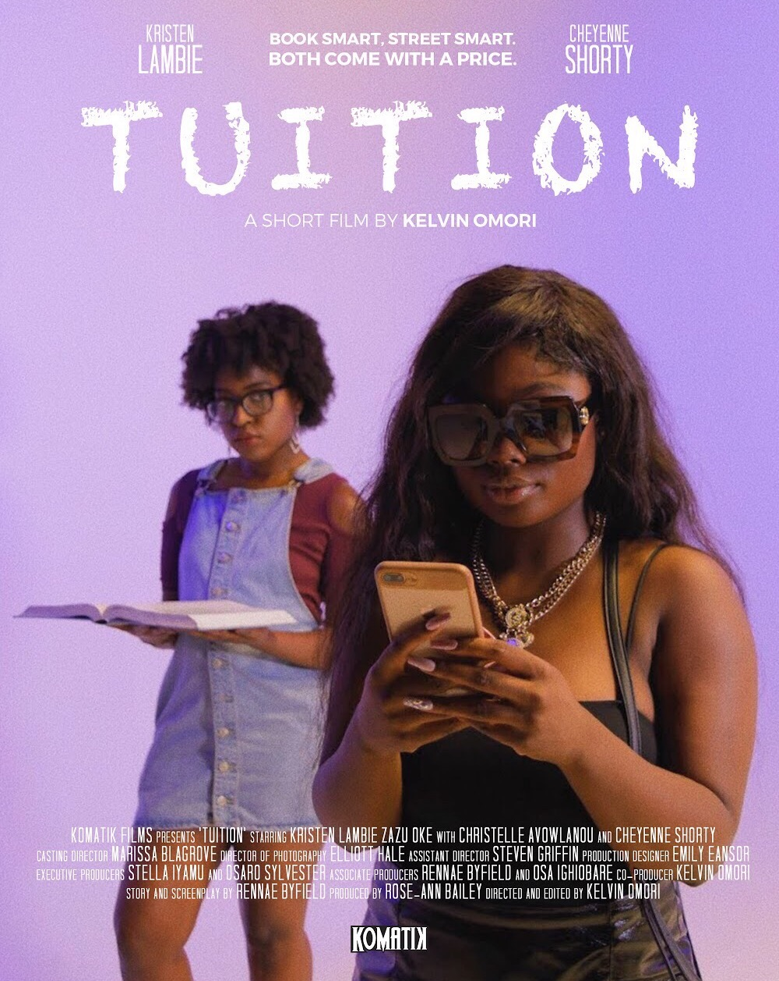
SYNOPSIS
Tamera is a bright student who is working on a dating app for her class assignment. She struggles financially and looks to OSAP to cover her tuition, but also to help pay the bills in her household. Her mom is sick and her dad is a gambler, which only adds to the financial strain. After talking with her best friend and classmate Karina on the phone, she is reintroduced to an old high school friend, Spice, who is seen living lavishly on Instagram. At a video shoot, Spice offers Tamera a chance to make money with her, but Karina warns Tamera that she is in the business of illegal activities. After seeing her mom in pain and unable to receive OSAP, she reluctantly takes Spice’s offer in order to resolve her problems. Spice introduces Tamera to her pimp, Neville. He lashes out at Spice after thinking she was wasting his time in the meetup. Tamera explains to Neville her dating app idea which can help make them money. After Neville’s investment, Tamera becomes able to pay off her tuition and help out in her household. Karina and Tamera run into each other at school and Karina warns Tamera of the dangers of her app, her missing out in classes and Spice’s jealousy towards her and Neville’s relationship. The exchange escalates to fall out between their friendship. After Tamera pleads with Neville about ending their business, he threatens her and also gifts her as a form of bribery. Spice later meets up with Tamera alone to give her an envelope full of cash that Spice claims Neville wanted Tamera to have as a bonus. After meeting up with Neville and Spice, Tamera is accused of stealing money from Neville, from the set up made by Spice due to her jealousy. The two girls almost fight, Tamera in an attempt to save herself lures Karina into their other “business” as a form of repayment.

Slide 5
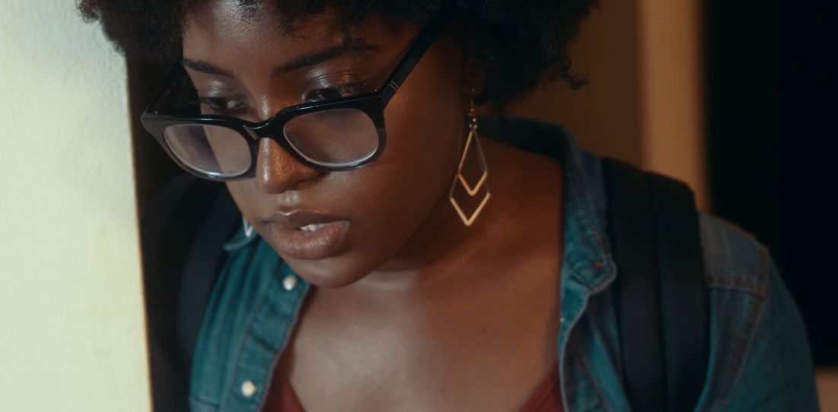
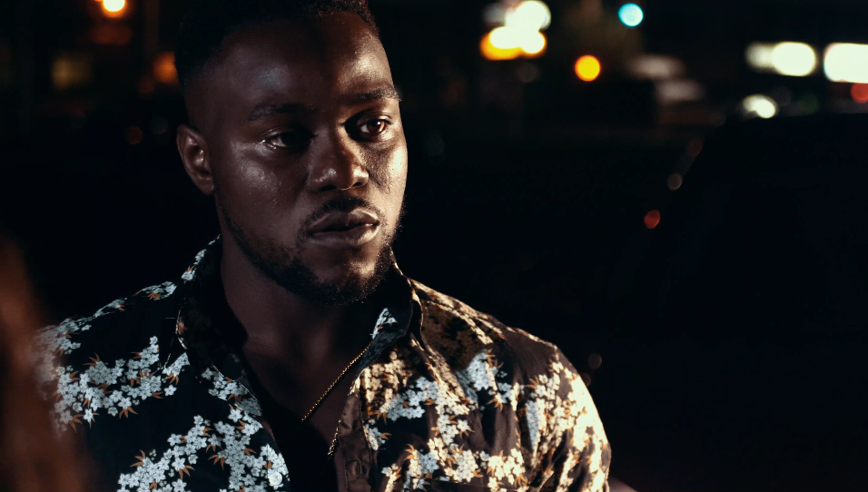
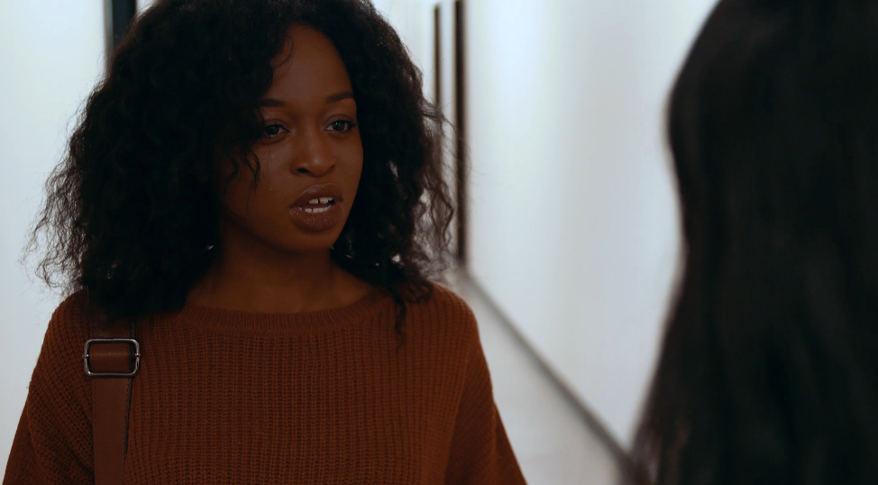
Kristen Lambie as Tamera
Zazu Oke as Neville
Christelle Avowlanou as Karina
Kristen Lambie has appeared in various independent television, film and commercial productions. Her most recent project includes a principal role in an upcoming Cineflix Productions Docudrama Television series which is currently in post production. She has trained at Armstrong Acting Studios and with acting coaches, Chris Frampton and Ingrid Hart. She holds an Honours BA in Communication Studies and Film Production and is currently pursuing her MA in Media Production at the notable Ryerson University where she is developing herself as a Producer as well.
Zazu Oke is a graduate from Brock university performing arts program he’s found his niche by reviewing and creating parody videos for South Indian films (Kollywood) on his hosted YouTube channel “Whistle Adi.” He’s well known in the south Indian community. Zazu just finished a 2 weeks run of his show called "Gods Like Us" at the factory theatre. A show he co wrote and produced with Vince Deiulis which was a great success. He continues to do a number of short films, web series, and touring with a theatre company all while being a full time husband and dad of three.
Christelle Avowlanou has had a passion for the performing arts from a young age. Now, with very little acting experience, she has decided to take her talents to the big screen. In fact, TUITION is the first project she has been a part of. She has trained at Talent INC Toronto with improv instructor Paul Barnes, and will be attending the Toronto Film School in January 2019. Christelle aspires to do it all: act, write and eventually produce and direct.

Slide 6
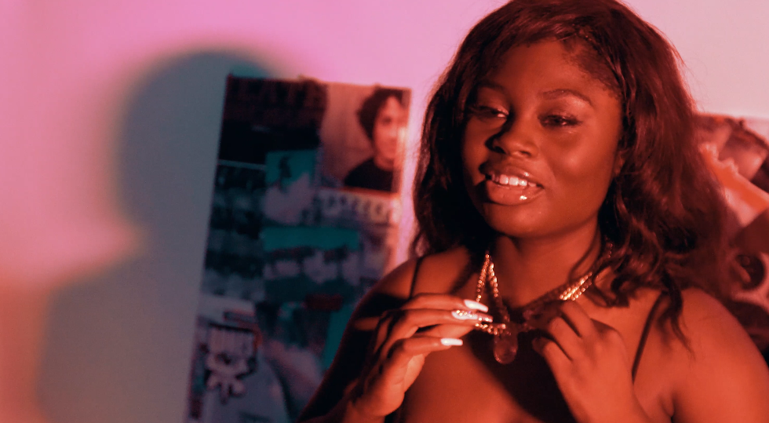
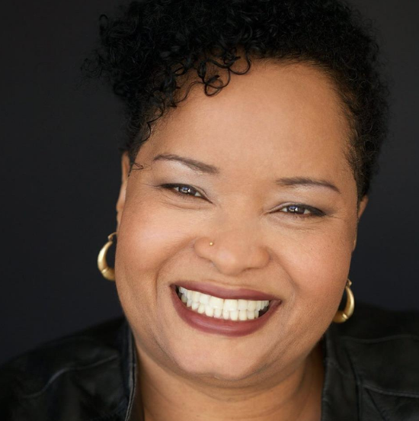
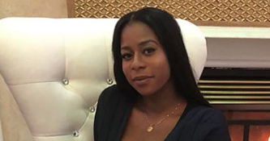
Cheyenne Shorty as Spice
PRODUCER, Rose-Ann Bailey
SCREENWRITER, Rennae Byfield
Cheyenne Shorty is a first-time actress with no prior acting background experience. However, she prides herself to trying new things that interest her. Shorty is an entrepreneur who owns her own cosmetic line called “Dark Angel Cosmetics.” She is considered to be a social media influencer and was hand chosen by our associate producer to play the role of Spice.
Rose-Ann M. Bailey is a graduate of York University where she earned a Bachelor of Fine Arts, Bachelor of Education, and a Masters in Education. Ms. Bailey, a visual artist, and a health educator has explored the inextricable link between racism, urban education and the social determinants of health, and how arts-based interventions can provide culturally relevant and responsive health education mandate for urban Canadian youth. Ms. Bailey is currently working to look at addressing domestic Human Trafficking, cannabis education and alternative interventions to address youth violence.
Rennae Byfield’s previous work with group homes around the GTA encouraged her passion for writing. It drove her passion to confront societal controversies. Rennae began her career writing columns for GTA local magazines which were well received . She is currently developing the social platform Bare Blog and plans to compose more socially aware content.

Slide 7
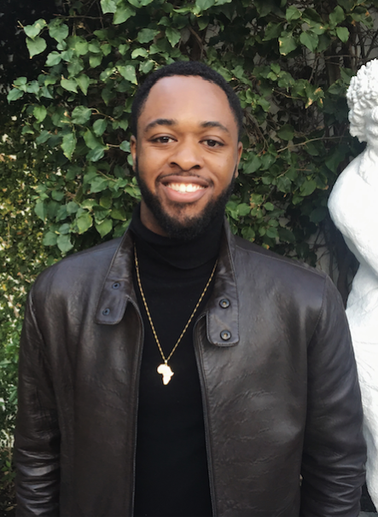
DIRECTOR, Kelvin Omori
After graduating from University of Windsor in 2015 with a bachelor’s degree in communications, media and film, Kelvin Omori landed an opportunity of a lifetime interning for his idol, the acclaimed and renowned music video director, Director X and his production company in Toronto. In that period of interning, Kelvin worked with artists likes Drake, Rihanna, Future, PartyNextDoor, and Majid Jordan.
Soon after his internship ended, Kelvin started his own production company in 2016 called “Komatik Films” where he’s produced and directed over a dozen music videos for local artist from the Greater Toronto Area under the moniker “Director Kells,” inspired by his idol’s name.
In the quest to learn more and keep his foot in the industry, Kelvin decided to move to Los Angeles where is currently in film school at UCLA and to get closer to the industry. L.A. gave Kelvin the confidence and understanding to step outside the box of just focusing on music videos and expand on doing narrative filmmaking.
In the start of 2018, Kelvin Omori plotted to direct and develop his first short film under his production company, which is now TUITION.

Slide 8
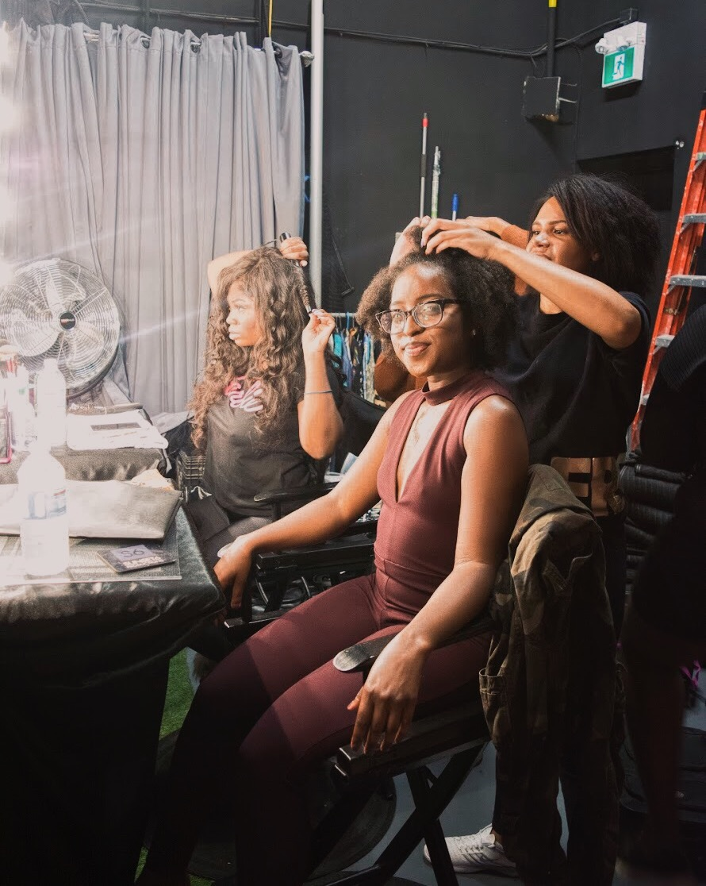
CREDITS
Directed by: Kelvin Omori
Written by: Rennae Byfield
Produced by: Rose-Ann Bailey Kelvin Omori
Director of Photography: Elliott Hale
1st Assistant Director: Steven Griffin
Production Designer: Emily Eansor
Editor: Kelvin Omori
Sound Recordist: Rory O’Keefe
Executive Producers: Stella Iyamu
Osaro Sylvester
CAST
Tamera Kristen Lambie
Neville Zazu Oke
Karina Christelle Avowlanou
Spice Cheyenne Shorty
Mom Jennifer Brathwaite
Dad Carlos Roberts
Financial Aid Employee Diane Newling
Hoodz Himself

Slide 9

CONTACTS
TWITTER
INSTAGRAM
FACEBOOK
OFFICIAL TRAILER
EMAIL: KOMATIKFILMS@GMAIL.COM OR ROSEANNM.BAILEY@GMAIL.COM

