Slide 1

by
DEATH CHOCOLATE

Slide 2




by
DEATH CHOCOLATE
SHORT FILM
HOW FAR WILL YOU GO TO GET
WHAT YOU CAN’T HAVE?
11 MIN 34 SEC | USA | ENGLISH | DRAMEDY

Slide 3
HOW FAR WILL YOU GO TO GET
WHAT YOU CAN’T HAVE?
by
DEATH CHOCOLATE
ASHANTI J’ARIA
SILVANA JAKICH
MICHAEL UNDERHILL
DIRECTED BY
MARC ERDAHI
WRITTEN AND PRODUCED BY
KAY GUNN
ASSOCIATE PRODUCER
CHRISTIAN GUNN-SAYE
ASSOCIATE PRODUCER
VICTORIA GUNN-SAYE
CINEMATOGRAPHER
JAMES MCSWEENEY
ASSISTANT DIRECTOR
CAMBRIA KYLINN MARTIN
1ST AC/GRIP
THEO ENDRENY
PROD. DESIGNER/PROPS
CORINA LUPP
EDITOR
CHRISTIAN GUNN-SAYE
CHOREOGRAPHER
TONY WILLIAMS II
SOUND MIXER
BRANDON VELAZQUEZ
DIT
CHRISTIAN GUNN-SAYE
COSTUME CONSULTANT
ANN LOWE
PRODUCTION ASSISTANT
JAYNA MCKINLAY
CASTING
SOIREE FAIR TALENT AND LITERARY
by
DEATH CHOCOLATE
SHORT FILM

Slide 4
TITLE: DEATH BY CHOCOLATE
RUNTIME: 11 MINUTES, 34 SECONDS
COUNTRY: UNITED STATES
LANGUAGE: ENGLISH
GENRE: DRAMEDY / PSYCHOLOGICAL
STATUS: COMPLETED
CONTACT:
INFO@BISCUITWHEELSPRODS.COM
609-686-7161
by
DEATH CHOCOLATE
SHORT FILM

Slide 5
LOGLINE
A CANDELIGHT DINNER BETWEEN TWO MIDDLE AGED WOMEN, A TIGHTLY WOUND WHITE SOUTHERN WIFE AND HER HUSBAND’S BLACK FIERY EX-MISTRESS LEADS TO A MORE THAN CORDIAL EVENING THAT CHALLENGES, IDENTITY, CONTROL AND DESIRE IN WAYS THAT NEITHER WOMAN EXPECTED.
by
DEATH CHOCOLATE
SHORT FILM

Slide 6
SYNOPSIS
After a fire destroys her New Jersey nightclub, Catalina, a sophisticated, middle-aged chanteuse desperately seeks funds to rebuild.
With no options left, she turns to Doug, a former lover now trapped in a stagnant marriage with his repressed wife, Ryman.
Catalina orchestrates an intimate dinner with Ryman that evolves from polite conversation into a deeply emotional and sensual connection. Drawn to Catalina’s boldness and honesty, Ryman experiences a long-suppressed awakening that challenges her identity and desires.
by
DEATH CHOCOLATE
SHORT FILM

Slide 7
SYNOPSIS (CONT’D)
As their connection intensifies, a sexual encounter comes to pass. Catalina views the affair as both emotional leverage and financial opportunity while Ryman sees it as a revelation and a brief but electrifying escape from years of loneliness, neglect and repression. The night culminates in Ryman funding Catalina’s quest to rebuild her club.
By morning, Catalina’s duplicity is revealed. She boasts over the phone that she has secured the money, framing the affair as both conquest and transaction. The audience is left questioning whether her connection with Ryman held genuine tenderness or whether it was always a grifter’s endgame.
by
DEATH CHOCOLATE
SHORT FILM

Slide 8
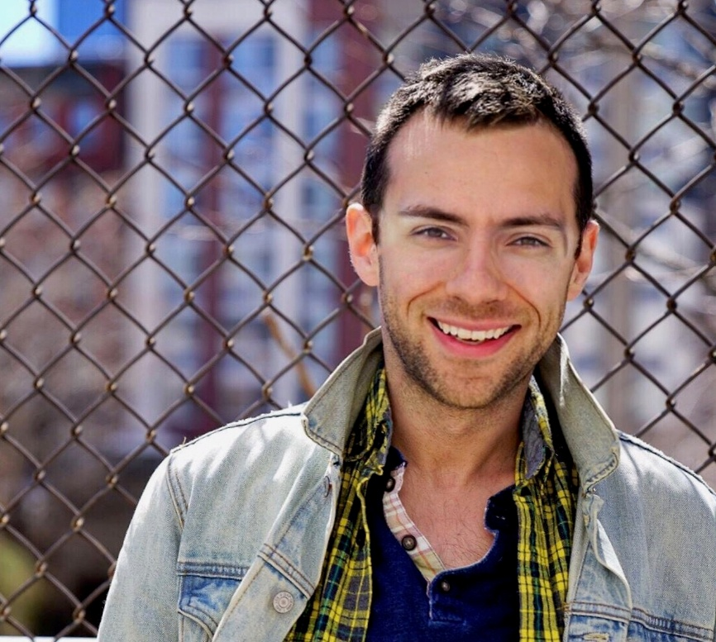
DIRECTOR’S STATEMENT
MARC ERDAHI
“Death by Chocolate” drew me in because it lives in the space between seduction and strategy, where intimacy becomes currency and power shifts quietly, almost imperceptibly, between two people. On its surface, the film is lush, romantic, even playful. But underneath, it’s a negotiation. A transaction. A carefully orchestrated emotional con.
What excited me most as a director was exploring that duality: how warmth, humor, and vulnerability can coexist with calculation. Catalina isn’t just charming—she’s precise. Ryman isn’t just lonely—she’s perceptive, hungry for connection, and ultimately complicit in her own undoing. Their relationship becomes a kind of dance—literally and figuratively—where control passes back and forth until we realize the outcome may have been decided long before the first step.
Visually and tonally, I wanted the film to feel intimate, almost intoxicating—candlelight, music, movement—so that the audience, like Ryman, is seduced into lowering their guard. By the time the truth lands, it shouldn’t feel like a twist; it should feel inevitable. My goal was to create a world where pleasure and manipulation are indistinguishable, and where the cost of being seen—truly seen—is far greater than either character is willing to admit.
Ultimately, “Death by Chocolate” is about desire: for connection, for reinvention, for survival. And the dangerous, often beautiful lengths we’ll go to get what we need.
by
DEATH CHOCOLATE
SHORT FILM

Slide 9
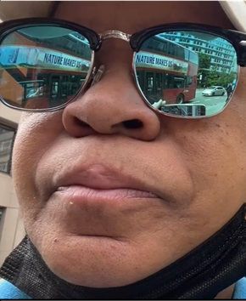
WRITER & PRODUCER STATEMENT
KAY GUNN
This story was inspired by observing how easily desire disguises itself as entitlement. “Death By Chocolate” is not about excess, or that decadent dessert that you can never finish, but about restraint being ignored. The film invites viewers to reflect on emotional choices we rationalize and the cost of crossing lines we know should never be crossed.
“Death By Chocolate” is a study in contrasts of beauty versus consequence, sweetness versus decay. I wanted to tell a story where danger is not loud, but seductive. This film asks the audience to sit with discomfort and question, the fact of “how far would you go to get what you can’t have?”
My joy and extended vision is writing character driven stories about women of a certain age who are embracing their maturity with a refined focus for life. These women don’t apologize for anything, don’t atone for anything and answer to no one. Moreover, they don’t have to account for their time to anyone and are too old to sleep in bunk beds.
by
DEATH CHOCOLATE
SHORT FILM

Slide 10
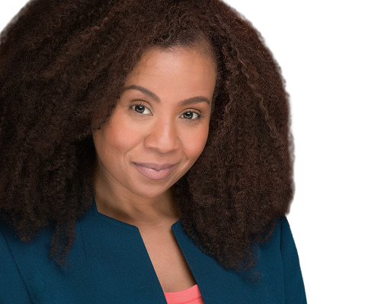

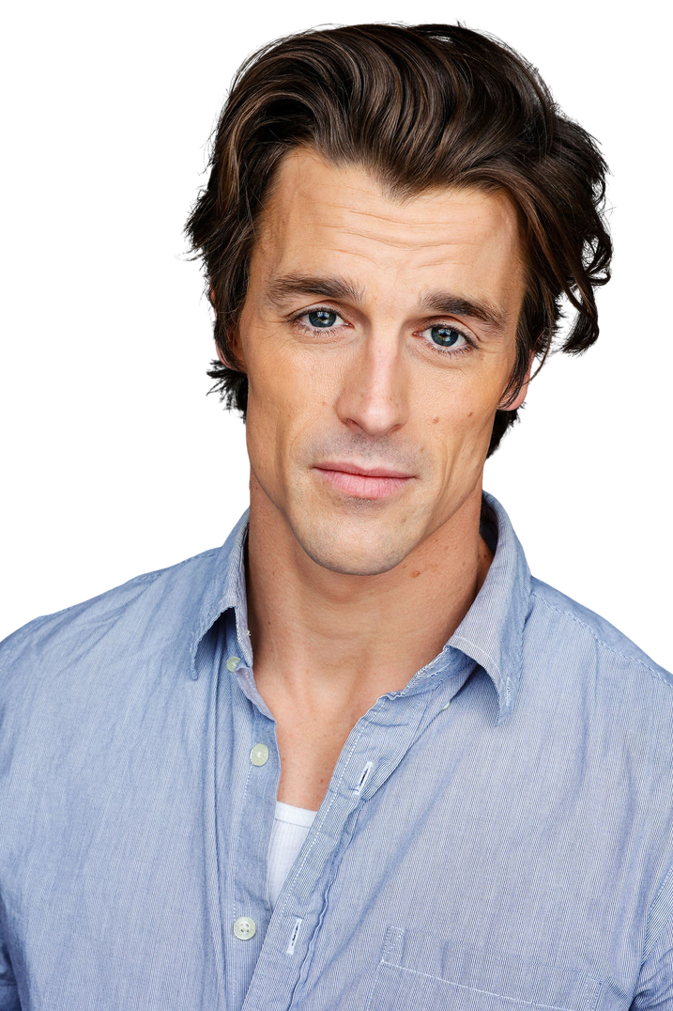
CAST
ASHANTI J’ARIA
SILVANA JAKICH
MICHAEL UNDERHILL
Ashanti J’Aria
as
CATALINA
Silvana Jakich
as
Michael Underhill
as
by
RYMAN
DOUG
DEATH CHOCOLATE
SHORT FILM

Slide 11
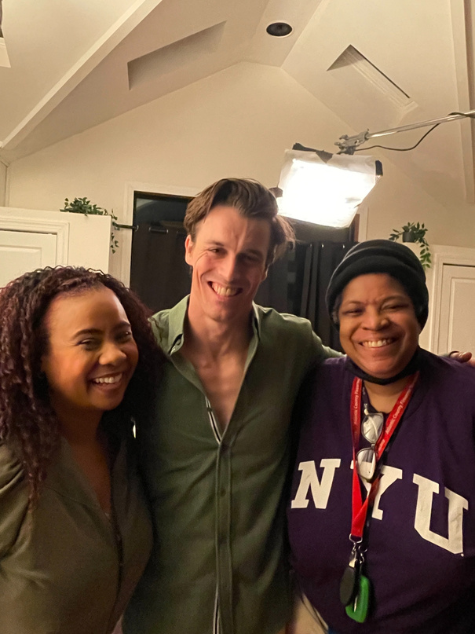
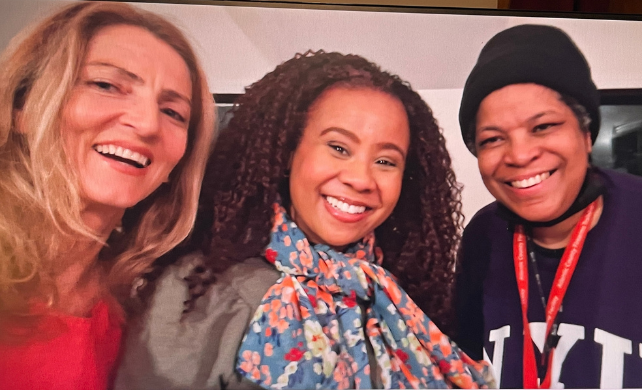
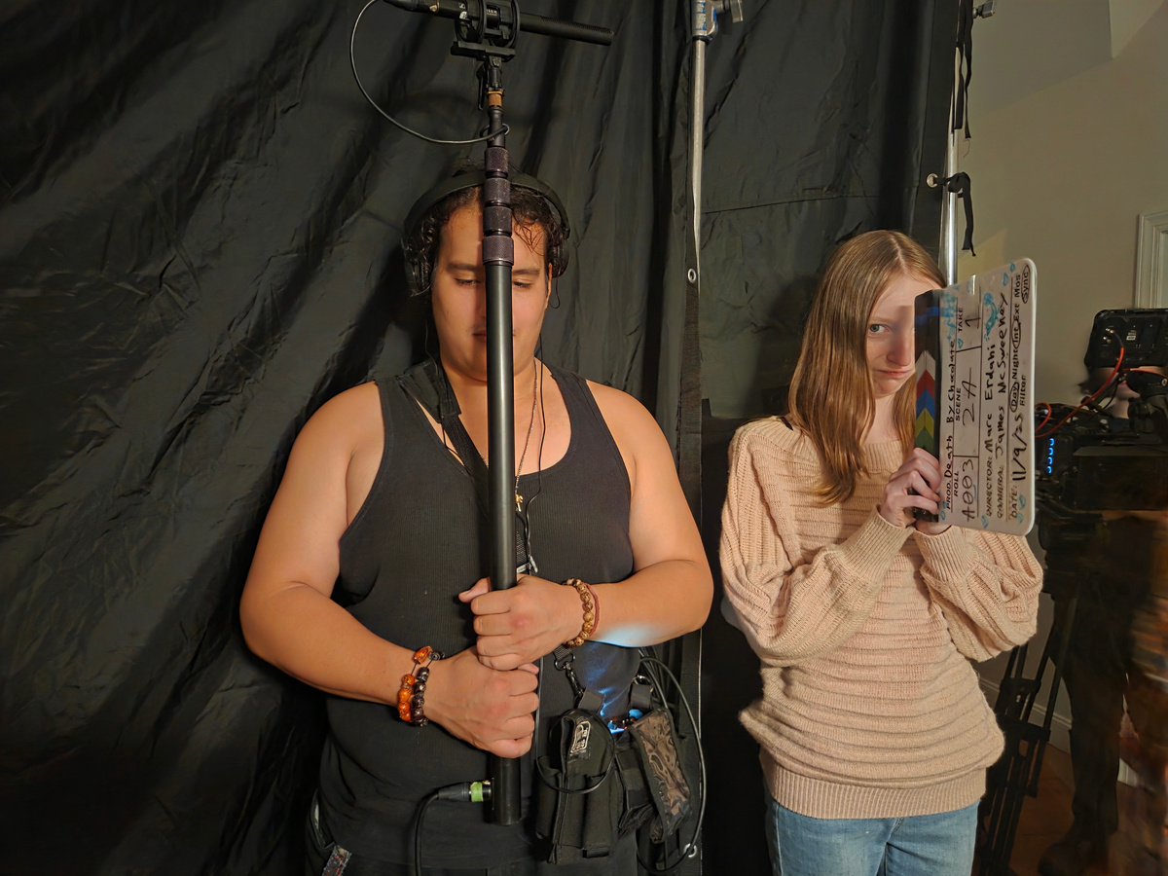
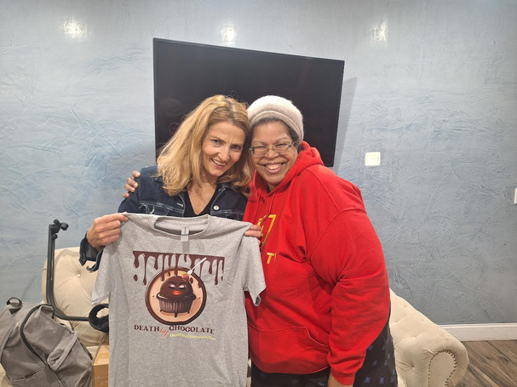
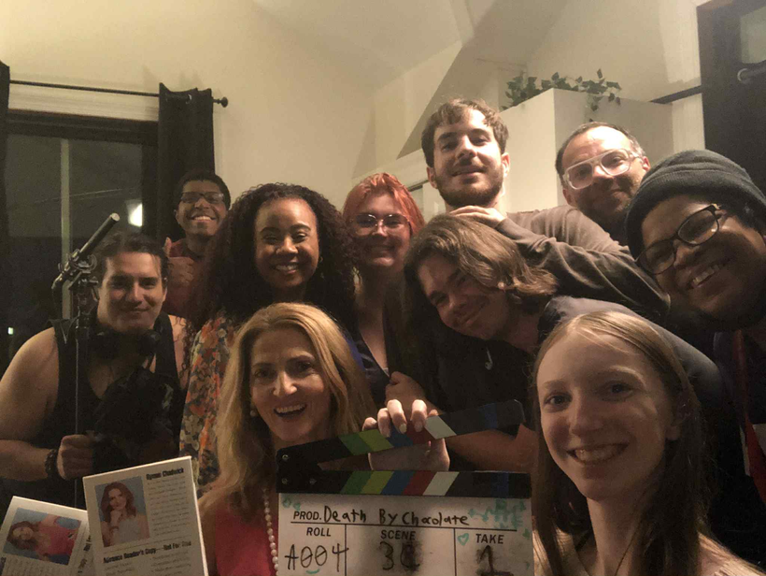
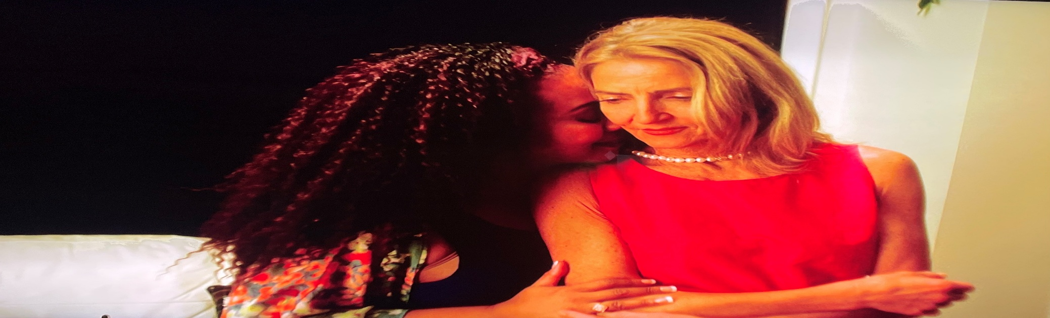
CREW
DIRECTED BY
MARC ERDAHI
WRITTEN AND PRODUCED BY
KAY GUNN
ASSOCIATE PRODUCER
CHRISTIAN GUNN-SAYE
ASSOCIATE PRODUCER
VICTORIA GUNN-SAYE
CINEMATOGRAPHER
JAMES MCSWEENEY
ASSISTANT DIRECTOR
CAMBRIA KYLINN MARTIN
1ST AC/GRIP
THEO ENDRENY
PROD. DESIGNER/PROPS
CORINA LUPP
EDITOR
CHRISTIAN GUNN-SAYE
CHOREOGRAPHER
TONY WILLIAMS II
SOUND MIXER
BRANDON VELAZQUEZ
DIT
CHRISTIAN GUNN-SAYE
COSTUME CONSULTANT
ANN LOWE
PRODUCTION ASSISTANT
JAYNA MCKINLAY
CASTING
SOIREE FAIR TALENT AND LITERARY
by
DEATH CHOCOLATE
SHORT FILM

Slide 12
THEMES & TONE
THEMES
OBSESSION
ENTITLEMENT
BETRAYAL
CONSEQUENCE
TONE
ELEVATED. INTIMATE. UNSETTLING.
by
DEATH CHOCOLATE
SHORT FILM

Slide 13
CONTACT & ASSETS
PRODUCTION COMPANIES:
BISCUIT WHEELS PRODUCTIONS
A KICKLINE PRODUCTION
EMAIL: BiscuitWheelsProds@gmail.com
PHONE: 609-686-7161
TRAILER, POSTERS, T-SHIRTS, STILLS
AVAILABLE UPON REQUEST.
by
DEATH CHOCOLATE
SHORT FILM

Slide 14

HOW FAR WILL YOU GO TO GET
WHAT YOU CAN’T HAVE?
by
DEATH CHOCOLATE
SHORT FILM

