Slide 1


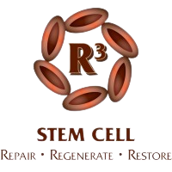




STEM CELL THERAPY FOR AUTOIMMUNE DISEASES | DR. DAVID
GREENE ARIZONA

Slide 2



AUTOIMMUNE DISEASES
Autoimmune diseases refer to medical conditions in which a human body’s natural defense mechanism “Immune System” attacks the body’s cells and organs by mistake

Slide 3
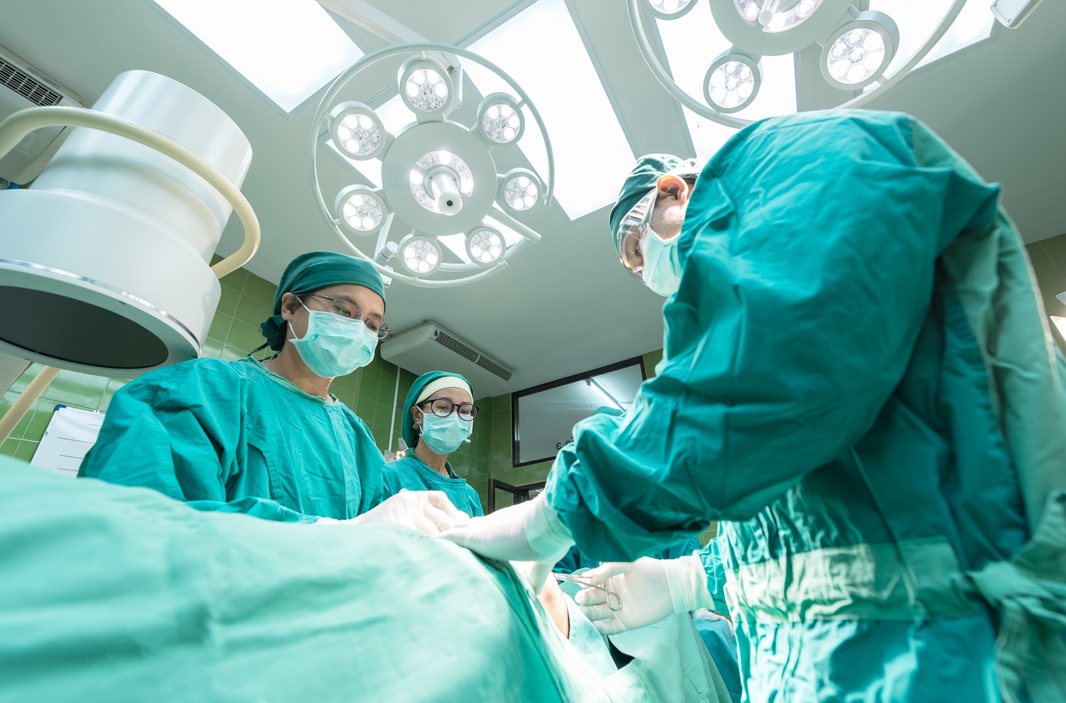
TREATMENT FOR AUTOIMMUNE DISEASES
Stem Cell Therapy is a permanent solution to autoimmune diseases and their associated conditions

Slide 4



SYMPTOMS OF AUTOIMMUNE DISEASES
Swelling and Redness
Fatigue
Muscle aches
Low-grade fever
Hair loss

Slide 5

DIAGNOSIS OF AUTOIMMUNE DISEASES
A positive ANA refers that the patient is suffering from an autoimmune disease but it cannot diagnose the type of Autoimmune Disease

Slide 6
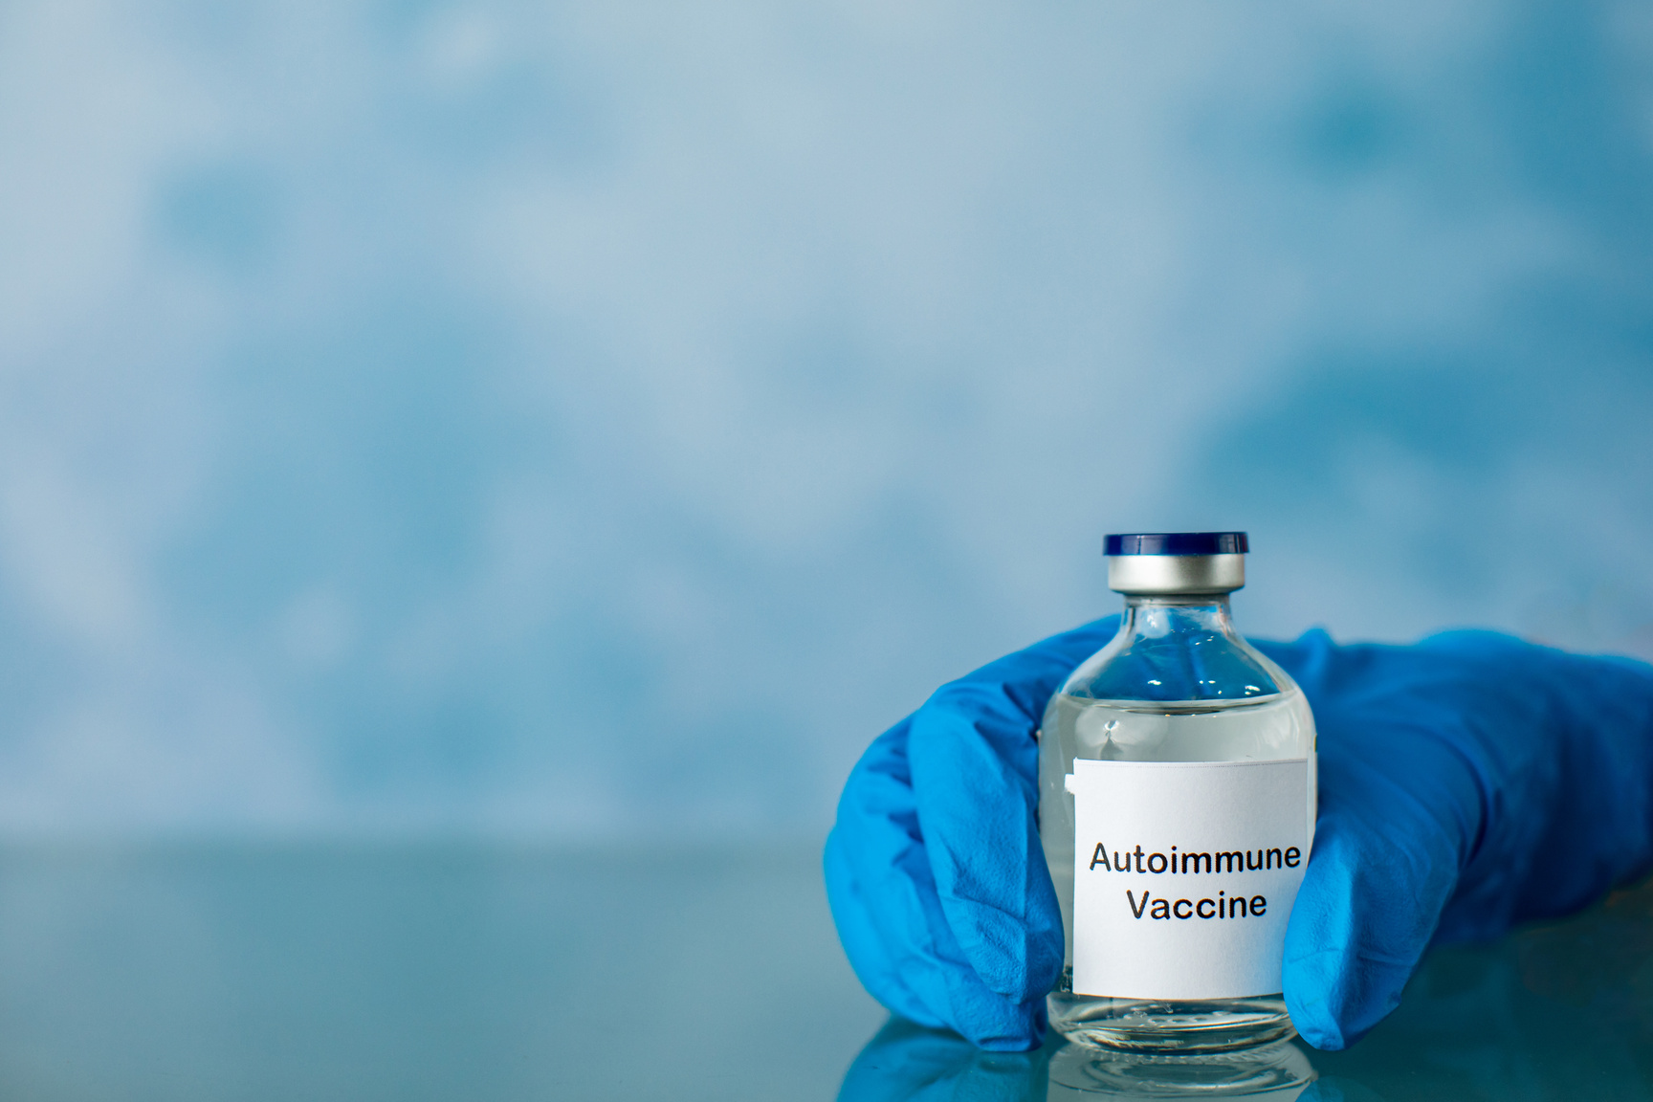
HOW AUTOIMMUNE DISEASES OCCUR
Doctors, researchers, and experts in the medical field haven’t yet found the exact and specific causes or reasons for autoimmune diseases.

Slide 7
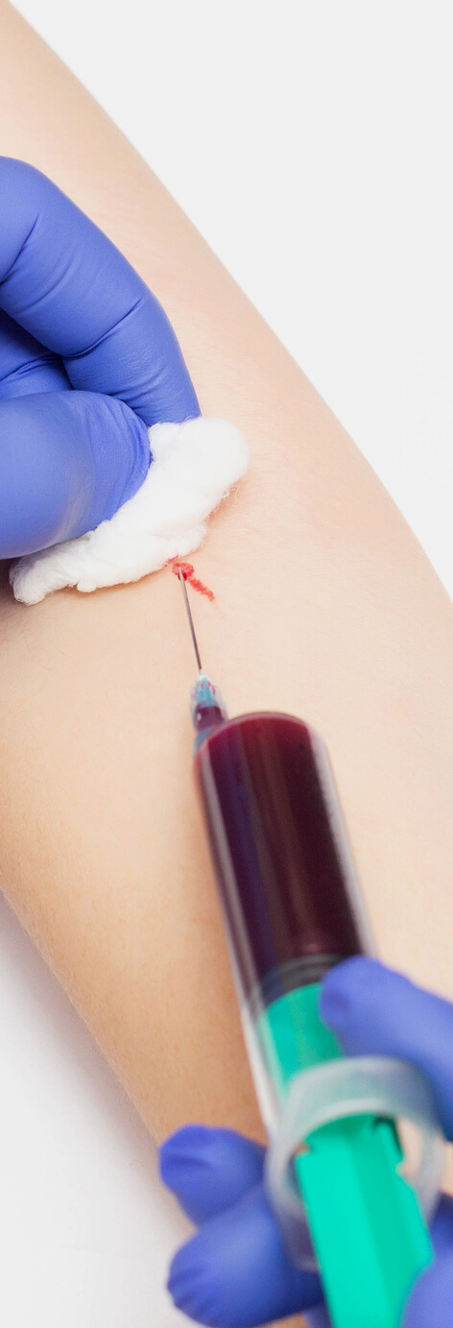
TYPES OF AUTOIMMUNE DISEASES
Type 1 Diabetes
Rheumatoid Arthritis
Multiple Sclerosis (MS)
Graves’ disease
Hashimoto’s Thyroiditis
PAGE 04

Slide 8
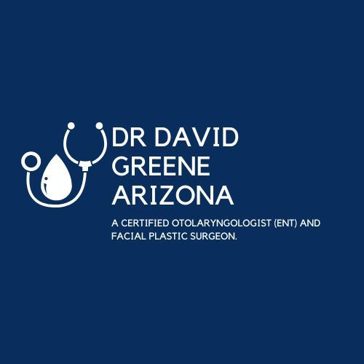


THANK YOU
+1-239-263-8444
www.r3stemcell.com

