Slide 1

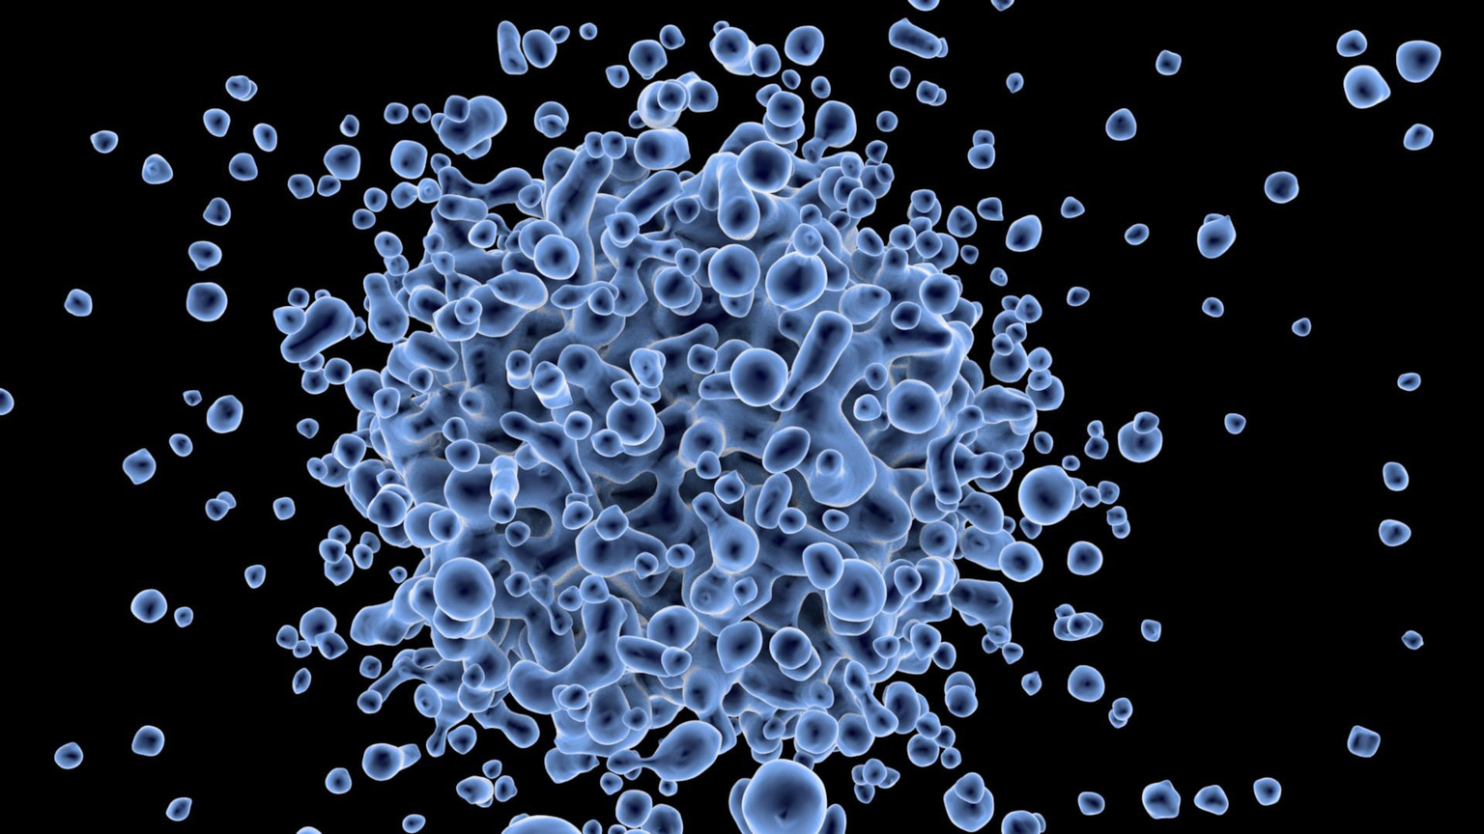

Why Does Stem Cell Matter, and Where Do You Find Them?

Slide 2


The term stem cell may conjure up thoughts of some rare type of cell that can only be found in very specific locations. The opposite is really true. Stem cells are pretty ubiquitous in the body, appearing in many different organs and tissues including the brain, blood, bone marrow, muscle, skin, heart, and liver tissues.

Slide 3
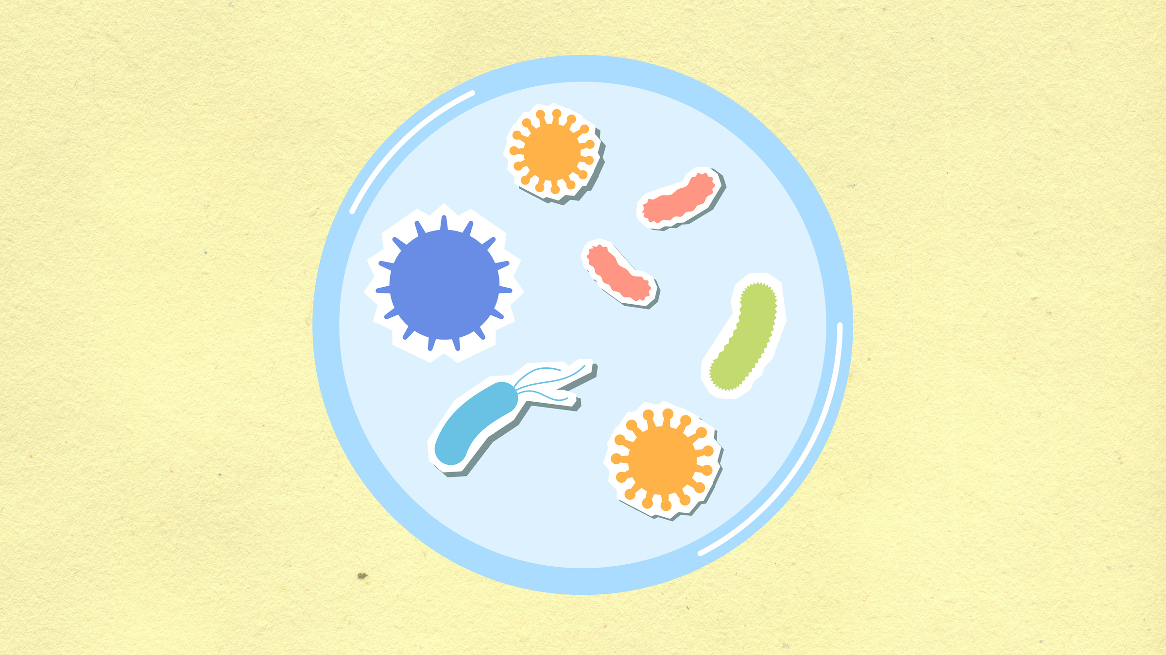
Embryonic
Found in large numbers during gestation, embryonic stem cells are by far the youngest stem cells and have the unique ability to become any type of cell in the body.

Slide 4
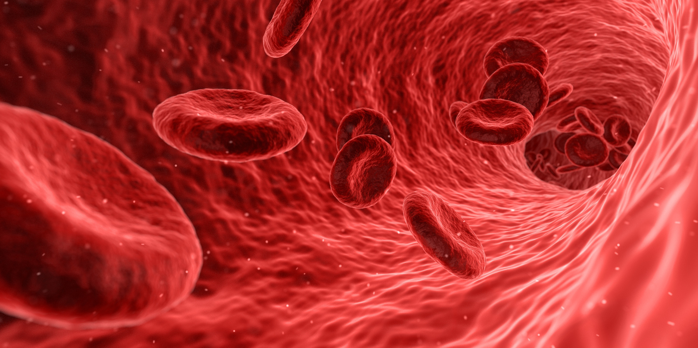
Cord Blood and Cord Tissue
Cord blood and cord tissue stem cells have the special quality of being the purest and youngest tissue-specific stem cells you can collect and function more quickly and effectively than adult stem cells from other sources.

Slide 5
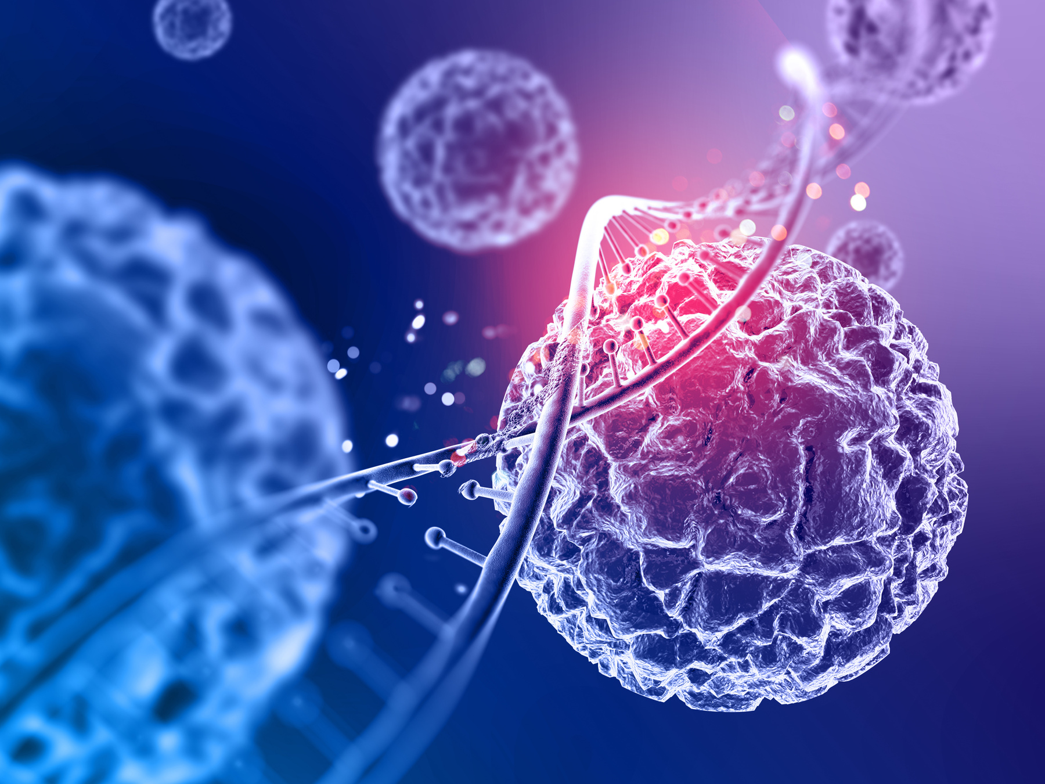
Placental tissue
The placenta and other amniotic tissues are also a rich source of the same type of stem cells found in cord tissue, and as with cord tissue, they can be easily collected at the time of birth.

Slide 6
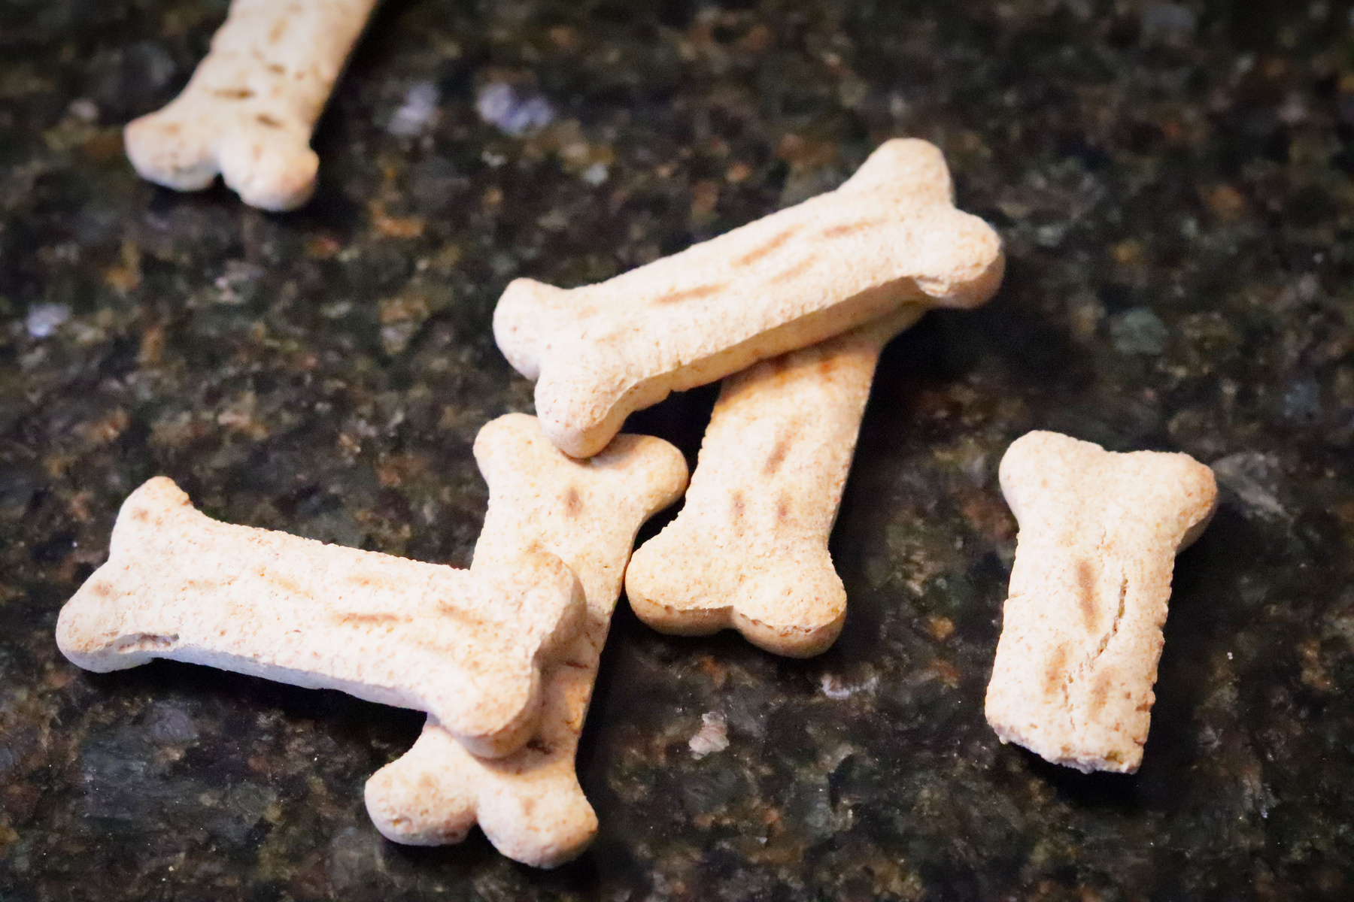
Bone Marrow
There are also areas where stem cells can be collected later in life. Bone marrow is rich in the blood-forming stem cells like those found in cord blood. To collect bone marrow stem cells, a needle is inserted into the soft center of the bone and requires the donor to undergo anesthesia.

Slide 7
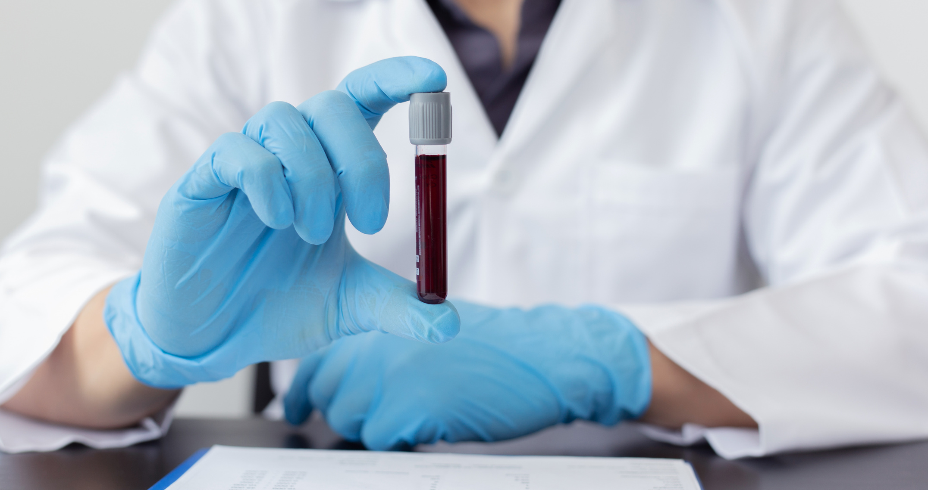
Peripheral blood
As noted earlier, blood contains stem cells, just not too many. To gather a large number of stem cells from blood, the blood- and immune system–forming stem cells in bone marrow need to be coaxed out and collected.

Slide 8

Fat (Adipose)-Derived
Adipose stem cells are collected from fat tissue by way of an invasive liposuction-like procedure and are not the same as those found in cord blood or bone marrow.

Slide 9

Dental Pulp
A relatively new discovery is the stem cells in dental pulp. Teeth contain the same type of stem cells as adipose tissue and umbilical cord tissue, so once again, they are not used to treat the blood cancers and diseases that cord blood or bone marrow treat.

Slide 10


THANK YOU
www.r3stemcell.com

