Slide 1
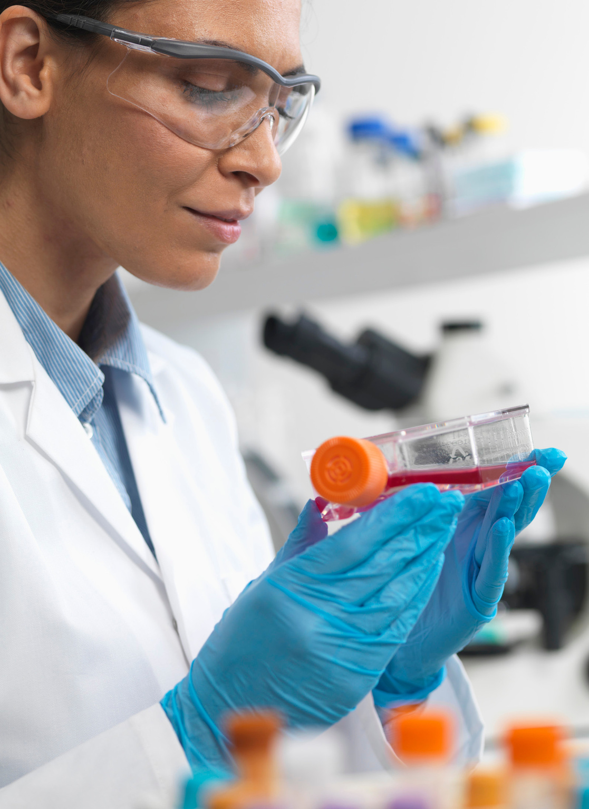
Conditions That Benefit from Stem Cell Therapy
Dr. David Greene Arizona

Slide 2

What are Stem Cells?
Stem Cells have the ability to become many other types of cells, which makes them indispensable in treating many chronic medical conditions. Pluripotent stem cells is a term that’s often used to describe this ability to differentiate (change) into different types of cells.
Check Here

Slide 3

Benefits of Stem Cell Therapy
Stem Cells have the ability to become many other types of cells, which makes them indispensable in treating many chronic medical conditions. Pluripotent stem cells is a term that’s often used to describe this ability to differentiate (change) into different types of cells.
Check Here

Slide 4

Arthritis
Arthritis is an inflammatory condition that affects our joints. Stem cell therapy can help by repairing damaged joint cartilage and by reducing inflammation that occurs in and around the joint.

Slide 5

Cancer
Stem cell transplants can be used to treat leukemia and lymphoma, replacing cells that have been damaged by the disease.

Slide 6

Parkinson’s Disease
Stem cells may be used to repair nerve damage that occurs in Parkinson’s disease, and novel research shows the therapy may help replace dopamine-producing brain cells destroyed by the disease.

Slide 7

Heart disease
Cardiac regeneration using stem cell therapy is being used to help patients who’ve had heart attacks, patients with heart failure, and even patients with large and small vessel disease.
In each case, the goal of treatment is to allow the stem cells to repair and replace damaged tissue in the heart and the blood vessels.

Slide 8

Multiple Sclerosis
Stem cells are being used to help repair neurological damage that occurs in MS, and studies show they’re also able to travel directly to brain lesions and improve brain cell health. Stem cells alo help control unusual immune system activity, which plays a significant role in MS.

Slide 9

Diabetes
Stem cells may help replace missing or damaged beta cells, special cells in the pancreas that produce insulin. Both type 1 and type 2 diabetes involve problems with beta cells (either there are not enough — or any — beta cells or the cells don’t function properly). Stem cell therapy might be helpful in patients with either type.

Slide 10

Fibromyalgia
Stem cells can be very helpful in modulating inflammatory responses, including inflammation thought to be associated with fibromyalgia. They can also help repair and regenerate damaged nerve cells that can “misfire,” sending pain signals when there is no painful stimulus.

Slide 11
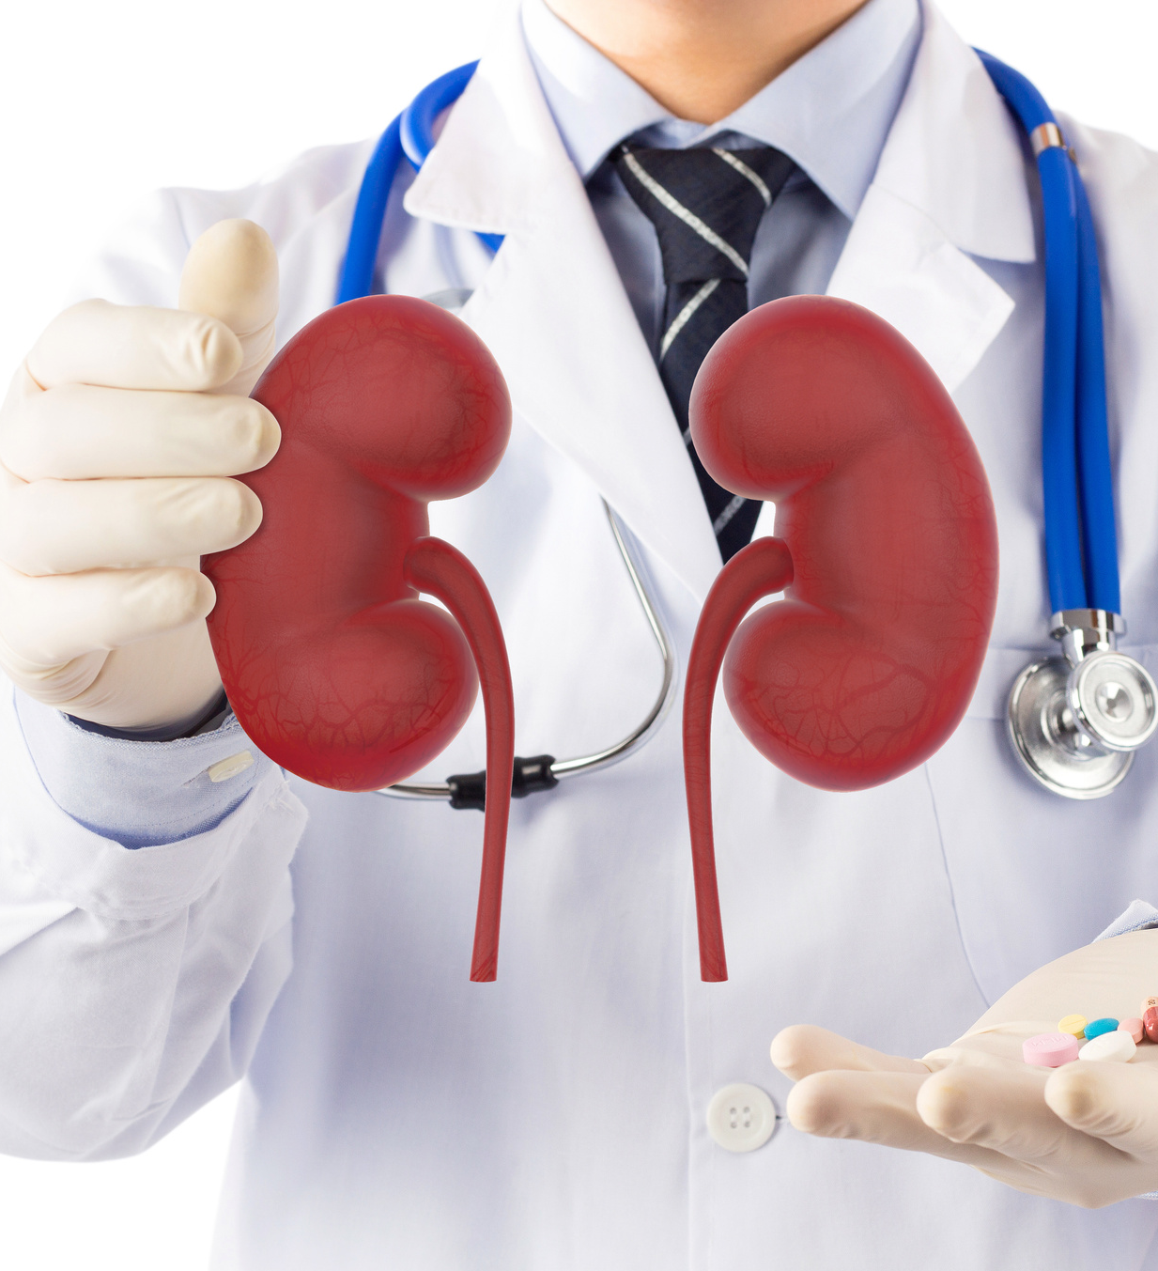
Kidney Disease
Because stem cells have the ability to transform into many other types of cells, including kidney tissue, they’re being used to treat both acute and chronic kidney injury and kidney disease. The goal is to replace damaged cells and cells that have already been lost due to tissue damage.

Slide 12

Thank you !

